Slide 1

EXPLORING AND DEFINING WHAT QUALITY OF LIFE MEANS
FOR COMMUNITIES:
An exploratory survey into the quality of life of PLHIV in 15 FTCs
Imane Sidibé (presenting)
Mariam Diallo Christopher Duncombe José M. Zuniga

Slide 2
Fast-Track Cities & Quality of Life
The Fast-Track Cities initiative takes a holistic approach to programmatic target attainment, recognizing the importance of improving the health-related quality of life (HR-QOL) of people living with HIV (PLHIV) by:
  Exploring the social, political, and economic factors affecting the overall wellbeing of PLHIV
  Using QoL indicators to measure and understand the barriers to quality of life among PLHIV
  Leveraging QoL data to inform the HIV response

Slide 3

Introducing the Fast-Track Cities Quality of Life Survey
Development and fielding made possible through support from Viiv Healthcare

Slide 4
What does the survey look like?
OVERALL WELLBEING
Emotional wellbeing: mental health, contentment, self-concept, stress, outlook...
SOCIAL PARTICIPATION AND INTERPERSONAL RELATIONSHIPS
BASIC NEEDS AND QUALITY OF HEALTH SERVICES
Economic/Structural:
employment, education, housing, financial, food security, access to healthcare
Social inclusion: engagement and roles in community, support networks/services, stigma and discrimination…
Interpersonal relationships: support, maintaining relationships, disclosure, sexual quality of life…
Physical wellbeing: overall health, activities of daily living, cognitive impairments…
Notes:
GOAL:
to offer a snapshot of HIVQoL issues in the cities selected

Slide 5
Methods
Cross sectional one-time online self-administered survey
Survey included 20 Fast-Track Cities
A target sample size of 300 per city
45 questions adapted from the following validated tools:
  WHOQoL Survey
  WHOQoL Survey HIV
  IAPAC ATLIS Survey
  People Living with HIV Stigma Index
  Integrated HIV Bio-behavioral Surveillance (IBBS) Survey
  CDC HRQoL
  MOS-HIV
Translated into 8 languages to address any barriers that may confound results: French, Spanish, Portuguese, Romanian, Dutch, German, Thai, and Greek

Slide 6
Cities Included In Survey
EUROPE | AFRICA | NORTH AMERICA | LATIN AMERICA AND THE CARIBEAN | ASIA/Pacific
Athens Berlin Lisbon Madrid | Bamako Dar es Salaam Durban Nairobi | Miami New York City Montreal | Buenos Aires Salvador de Bahia Santiago | Bangkok

Slide 7
Background and Key demographics

Slide 8
The majority of study participants are male, except in African countries where women outnumber men two to one.
Total number of respondents to date:
3206
EUROPE (17%) | AFRICA (35%) | NORTH AMERICA (12%) | LATIN AMERICA & CARIBEAN (29%) | ASIA PACIFIC (7%)
Notes:
Efforts were made to try to recruit respondents from key populations including etc etc
In some countries we had more success than other especially with transgender….

Slide 9
Most participants (75%) are over the age of 30 with some noteworthy differences in age by region. Respondents from North America skew older while those from African and Asian/Pacific nations are generally younger.

Slide 10

About 40% of respondents have been living with HIV or AIDS for greater than ten years.
Majority of respondents (80%) reported being consistently on ART, with lowest levels reported in Africa.
Notes:
Missing doses reflects the need to address adherence issues to be able to reach the 3rd 90.

Slide 11

On average, 38% of respondents indicated a diagnosis of anxiety and/or depression across all regions. Respondents in Europe and North America reported diagnosis 1.5 to almost 4 times more than other regions.
Results from the 2010 ATLIS
(AIDS Treatment for Life International Survey) were notably lower:
Latin America: 28%
Europe: 27%
Asia/Pacific: 25%
North America: 47%
Africa: 13%

Slide 12
Almost one third (32%) of the respondents indicated having disclosed their status to family members. Disclosure to friends (30 %) and members of the community (20%) was slightly higher in North America and Europe compared to other regions.

Slide 13
Percentages for disclosure to family was higher among respondents from African, Asian, and Latin American regions (37%). Disclosure to community members (7%) and at the workplace (8%) was lower than in other regions.

Slide 14
Though stigma and discrimination was an issue across all regions, respondents in African countries more frequently reported experiencing stigma and/or discrimination in both their communities (51%) and healthcare facilities (36%).
In the ATLIS 2010 data, respondents reported stigma and/or discrimination as being the main concern when living with HIV:
Africa: 76%
N. America: 90%
Asia/Pacific: 91%
Europe: 74%
L. America: 91%

Slide 15
Many respondents (40%) reported having a positive outlook on life, with African respondents less likely to report a positive outlook when compared to other regions.

Slide 16

Most respondents (approx. 40%) reported being satisfied with their overall quality of life. One quarter were “very” satisfied.
Responses were similar across all regions.

Slide 17
Key Data from 8 Fast-Track Cities

Slide 18
Majority of respondents who were diagnosed with anxiety and/or depression have been living with HIV for more than 10 years.
 | 10+ years since diagnosis
Buenos Aires, Dar es Salaam, Durban, Salvador | 40% - 50%
Athens, Santiago | 50% - 55%
Miami | 74%

Slide 19
On average one quarter of all respondents reported fear of disclosure to intimate partners over that last year.

Slide 20
Distribution of respondents reporting experiencing stigma and/or discrimination by years since diagnosis
Experience in Community
Experience in Healthcare Settings
 | < 10 years since diagnosis
Bangkok, Buenos Aires | 5-10%
Salvador, Athens | 25-30%
Santiago | 40%
Miami, Durban | 50-60%
Dar es Salaam | 69%
 | < 10 years since diagnosis
Bangkok, Santiago | 15%
Buenos Aires, Salvador, Miami | 10%
Athens | 20%
Dar es Salaam, Durban | 50-60%

Slide 21
Distribution of respondents reporting a “positive” outlook on life among those consistently on ART was comparable across all 8 FTCs.
Athens | Bangkok | Buenos Aires | Dar es Salaam | Durban | Miami | Salvador | Santiago
38% | 45% | 39% | 35% | 34% | 42% | 39% | 34%
Distribution of respondents reporting being “satisfied” with their overall quality of life and also consistently on ART.
Athens | Bangkok | Buenos Aires | Dar es Salaam | Durban | Miami | Salvador | Santiago
31% | 38% | 44% | 52% | 27% | 46% | 47% | 31%

Slide 22
Top 3 major concerns respondents identified regarding aging with HIV.
1. Decreased mobility, disability | Athens (37%) Buenos Aires (26%) Salvador de Bahia (42%)
2. Lifelong HIV medication-taking | Bangkok (41%) Dar es Salaam (91%) Durban (60%) Miami (63%) Santiago (44%) Salvador de Bahia (35%)
3. Decreased life expectancy | Bangkok (18%) Buenos Aires (37%) Dar es Salaam (88%) Durban (50%) Santiago (47%)

Slide 23
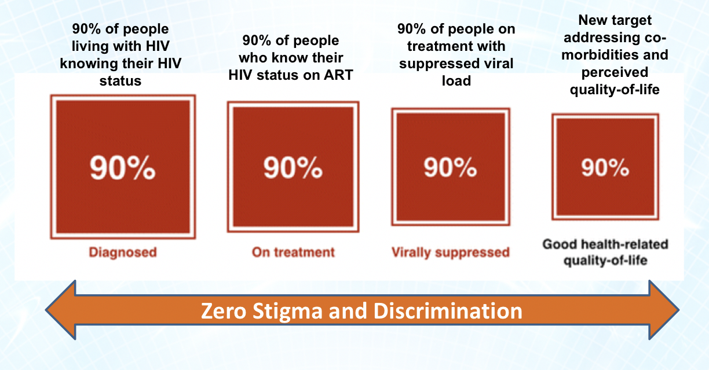
Conclusions
Understanding the factors playing a key role in the perceived quality of life remains a key step to ensuring those already virally suppressed continue on a good overall health trajectory.
Pushing towards a more integrated, people-centered care is the key to addressing challenges that persist even for those already virally suppressed i.e stigma and discrimination, co-morbidities, aging with HIV, fear of transmission
Complete success in HIV care and treatment will be attained when we will reach the “Fourth 90”!
Beyond viral suppression (Lazarus JV et al. BMC Medicine 2016 14:94)

Slide 24
Acknowledgements
Dissemination Support
Athens | Positive Voice
Bamako | Coalition Plus / ARCAD-SIDA
Bangkok | Dr. Nittaya Phanuphak Pungpapong
Berlin | Berlin AIDS Hilfe Schwulenberatung Berlin Via in Berlin – Netzwerkstelle HIV und Migration Fixpunkt
Brussels | VZW Lhiving Sensoa UTOPIA_BXL Founder Plateforme Prévention Sida
Bucharest | ARAS
Buenos Aires | Dr. Miguel Pedrola – AHF
Dar es Salaam | Tanzania National Network of People with HIV/AIDS (TANEPHA) Tanzania National Network of Girls and Young Women Affected and Living with HIV/AIDS (TANGYWA+)
Durban | AIDS Foundation of South Africa The National Association of PLHIV (NAPWA South Africa)
Lisbon | GAT – CheckpointLX Associao ILGA Portugal
Madrid | Seisida
Miami, FL | Empower U Community Health center
Montréal | Maison Plein Coeur COCQ-SIDA
Nairobi | African Jesuit AIDS Network
Paris | AIDES Solidarité SIDA
Santiago | Chile Positivo
Contributions
Dr. Laurel Sprague (UNAIDS)
Christoforos Mallouris (UNAIDS)
Andrea Boccardi Vidarte (UNAIDS)
Luisa Cabral (UNAIDS)
Konstantinos Lykopoulos (ViiV)
Florence Anam (ICW)
Christopher Duncombe (IAPAC)
Paula Munderi (IAPAC)
José M Zuniga (IAPAC)

