Slide 1
HIV Clinical Management
PRESENTER(S) NAME(S)

Slide 2



Regional Capacity-Building Network
Based in Johannesburg, South Africa
Mission: Strengthen clinician capacity to deliver HIV, HBV, and HCV treatment
Partners include:
Supported through an educational grant from:

Slide 3
Course Outline
Module 1: Defining, Measuring, and Monitoring the HIV Care Continuum
Module 2: Optimizing the HIV Care Environment
Module 3: HIV Testing and Linkage to Preventative and Therapeutic Care
Module 4: Implementing Earlier ART Initiation and Selecting 1st line ART
Module 5: Defining Treatment Failure and Selecting 2nd Line ART
Module 6: Special Considerations for the Clinical Management of Pregnant Women
Module 7: Beyond ART Prescription: Achieving Long-Term Engagement and Retention

Slide 4
*Primary Sources
Guidelines for the Optimizing the HIV Care Continuum for Adults & Adolescents. IAPAC, 2015
Guideline on When to Start Antiretroviral Therapy and on Pre-Exposure Prophylaxis for HIV. WHO, 2015
Consolidated Guidelines on HIV Testing Services. WHO, 2015
Consolidated Guidelines on HIV Prevention, Diagnosis, Treatment & Care for Key Populations. WHO, 2014
Consolidated Guidelines for the Use of Antiretroviral Drugs for Treating & Preventing HIV Infection. WHO, 2013
HIV and Adolescents: Guidance for HIV Testing and Counselling & Care for Adolescents Living with HIV. WHO, 2013
Guidelines for Improving Entry into & Retention in Care & ARV Adherence for Persons with HIV. IAPAC, 2012

Slide 5




IAPAC Learning Resources
myHIVClinic.org
Collection of resources on healthy aging with HIV and NCDs
Without-Exception.org
Repository of resources to promote HIV testing and linkage to care
AIDSInfoNet.org
Collection of concise fact sheets on HIV medications, tests, and conditions
See Us/Women Take a Stand on HIV
Tool set to help women dialogue with their providers regarding HIV care

Slide 6
Defining, Measuring, and Monitoring the HIV Care Continuum
Module 1

Slide 7
Learning Objectives
Understand the use of ART for HIV treatment and prevention
Identify the steps in the HIV care continuum
Define how the continuum should be measured and reported
Describe the relevance of UNAIDS’ 90-90-90 targets for 2020

Slide 8
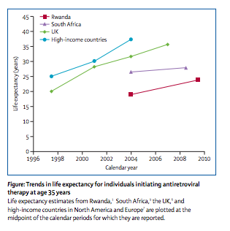
Introduction
Modern antiretroviral therapy (ART) has changed the course of HIV disease
Life expectancy can be near-normal with a highly preserved quality of life.¹ Life expectancy in some southern African countries is increasing²
¹The Antiretroviral Therapy Cohort Collaboration, Lancet 2008; ²Nsanzimana, et al., Lancet Glob Health 2015

Slide 9
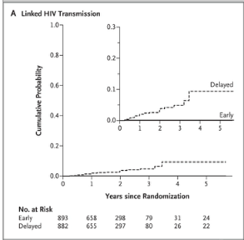
Introduction (continued)
ART is highly effective in preventing sexual, parenteral, and vertical transmission of HIV^{2,3,4}
HIV treatment as prevention (TasP) strategy can prevent AIDS progression, premature death, and HIV transmission^{5,6,7}
2. Cohen MS, et al. N Engl J Med. 2011 Aug 11; 365(6):493-505.
3. Wood E, et al., BMJ. 2009-04-30 10:19:31.
4. De Cock KM, et al., JAMA. 2000 Mar 1; 283(9):1175-82.
5. Montaner JS, et al., Lancet. 2006 Aug 5; 368(9534):531-6.
6. Granich RM, et al., The Lancet. 2009; 373(9657):48-57.
7. Montaner JS, et al. PLoS One. 2014; 9(2):e87872.
Cohen, N Engl J Med, 2011²
Notes:
2. Cohen MS, Chen YQ, McCauley M, Gamble T, Hosseinipour MC, Kumarasamy N, et al. Prevention of HIV-1 infection with early antiretroviral therapy. N Engl J Med. 2011 Aug 11; 365(6):493-505.
3. Wood E, Kerr T, Marshall BDL, Li K, Zhang R, Hogg RS, et al. Longitudinal community plasma HIV-1 RNA concentrations and incidence of HIV-1 among injecting drug users: prospective cohort study2009 2009-04-30 10:19:31.
4. De Cock KM, Fowler MG, Mercier E, de Vincenzi I, Saba J, Hoff E, et al. Prevention of mother-to-child HIV transmission in resource-poor countries: translating research into policy and practice. JAMA. 2000 Mar 1; 283(9):1175-82.
5. Montaner JS, Hogg R, Wood E, Kerr T, Tyndall M, Levy AR, et al. The case for expanding access to highly active antiretroviral therapy to curb the growth of the HIV epidemic. Lancet. 2006 Aug 5; 368(9534):531-6.
6. Granich RM, Gilks CF, Dye C, De Cock KM, Williams BG. Universal voluntary HIV testing with immediate antiretroviral therapy as a strategy for elimination of HIV transmission: a mathematical model. The Lancet. 2009; 373(9657):48-57.
7. Montaner JS, Lima VD, Harrigan PR, Lourenco L, Yip B, Nosyk B, et al. Expansion of HAART coverage is associated with sustained decreases in HIV/AIDS morbidity, mortality and HIV transmission: the "HIV Treatment as Prevention" experience in a Canadian setting. PLoS One. 2014; 9(2):e87872.

Slide 10

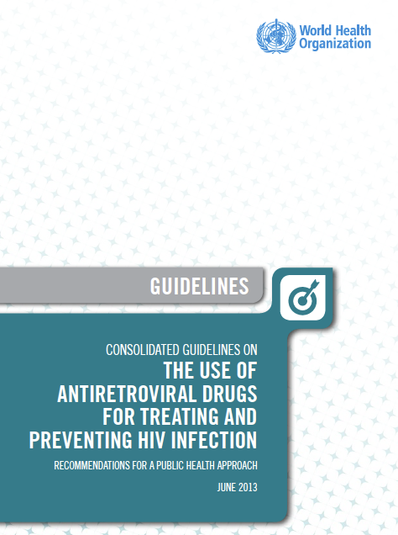
“Continuum of HIV Care”
The “continuum of HIV care” refers to a comprehensive package of HIV prevention, diagnostic, treatment, and support services provided for people living with HIV (PLHIV) and their families ranging across: initial HIV diagnosis and linkage to care; management of opportunistic infections and other comorbid conditions; initiating, maintaining, and monitoring ART; switching to second-line and third-line ART; and palliative care.
WHO Consolidated Guidelines on the Use of Antiretroviral Drugs for Treating and Preventing HIV Infection, 2013

Slide 11
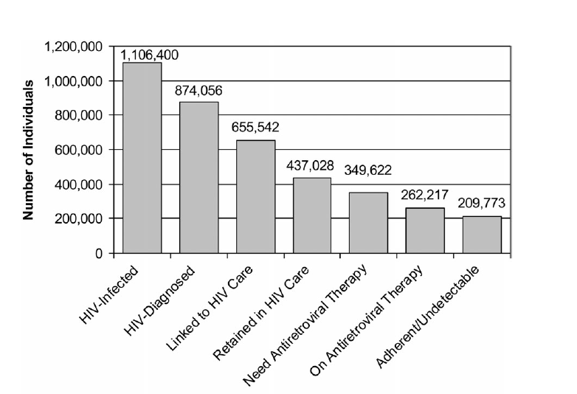
Continuum of HIV Care (where it all started…)
Spectrum of engagement in HIV care, US 2011
Gardner E et al. Clin Infect Dis. 2011
Notes:
This graphic comes from the first description of HIV care continuum: Gardner 2011. Significant decline in United States care continuum with each step (diagnosis, linked to care, retained in care, on ART, viral suppression). In this analysis, approximately 20% were not diagnosed, 20% not linked to care, and so on. Overall, 19% of the total HIV population achieved viral suppression. Similar analyses have been performed around the world, with qualitatively similar results- only a minority of the total HIV population receives ART and achieves viral suppression.

Slide 12
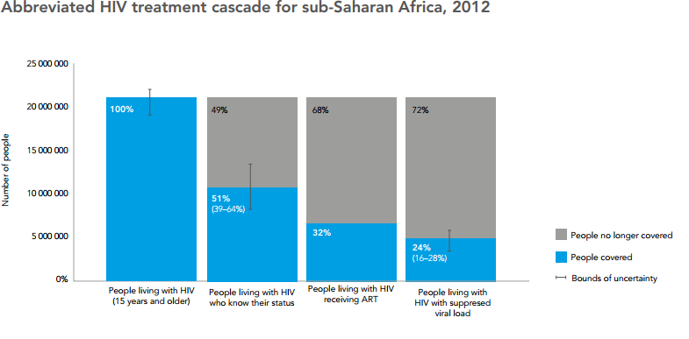
Continuum of HIV Care (Sub-Saharan Africa)
UNAIDS. Global Report 2013

Slide 13
Measuring the Continuum
Measuring the continuum is critical to evaluating the success of HIV responses at clinic-, local-, national-, subnational-, and international levels
Use standardized method to estimate total # of PLHIV
For the sake of comparability, use a common method to establish the continuum’s denominator; critical for unbiased evaluation of program implementation progress and impact
Estimated total # of PLHIV should be denominator for measuring HIV care continuum
IAPAC Guidelines for Optimizing the HIV Care Continuum for Adults and Adolescents, 2015
Notes:
These recommendations and notes are adapted from the
IAPAC Guidelines for Optimizing the HIV Care Continuum for Adults and Adolescents, 2015
Recommendation 36: A standardized method should be used to estimate the total number of PLHIV (diagnosed and undiagnosed) within a jurisdiction. [A IV]
For the sake of comparability, the use of a common method to establish the denominator for the continuum of HIV care is critical to unbiased evaluation of the progress and impact of program implementation. The Spectrum tool (248) is available and can be applied to jurisdictions with a minimal set of data elements. Additionally, national and local governments may opt to use other estimation methodologies to estimate the overall number of PLHIV. It is important to standardize, validate, and publish the methodology for review. In some settings with comprehensive HIV testing, the number of people diagnosed with HIV may serve as an accurate surrogate for the number of PLHIV. The estimations for key populations require different methodologies, and countries are encouraged to monitor the continuum among these vulnerable and often neglected communities. Continua should be measured annually and all proposed metrics should be expressed as period, rather than point prevalence figures.
Recommendation 37: The estimated number of PLHIV in the geographic setting should be the overall denominator for the HIV care continuum. [A IV]
The estimated number of prevalent HIV/AIDS cases in a given geographic setting or jurisdiction during a given calendar year is taken as the denominator. No exclusions are made pertaining to the status or risk group of the individual. It is expressed as both a count and as a proportion of the total population within the jurisdiction. This indicator serves as the denominator for all the remaining steps in the continuum and is crucial for the population-based framework of the continuum. Although it is the most challenging step in the continuum to estimate, it is key for monitoring the success of HIV case-finding efforts. To prioritize and monitor efforts to increase HIV diagnosis, an estimate of the undiagnosed fraction is required. This measure is the cornerstone of the entire continuum framework and is required to assess the relative priority or success of efforts to improve case-finding and access to HIV care and treatment.
Recommendation 38: Collection of a minimum set of four data elements should be considered to populate HIV care continuum. [A IV]
Estimated number of HIV-infected persons
Number and proportion of HIV-infected persons who are diagnosed as having HIV
Number and proportion of HIV-infected persons on ART
Number and proportion of HIV-infected persons on ART who are virally suppressed
Focusing on these minimal elements can serve as an important step towards establishing an evidence-based approach to decision-making for individual care and overall HIV response. The estimated number of PLHIV (diagnosed and undiagnosed) serves as the first data element and the overall denominator for the HIV care continuum.
The numerator for the first step in the continuum should be the total number of people diagnosed with HIV. The indicator should be expressed both as a count and as the proportion of the estimated number of PLHIV within the jurisdiction. Not standardizing the denominator can lead to bias towards using smaller denominators to inflate reported success with implementing the continuum, and also prohibits the comparison of program success both within the program and with other programs.
The second step in the continuum is the total number of HIV-infected persons on ART. It is defined as the number receiving ART at least once within the calendar year. The indicator should be expressed as both a count of HIV-infected persons on ART and as a proportion of the number of PLHIV within the jurisdiction. This is a key element of the continuum and determines the potential for sustained viral suppression, which is the ultimate objective of the continuum. The number of PLHIV picking up medications can be determined from providers or others, and does not require clinical evaluation and/or other tests.
The numerator for the third step in the continuum is the total number of HIV-infected persons with documented viral suppression within a given geographic setting (viral suppression is defined as at least one measurement of HIV RNA <200 copies/mL during the measurement period). This indicator should be expressed as both a count and as a proportion of the number of HIV-infected persons within the jurisdiction. Viral suppression among PLHIV is the single most important common goal of HIV care and prevention, and the key element of the continuum.

Slide 14
Continuum Data Elements
Collect a minimum of 5 data elements:
Estimated # of PLHIV in a jurisdiction
# and % of PLHIV who are diagnosed HIV positive
# and % of PLIHV who are diagnosed and linked to care (optional)
# and % of PLHIV who are on ART
# and % of PLHIV on ART who are virally suppressed
Focusing on these 5 data elements helps with measuring program improvement/success; other program metrics may also be used
IAPAC Guidelines for Optimizing the HIV Care Continuum for Adults and Adolescents, 2015
Notes:
These recommendations and notes are adapted from the IAPAC Guidelines for Optimizing the HIV Care Continuum for Adults and Adolescents, 2015
Recommendation 36: A standardized method should be used to estimate the total number of PLHIV (diagnosed and undiagnosed) within a jurisdiction. [A IV]
For the sake of comparability, the use of a common method to establish the denominator for the continuum of HIV care is critical to unbiased evaluation of the progress and impact of program implementation. The Spectrum tool (248) is available and can be applied to jurisdictions with a minimal set of data elements. Additionally, national and local governments may opt to use other estimation methodologies to estimate the overall number of PLHIV. It is important to standardize, validate, and publish the methodology for review. In some settings with comprehensive HIV testing, the number of people diagnosed with HIV may serve as an accurate surrogate for the number of PLHIV. The estimations for key populations require different methodologies, and countries are encouraged to monitor the continuum among these vulnerable and often neglected communities. Continua should be measured annually and all proposed metrics should be expressed as period, rather than point prevalence figures.
Recommendation 37: The estimated number of PLHIV in the geographic setting should be the overall denominator for the HIV care continuum. [A IV]
The estimated number of prevalent HIV/AIDS cases in a given geographic setting or jurisdiction during a given calendar year is taken as the denominator. No exclusions are made pertaining to the status or risk group of the individual. It is expressed as both a count and as a proportion of the total population within the jurisdiction. This indicator serves as the denominator for all the remaining steps in the continuum and is crucial for the population-based framework of the continuum. Although it is the most challenging step in the continuum to estimate, it is key for monitoring the success of HIV case-finding efforts. To prioritize and monitor efforts to increase HIV diagnosis, an estimate of the undiagnosed fraction is required. This measure is the cornerstone of the entire continuum framework and is required to assess the relative priority or success of efforts to improve case-finding and access to HIV care and treatment.
Recommendation 38: Collection of a minimum set of four data elements should be considered to populate HIV care continuum. [A IV]
Estimated number of HIV-infected persons
Number and proportion of HIV-infected persons who are diagnosed as having HIV
Number and proportion of HIV-infected persons on ART
Number and proportion of HIV-infected persons on ART who are virally suppressed
Focusing on these minimal elements can serve as an important step towards establishing an evidence-based approach to decision-making for individual care and overall HIV response. The estimated number of PLHIV (diagnosed and undiagnosed) serves as the first data element and the overall denominator for the HIV care continuum.
The numerator for the first step in the continuum should be the total number of people diagnosed with HIV. The indicator should be expressed both as a count and as the proportion of the estimated number of PLHIV within the jurisdiction. Not standardizing the denominator can lead to bias towards using smaller denominators to inflate reported success with implementing the continuum, and also prohibits the comparison of program success both within the program and with other programs.
The second step in the continuum is the total number of HIV-infected persons on ART. It is defined as the number receiving ART at least once within the calendar year. The indicator should be expressed as both a count of HIV-infected persons on ART and as a proportion of the number of PLHIV within the jurisdiction. This is a key element of the continuum and determines the potential for sustained viral suppression, which is the ultimate objective of the continuum. The number of PLHIV picking up medications can be determined from providers or others, and does not require clinical evaluation and/or other tests.
The numerator for the third step in the continuum is the total number of HIV-infected persons with documented viral suppression within a given geographic setting (viral suppression is defined as at least one measurement of HIV RNA <200 copies/mL during the measurement period). This indicator should be expressed as both a count and as a proportion of the number of HIV-infected persons within the jurisdiction. Viral suppression among PLHIV is the single most important common goal of HIV care and prevention, and the key element of the continuum.

Slide 15
Continuum Optimization
The methodology of determining the care continuum should be described within all reports on continuum optimization
Comprehensive and transparent reporting of the measurement methodology is imperative for internal decision-making and external comparison
Incomplete reporting may result in suboptimal program assessment and suboptimal resource allocation decisions
Where possible, consider longitudinal cohort measurement of HIV service utilization and treatment outcomes
Helps to identify means to maximize viral suppression through early ART access and minimizing ART discontinuation
IAPAC Guidelines for Optimizing the HIV Care Continuum for Adults and Adolescents, 2015
Notes:
These recommendations and notes are adapted from the IAPAC Guidelines for Optimizing the HIV Care Continuum for Adults and Adolescents, 2015
Recommendation 39: The methodology of determining the HIV care continuum should be described within all reports on continuum optimization. [A IV]
Comprehensive and transparent reporting of the measurement methodology is imperative for internal decision-making and external comparison. Incomplete reporting may result in suboptimal program assessment and suboptimal resource allocation decisions. If the recommended continuum is not followed, then a clear explanation of the methodology that is used should be included to alert end-users, and to avoid inappropriate comparison of results with continua that use the recommended approach.
Recommendation 40: Where possible, jurisdictions should consider longitudinal cohort measurement of HIV service utilization and treatment outcomes to identify the means to maximize viral suppression through ensuring early access to ART and minimizing ART discontinuation. [A IV]
Annualized measurements of cross-sections of the HIV care continuum are recommended, from which information on overall performance, and improvement or deterioration in performance over time can be established. There is also considerable value in taking a longitudinal cohort approach to follow individuals living with HIV infection. Cohort methods allow for monitoring and evaluation of HIV service utilization and outcomes among individuals over time.
Attrition, or ‘leakage’ at different stages along the continuum, is heterogeneous. It comprises individuals who drop out of treatment for the first time, experience multiple treatment discontinuations, as well as those lost to HIV care entirely (i.e., discontinued regular physician follow-up and diagnostic testing). The sometimes-cyclical process of engagement, disengagement and re-engagement in HIV care has been referred to as continuum ‘churn,’ and has been cited as a crucial component of HIV monitoring. Persistence with ART, or sustained engagement (as opposed to adherence, which measures the number of prescribed doses of ART that were ingested), is of particular interest, as the ultimate goal of sustained viral suppression cannot be achieved without it.
Longitudinal cohort analyses from the time of diagnosis to ART initiation and viral suppression (including ART discontinuation and re-entry, death, LTFU, and other outcomes) can inform efforts to identify interventions at various stages of the continuum, the patient populations most in need of intervention, and those most likely to benefit. Although the longitudinal cohort approach may appear to be complex, it has been successfully implemented in a number of diverse settings, including directly observed treatment, short-course (DOTS)-based TB control, non-communicable chronic diseases, and also HIV in some settings, including in British Columbia, Canada; Malawi; and Rwanda (243, 249, 250).

Slide 16
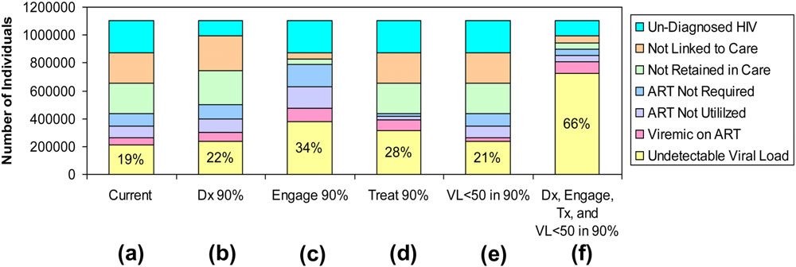
Effect of Interventions on Continuum
Simulations of the effect of assessing different levels of engagement in care
Gardner E et al. Clin Infect Dis. 2011
Notes:
From the seminal Gardner publication: Achieving 90% targets for only any single step in continuum results in modest gains in population viral suppression. Only with improving diagnosis, engagement, treatment, and viral suppression to 90% are large increases in community viral load suppression accomplished.

Slide 17
UNAIDS 90-90-90 Targets
UNAIDS estimates that:
~55%, or 15 million PLHIV, who are in need of ART are currently on ART
˂25% of PLHIV on ART have achieved long-term viral suppression
UNAIDS has set 90-90-90 targets to achieve by 2020:
90% of PLHIV should know their status (testing target)
90% of PLHIV who know their status should be receiving ART (treatment target)
90% of PLHIV on ART should have achieved viral suppression (optimization target)
Modeling suggests that achieving these targets will decrease AIDS incidence, AIDS-related deaths, and new HIV infections by 90% from 2010 levels by 2030
UNAIDS. 90-90-90. 2014
Notes:
Joint United Nations Programme on HIV/AIDS (UNAIDS). 90-90-90 An ambitious treatment target to help end the AIDS epidemic. Geneva: UNAIDS; 2014 [cited 2015 May 1]. Available from: http://www.unaids.org/en/resources/documents/2014/90-90-90.

Slide 18
Practical Considerations
Recognize that ART prevents illness, death, and transmission
Measuring the HIV care continuum using a standardized methodology is critical to assessing the quality of care at clinic-, local-, national-, subnational-, and regional levels
Work is needed to optimize the HIV care continuum to increase testing and treatment coverage, as well as retention in care, and improve the proportion of the population successfully treated
Global solidarity to attain the 90-90-90 targets extends to every clinic, hospital, health district, and Ministry of Health

Slide 19
Optimizing the HIV Care Environment
Module 2

Slide 20
Learning Objectives
Understand how legal circumstances negatively influence the HIV care environment
Describe the use of stigma measures to improve engagement in HIV care
Summarize how task-shifting/-sharing and decentralized care may improve the HIV care environment

Slide 21
Introduction
Optimizing the HIV care environment may be the most important action to ensure that there are meaningful increases in the number of PLHIV achieving viral suppression
Legal, social, environmental, and structural barriers limit access to the full range of services
Repeal HIV-related restrictions on entry, stay, and residence in any country
Requires multi-stakeholder engagement, diversified and inclusive strategies, as well as innovative approaches
Critically important to address HIV-specific laws that criminalize the conduct of key affected populations and reduce HIV-related stigma and discrimination
Notes:
Overcoming the legal, social, environmental and structural barriers that limit access to the full range of services across the HIV continuum requires multi-stakeholder engagement, diversified and inclusive strategies, and innovative approaches. It is also critically important to address HIV-specific laws that criminalize the conduct of key affected populations, and reduce HIV-related stigma and discrimination. In many settings, optimizing the HIV care environment may be the most important action to ensure that there are meaningful increases in the number of people who are tested for HIV, linked to care, started on ART if diagnosed to be HIV positive, and assisted to achieve and maintain long-term viral suppression (1-3). PLHIV must also be supported through peer counseling, education, and navigation mechanisms, and their self-management skills reinforced by strengthening HIV literacy across the continuum of care (4).
Pineirua A, Sierra-Madero J, Cahn P, Guevara Palmero R, Martinez E, Young B. The HIV care cascade in Latin America: Challenges and Opportunities. Lancet Infect Dis. 2015;15:833-839
Center for Disease Control (CDC). Understanding the HIV Care Continuum 2014 [2015 Jan 20 ]. Available from: http://www.cdc.gov/hiv/pdf/dhap_continuum.pdf.
Govindasamy D, Meghij J, Negussi EK, Baggaley RC, Ford N, Kranzer K. Interventions to improve or facilitate linkage to or retention in pre-ART (HIV) care and initiation of ART in low- and middle-income settings – a systematic review. Journal of the International AIDS Society. 2014 17(1):19032.
Underwood C, Hendrickson Z, Van Lith LM, Lengwe Kunda JE, Mallalieu EC. Role of community-level factors across the treatment cascade: a critical review. J Acquir Immune Defic Syndr. 2014 Aug 15; 66 Suppl 3:S311-8.

Slide 22
Optimizing the Care Environment
Eliminate stigma and discrimination based on race, ethnicity, gender, age, sexual orientation, and behavior in all settings, but particularly in healthcare settings, using standardized measures and evidence-based interventions
Take proactive steps to identify and manage clinical mental health disorders, and/or mental health issues related to HIV diagnosis, disclosure of HIV status, and/or HIV treatment
IAPAC Guidelines for Optimizing the HIV Care Continuum for Adults and Adolescents, 2015
Notes:
These recommendations and notes are adapted from the IAPAC Guidelines for Optimizing the HIV Care Continuum for Adults and Adolescents, 2015
Recommendation 1: Laws that criminalize the conduct of or exert punitive legal measures against men who have sex with men (MSM), transgender individuals, substance users, and sex workers are not recommended and should be repealed where they have been enacted. [A IV]
Many countries have enacted legal measures to make substance use and certain sexual behaviors among consenting adults illegal, and have imposed mandatory HIV testing requirements and/or forced rehabilitation for MSM, transgender persons, and sex workers. Sexual minorities and sex workers often face significant vulnerability to HIV as a result of high-risk behavior (e.g. substance use), poor coverage by HIV and healthcare services, social marginalization, and continuing stigma and discrimination (17-20). Criminalizing the conduct of sexual minorities exacerbates the stigma and discrimination experienced by these individuals, which may result in increased HIV transmission and acquisition risks, and contribute to decreased access to and utilization of HIV services (21).
Recommendation 2: Laws that criminalize the conduct of people living with HIV (PLHIV) based on perceived exposure to HIV, and without any evidence of intent to do harm, are not recommended and should be repealed where they have been enacted. [A IV]
Numerous countries have enacted laws that criminalize behaviors associated with HIV exposure, many of which pose a low or negligible HIV transmission risk (22-24). No change in behavior has been noted between settings that enact such laws and those that do not (25-29). Many of these laws do not take into account measures that reduce HIV transmissibility, including condom use (30, 31), and were enacted before the preventive benefit of ART (32) or antiretroviral (ARV) based pre-exposure prophylaxis (PrEP) (33) were fully characterized. Most PLHIV who know their status take steps to prevent transmitting HIV to others (34, 35). HIV-specific laws thus primarily exacerbate HIV-related stigma and decrease HIV service uptake (22, 36-38).
Recommendation 3: Strategies to monitor for and eliminate stigma and discrimination based on race, ethnicity, gender, age, sexual orientation, and/or behavior in all settings, but particularly in healthcare settings, using standardized measures and evidence-based approaches, are recommended. [B II]
Stigma can negatively shape the quality of life, affect mental health, and influence ART use and outcomes. Studies have shown that individuals on ART face greater stigma, and that healthcare settings and the personal environment were areas where the most stigma was experienced (39-41). A number of interventions have been shown to reduce HIV/AIDS stigma, including peer-led or -based strategies, community and popular leader interventions (42), healthcare provider interventions, and community-level biomedical approaches (43). The use of standardized stigma measures is recommended to ensure better comparability across healthcare and epidemic settings (44, 45). The People Living with HIV Stigma Index developed by and for PLHIV is recommended as an instrument that can be adapted and used in different settings (46, 47).

Slide 23
Task-Shifting/-Sharing
Shifting and sharing HIV testing, dispensing of ART, and other appropriate tasks among professional and paraprofessional health worker cadres is recommended
Use of lay health workers to provide pre-test education and testing and to enhance PLHIV engagement in HIV care
Task-shifting/-sharing from physicians to appropriately trained healthcare providers, including nurses and associate clinicians, for ART initiation and maintenance
IAPAC Guidelines for Optimizing the HIV Care Continuum for Adults and Adolescents, 2015
Notes:
These recommendations and notes are adapted from the IAPAC Guidelines for Optimizing the HIV Care Continuum for Adults and Adolescents, 2015
Recommendation 9: Shifting and sharing HIV testing, dispensing of ART, and other appropriate tasks among professional and paraprofessional health worker cadres is recommended. [A I]
Use of outreach workers as providers of HIV tests for key populations is recommended. [B I]
Use of trained non-medical health workers improves access to care and should be considered to increase HIV testing. [B III]
Use of a range of cadres including community health workers, peer health navigators, and adherence counselors to provide support for facilitating access to and long-term engagement in HIV care should be considered. [B III]
Task shifting/sharing from physicians to appropriately trained healthcare providers for ART initiation and maintenance, including nurses and associate clinicians, is recommended to improve adherence and/or retention in care. [B II]
When provided with appropriate training and oversight, and guided by national policies, lay health worker cadres can effectively distribute ART, provide counseling and testing, and support related administrative tasks at the facility and community levels. It has been shown to be cost-effective (68), and allows for significantly increased patient enrollment (69) while maintaining the quality of (70, 71) and retention in care (72). Use of community-based outreach workers or peers of similar risk status/cultural backgrounds has been shown to improve the uptake of HIV testing within social and risk-based networks when provided appropriate pre-service and in-service training and competent professionally based supervision (73, 74).
Community-based HIV rapid testing attracts those who are unlikely to undergo routine HIV testing at a medical facility, such as key populations (42, 75). Satisfaction with the services among clients was high in one study; 92% reported being ‘very satisfied’ (76). Counseling by community-based counselors increased uptake in pre-ART care (77), decreased virologic failure (78), and improved ART adherence and CD4 count response (79, 80). Nurse-led interventions were linked to improved ART adherence (81), a significantly higher rate of retention in care (82), and possibly decreased the number of patients lost to follow-up (83, 84).

Slide 24
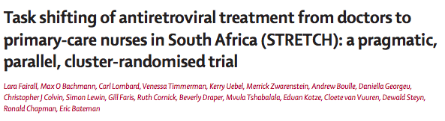
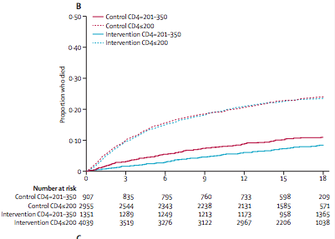
Expansion of primary care nurses’ roles to include ART initiation and prescription can be done safely
can improve health outcomes and quality of care
but might not reduce time to ART initiation or AIDS-related mortality
Fairall et al. Lancet. 2012
Notes:
LTS 56 Lara Fairall, Max O Bachmann, Carl Lombard, Venessa Timmerman, Kerry Uebel, Merrick Zwarenstein, Andrew Boulle, Daniella Georgeu, Christopher J Colvin, Simon Lewin, Gill Faris, Ruth Cornick, Beverly Draper, Mvula Tshabalala, Eduan Kotze, Cloete van Vuuren, Dewald Steyn, Ronald Chapman, Eric Bateman Task shifting of antiretroviral treatment from doctors to primary-care nurses in South Africa (STRETCH): a pragmatic, parallel, cluster-randomised trial 2008-2010 South Africa RCT/Intervention Patients in cohort 1 were adults (aged ≥16 years) with CD4 counts of 350 cells per μL or less who had not yet started ART. Patients in cohort 2 were adults who had already received ART for at least 6 months and were being treated at the time of enrolment. All patients were enrolled from all 31 clinics participating in the ART programme. Adults 5390 in cohort 1, 3029 in cohort 2 (C): Control clinics continued the standard of HIV and ART care in provincial health services of the Free State that was in place before the trial. (I): Intervention clinics implemented the STRETCH programme. . Prescribing nurses received at least four educational outreach training sessions about ART prescribing and side-eﬀ ects with a special edition of the PALSA PLUS guidelines, which included algorithms to start and to monitor patients on ART, and to identify those needing referral to a doctor. The intervention was implemented in three phases. First, training was delivered and the STRETCH trial coordinator visited every intervention clinic to establish a STRETCH team who were responsible for support of phased decentralisation of care. Second, nurses assumed responsibility for represcribing ART for patients already receiving treatment. The care for all stable patients given ART was consolidated in their clinic, so they did not need to travel to another treatment site for repre scriptions. Third, nurses began to initiate ART in eligible patients. The primary outcome for cohort 1 was time from enrolment to death. For cohort 2, the primary outcome was the proportion with undetectable viral loads (<400 copies per mL) 1 year after enrolment. Median follow-up was 16.3 months (IQR 12.2-18.0) in cohort 1 and 18.0 months (18.0-18.0) in cohort 2. In cohort 1, 997 (20%) of 4943 patients analysed in the intervention group and 747 (19%) of 3862 in the control group with known vital status at the end of the trial had died. Time to death did not differ (hazard ratio [HR] 0.94, 95% CI 0.76-1.15). In a preplanned subgroup analysis of patients with baseline CD4 counts of 201-350 cells per uL, mortality was slightly lower in the intervention group than in the control group (0.73, 0.54-1.00; p=0.052), but it did not differ between groups in patients with baseline CD4 of 200 cells per uL or less (0.94, 0.76-1.15; p=0.577). In cohort 2, viral load suppression 12 months after enrolment was equivalent in intervention (2156 [71%] of 3029 patients) and control groups (2230 [70%] of 3202; risk difference 1.1%, 95% CI -2.4 to 4.6). 2012

Slide 25

Community and Patient Engagement
Engage community across continuum of care
Models of community-based support and ART delivery to can complement public sector ART programs by enhancing psychosocial support, improving ART access and outcomes
Enabling PLHIV to take responsibility for their care (chronic disease management) can result in improved health outcomes, increased health services utilization
Self-management (e.g., monitoring, decision-making)
User-driven care (e.g., electronic intervention)
IAPAC Guidelines for Optimizing the HIV Care Continuum for Adults and Adolescents, 2015

Slide 26
HIV Testing and Linkage to Preventative and Therapeutic Care
Module 3

Slide 27
Learning Objectives
Summarize strategies for increasing access to HIV testing
List barriers to successful linkage to care
Distinguish differences in linkage to care and interventions for people who test HIV positive and HIV negative
Evaluate the merits of community- vs. home-based HIV testing

Slide 28
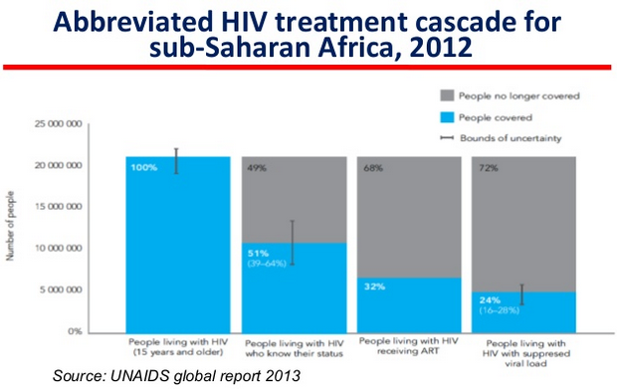
Introduction
Optimizing HIV testing is the critical first step in addressing the HIV care continuum
Healthcare systems should strive to make HIV screening widely available and accessible to all individuals regardless of gender, age or perceived risk factors
HIV testing should be done in a high-quality confidential setting
A critical focus is post-test counseling and immediate linkage to care and access to ART
UNAIDS Global Report. 2013
Notes:
Optimizing the offer of HIV testing (‘seek and test’) is the critical first step in addressing the HIV care continuum. This should be done within the context of a high-quality confidential diagnosis in the location that best suits the patient’s needs. A critical focus should be placed on post-test counseling, and immediate linkage to care as well as immediate access to ART (94). The START study recently showed a 53% reduction in serious morbidity and mortality from HIV due to early ART at CD4 cell counts of over 500 cells/mm³ compared to deferred initiation of ART at CD4 cell counts of 350 cells/mm³ (95). Healthcare systems should strive to make HIV screening widely available and accessible to all individuals regardless of gender, age, or perceived risk factors (96). In addition, targeted HIV testing approaches are recommended, both in concentrated and in generalized epidemics.

Slide 29
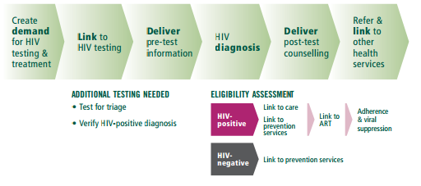
HIV Testing Continuum
WHO Consolidated Guidelines on HIV Testing Services, 2015

Slide 30
Increasing HIV Testing Coverage
To increase HIV testing coverage, the following is recommended:
Routine offer of opt-out HIV testing
Community-based HIV testing
Confidential, voluntary HIV testing in workplace/institutional settings
HIV self-testing with the provision of guidance about proper method for administering test and direction on what to do once results obtained
Offer HIV testing to partners of newly diagnosed individuals
Use of epidemiological data and network analyses to identify individuals at risk of HIV infection for HIV testing
IAPAC Guidelines for Optimizing the HIV Care Continuum for Adults and Adolescents, 2015
Notes:
These recommendations and notes are adapted from the IAPAC Guidelines for Optimizing the HIV Care Continuum for Adults and Adolescents, 2015
Recommendation 11: Routinely offering opt-out HIV testing to all individuals in care is recommended.
Routine HIV screening identifies significantly more undiagnosed HIV infections than a risk-based approach, and routine screening is generally cost-effective in populations that meet minimum thresholds of HIV prevalence of >0.1% (96). Opt-out HIV screening and testing means that the patient is notified that an HIV test will be performed unless the patient declines, and is now routinely recommended in both national and international guidelines (96). In a retrospective cohort study, 2,408 of 3,303 (73%) HIV-infected women diagnosed during the study period had missed-opportunity medical visits, suggesting that a routine offer could have diagnosed them earlier (97). Another retrospective cohort study indicated that the 1,769 individuals diagnosed ‘late’ with HIV (i.e., who developed AIDS within one year of their diagnosis) made a total of 7,988 visits to a healthcare facility during 1997–2005 before their first reported positive HIV test (98). Further, the diagnoses reported that nearly 8 in 10 of these visits were not likely to prompt HIV testing under a risk-based testing strategy. In addition to general medical/primary care outpatient settings, this recommendation includes outpatient venues where individuals seek care for conditions associated with HIV, such as tuberculosis (TB) and sexually transmitted infection (STI) clinics.
Recommendation 12: Community-based HIV testing is recommended to reach those who are less likely to attend facility-based HIV testing.
One RCT (99), a systematic review and meta-analysis (100), and numerous observational studies examined various community-based testing approaches (101-108). In addition to routine HIV screening in facility-based settings, community-based HIV testing approaches have the potential to normalize testing within a community, significantly expand HIV testing and reach those who do not access the health system. Project Accept (HPTN 043) was especially effective in reaching men (99), and also demonstrated a fourfold increase in previously undiagnosed HIV cases in comparison to the control group. Community-based HIV testing interventions (109) identified a larger proportion of people who had tested for the first time and who had CD4 counts above 350 cells/mm³ than standard facility-based HIV testing, though the positivity rate was lower. Overall acceptability of the approaches exceeded 80% (109). Using varied modalities to reach people (110, 111) has the potential to reach those who have never been tested before. Multi-disease prevention community health campaigns that combine other public health interventions (112) with HIV testing and counseling, such as maternal–child health programs, can be effective (113) and cost-efficient (114, 115).
Recommendation 13: Confidential, voluntary HIV testing in large workplace and institutional settings (military, police, mining/trucking companies, healthcare facilities, and educational venues) should be considered.
HIV prevalence is often higher than anticipated or reported among employee populations in large institutional settings, particularly in communities where the undiagnosed HIV seroprevalence is >0.1% (116-118). Screening programs in such settings have the potential to identify undiagnosed individuals earlier than they might otherwise present (i.e., if they waited until they were symptomatic) and get them early into care, so that they can optimize their own health by starting ART and protect their partners. However, stigma and confidentiality concerns remain significant barriers to acceptance of HIV testing in some workplace settings, especially in communities where stigma due to HIV is acute (e.g., mining/trucking companies) (119-121). In such communities, voluntary workplace testing should be conducted after strict implementation of confidentiality measures and assurances of fair treatment of those who test HIV positive. Despite high acceptance of the HIV test offer at employment sites, some studies have suggested that follow-up rates can be low and that HIV positivity can be a risk factor for non-attendance at follow-up (119). These results point to the likely benefit of rapid test results in employee testing programs, as well as supportive and rapid linkage to care protocols.
Recommendation 14: HIV self-testing is recommended with the provision of guidance about the proper method for administering the test and direction on what to do once the results have been obtained.
HIV self-testing can happen in private with indirect support such as provision of referral information, or can be supervised with moderate pre-test and/or post-test support. The modality can include non-restricted access to HIV self-testing through various sites and locations (over-the-counter, vending machines, pharmacies, internet), or through community or healthcare facility distribution. Three cross-sectional feasibility studies (122-124) examined the acceptability and uptake of HIV self-testing in different settings for different populations. All the studies demonstrated that the testing modality is well accepted in both high-prevalence settings (125) and concentrated epidemics, and across different populations (123, 124), with high accuracy after moderate direction on how to use the self-test. HIV self-testing was also cost–effective in resource-limited settings (126). Ensuring high-quality products for self-testing through regulatory processes and policies concerning medical devices, and regulating the legal use of the devices is essential for scale-up of quality HIV self-testing.

Slide 31
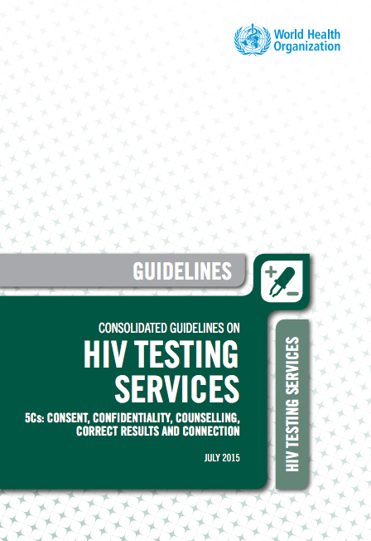
WHO HIV Testing Guidelines
Trained lay providers can independently conduct HIV testing with rapid diagnostic tests and increase access to testing through community-based approaches
Annual retesting of key populations and HIV-negative partners
Provider-initiated HIV testing should be considered for malnutrition, STI, hepatitis, and TB services
WHO Consolidated Guidelines on HIV Testing Services, 2015

Slide 32
WHO HIV Testing Guidelines (continued)
Who to Test | When to Test
Pregnant women and partners | First antenatal care visit Retesting during third trimester or peripartum Offer couples and partner testing
Infants and children <18 months old | 4-6 weeks for all infants exposed to HIV or whose mothers have an uncertain status Final status after 18 months and/or when breastfeeding ends
Adolescents | Integrate into all healthcare encounters Annually if sexually active; with new sexual partners
WHO Consolidated Guidelines on HIV Testing Services, 2015

Slide 33
Increasing Linkage to Care
Linkage to care is a critical but often poorly managed step in care continuum
Typically, linkage may consist of verbal or written referral to a care facility by a counselor or the individual who provided the HIV test result
Linkage to care should enable a patient to engage in care early, benefit from a broad package of care, and facilitate immediate access to ART
Prompt engagement in care optimizes individual and public health outcomes
Key barriers to linkage to care include economic, geographic, transportation and distance barriers, as well as stigma and discrimination
IAPAC Guidelines for Optimizing the HIV Care Continuum for Adults and Adolescents, 2015
Notes:
These notes are adapted from the IAPAC Guidelines for Optimizing the HIV Care Continuum for Adults and Adolescents, 2015
Linkage to medical care is a critical but often poorly managed step in the HIV care continuum (136). It can be defined as the process that moves a newly diagnosed person to become engaged in HIV care. Typically, linkage may consist of verbal or written referral to an HIV care facility by the counselor or the individual who provided the HIV test result (137). In settings where HIV testing and care are provided at the same facility, recently diagnosed persons may be escorted from the test site to the care site to ensure that this initial linkage is successful.
Linkage to care should enable a patient with HIV to engage in care early, benefit from a broad package of care, and facilitate immediate access to ART. Prompt engagement in HIV care individuals optimizes individual and public health outcomes (32). Key barriers to linkage to care include economic, geographic, transportation and distance barriers, as well as stigma and discrimination (138, 139).

Slide 34
Recommendations
Immediate referral to HIV care improves linkage to ART
For high-risk individuals who test HIV negative:
Offer PEP or PrEP
Provide free condoms
Educate about risk-reduction strategies
Offer voluntary medical male circumcision (as appropriate)
Use case managers/patient navigators
IAPAC Guidelines for Optimizing the HIV Care Continuum for Adults and Adolescents, 2015
Notes:
These recommendations and notes are adapted from the IAPAC Guidelines for Optimizing the HIV Care Continuum for Adults and Adolescents, 2015
Recommendation 17: Immediate referral to HIV care is recommended following an HIV-positive diagnosis to improve linkage to ART. [A I]
In a study conducted at a hospital emergency department, on-site linkage teams were able to connect over 90% of newly diagnosed and out-of-care HIV-infected patients to care (140). However, this approach is not always as successful (141, 142). In Uganda, outpatients referred to HIV testing (74%) were more likely to attend an HIV clinic within 6 months than those receiving HIV testing and counseling on-site as inpatients (143).
Recommendation 18: For high-risk individuals who test HIV negative, offering PrEP is recommended in addition to the provision of free condoms, education about risk reduction strategies, post-exposure prophylaxis (PEP), and voluntary medical male circumcision (as appropriate). [A I]
Couples HIV counseling and testing increases condom use and substantially reduces HIV transmission (144, 145). MSM also have high rates of HIV serodiscordance and have been shown to accept couples HIV counseling and testing as an intervention. The additional use of PrEP reduces the transmission risk among adherent clients to 0.5% (146). HIV serodiscordance in couples is common; approximately 45% of HIV-infected individuals have an HIV-uninfected partner (147). The option of early ART in combination with PrEP while the index member of the couple has a detectable viral load should be considered among HIV-serodiscordant monogamous couples, as a means to virtually eliminating the likelihood of HIV transmission. In a real-world trial of daily PrEP in high-risk MSM, an 86% reduction in the risk of HIV infection was observed in the PrEP treatment group compared to no PrEP, and the number needed to treat to prevent a single infection was 13 (148).
Recommendation 19: Use of case managers/patient navigators is recommended. [B II]
The potential magnitude of the benefit provided by patient navigators is high (136, 149, 150). Newly diagnosed HIV-positive persons have been more successfully linked to care when supported or encouraged by a patient navigator (151). When the patient navigator is also a person living with HIV, the potential magnitude of benefit may be even higher (139).
Recommendation 20: Community- and home-based HIV testing coupled with follow-up by peer navigators should be considered. [B III]
Community-based HIV testing should be coupled with follow-up by an HIV-positive patient navigator. Such an intervention can significantly contribute to linking and retaining HIV-positive persons to care in a timely manner (152).

Slide 35
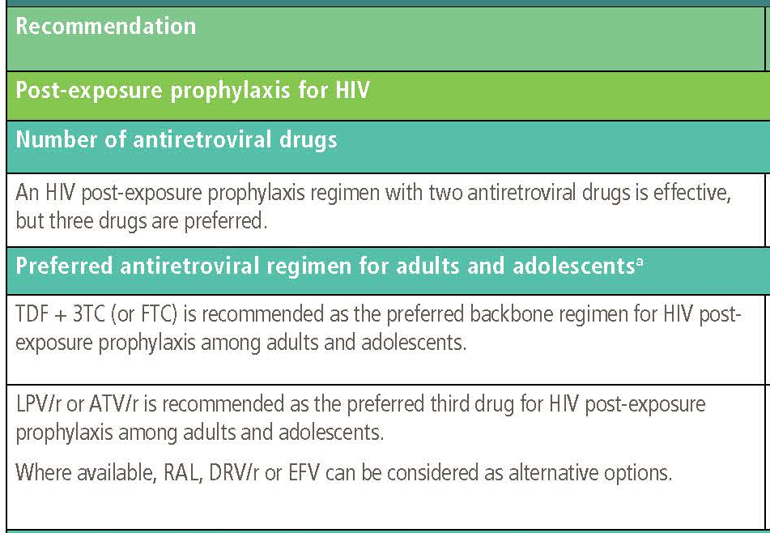
Post-Exposure Prophylaxis
WHO Guidelines on Post-Exposure Prophylaxis for HIV, 2014

Slide 36
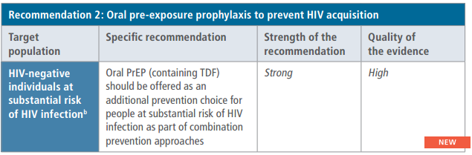
Pre-Exposure Prophylaxis
WHO Guideline on When to Start Antiretroviral Therapy and on Pre-Exposure Prophylaxis for HIV, 2015

Slide 37
Implementing Test and Treat and Selecting 1st Line ART
Module 4

Slide 38
Learning Objectives
Appraise the scientific support and weaknesses for immediate initiation of ART (test and treat)
Describe how HIV viral load testing should be optimally used for monitoring ART
Define how community-based ART distribution and pharmacies strengthens the HIV care continuum

Slide 39
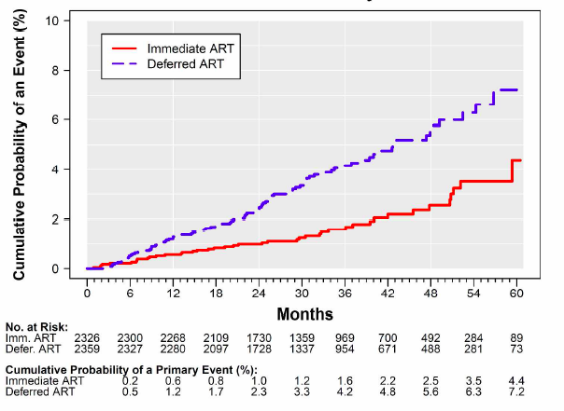
Introduction
Increasing early access to ART is associated with decreased AIDS-related morbidity, mortality and transmission
START showed >50% reduction in:
risk of progression to AIDS
other serious illness (including TB or cancer) or death among people who initiated ART with CD4 >500 cells/mm³ compared with deferred ART initiation after CD4 <350 cells/mm³
Lundgren J et al. N Engl J Med. 2015
Notes:
Increasing early access to ART is associated with decreased AIDS-related morbidity and mortality, as well as reduced risk of HIV transmission (153). Preliminary results from the PARTNERS study of 1,100 serodiscordant couples, 40% of them MSM, found that there had been no HIV transmission within couples who were not using condoms from a partner with an undetectable viral load (154).
Recently, the TEMPRANO study showed that initiating ART at the 500 cells/mm³ threshold in lower-income settings with a high prevalence of TB and bacterial infections reduced the risk of serious illness, including TB and death, by 44% when compared to starting ART according to 2013 WHO guidance (94). Similarly, the START study showed that the risk of progression to AIDS, other serious illnesses or death was reduced by 53% among people who initiated treatment immediately, with CD4 levels above 500 cells/mm³, compared to deferred initiation of treatment, until after the CD4 levels were below 350 cells/mm³ (155).

Slide 40
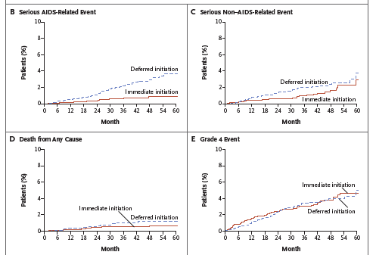
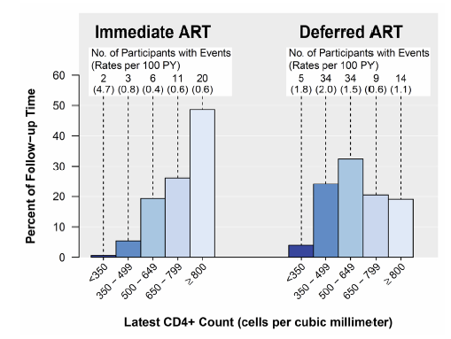
START Results
In START, clinical events occurred in many patients with CD4 counts >500 cells/mm³
Lundgren J et al. N Engl J Med. 2015
Notes:
In the landmark START clinical trial, deferral of ART initiation was associated with increased number of primary endpoints (Serious AIDS, serious non-AIDS and death), and in the majority of patients, occurred with CD4 counts above 500.

Slide 41
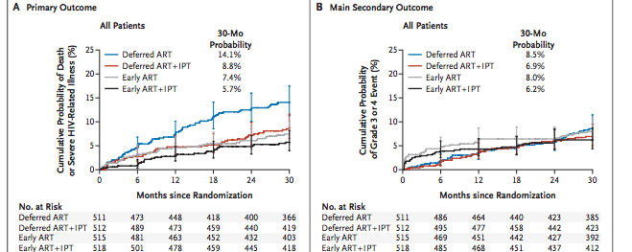
TEMPRANO Clinical Trial (Côte d’Ivoire)
TEMPRANO ARNS 12136 Study Group. New Engl J Med. 2015
Notes:
BACKGROUND In sub-Saharan Africa, the burden of human immunodeficiency virus (HIV)–associated tuberculosis is high. We conducted a trial with a 2-by-2 factorial design to assess the benefits of early antiretroviral therapy (ART), 6-month isoniazid preventive therapy (IPT), or both among HIV-infected adults with high CD4+ cell counts in Ivory Coast.
METHODS We included participants who had HIV type 1 infection and a CD4+ count of less than 800 cells per cubic millimeter and who met no criteria for starting ART according to World Health Organization (WHO) guidelines. Participants were randomly assigned to one of four treatment groups: deferred ART (ART initiation according to WHO criteria), deferred ART plus IPT, early ART (immediate ART initiation), or early ART plus IPT. The primary end point was a composite of diseases included in the case definition of the acquired immunodeficiency syndrome (AIDS), non–AIDS-defining cancer, non–AIDS-defining invasive bacterial disease, or death from any cause at 30 months. We used Cox proportional models to compare outcomes between the deferred-ART and early-ART strategies and between the IPT and no-IPT strategies.
RESULTS A total of 2056 patients (41% with a baseline CD4+ count of ≥500 cells per cubic millimeter) were followed for 4757 patient-years. A total of 204 primary end-point events were observed (3.8 events per 100 person-years; 95% confidence interval [CI], 3.3 to 4.4), including 68 in patients with a baseline CD4+ count of at least 500 cells per cubic millimeter (3.2 events per 100 person-years; 95% CI, 2.4 to 4.0). Tuberculosis and invasive bacterial diseases accounted for 42% and 27% of primary end-point events, respectively. The risk of death or severe HIV-related illness was lower with early ART than with deferred ART (adjusted hazard ratio, 0.56; 95% CI, 0.41 to 0.76; adjusted hazard ratio among patients with a baseline CD4+ count of ≥500 cells per cubic millimeter, 0.56; 95% CI, 0.33 to 0.94) and lower with IPT than with no IPT (adjusted hazard ratio, 0.65; 95% CI, 0.48 to 0.88; adjusted hazard ratio among patients with a baseline CD4+ count of ≥500 cells per cubic millimeter, 0.61; 95% CI, 0.36 to 1.01). The 30-month probability of grade 3 or 4 adverse events did not differ significantly among the strategies.
CONCLUSIONS In this African country, immediate ART and 6 months of IPT independently led to lower rates of severe illness than did deferred ART and no IPT, both overall and among patients with CD4+ counts of at least 500 cells per cubic millimeter. (Funded by the French National Agency for Research on AIDS and Viral Hepatitis; TEMPRANO ANRS 12136 ClinicalTrials.gov number, NCT00495651.)

Slide 42
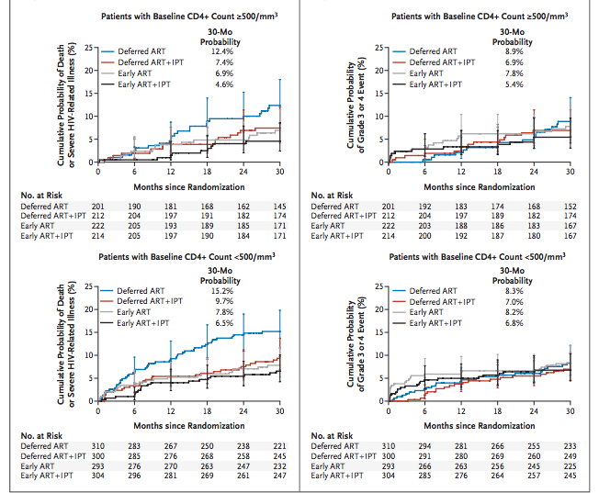
TEMPRANO Clinical Trial (Côte d’Ivoire)
TEMPRANO ARNS 12136 Study Group. New Engl J Med. 2015
Notes:
BACKGROUND In sub-Saharan Africa, the burden of human immunodeficiency virus (HIV)–associated tuberculosis is high. We conducted a trial with a 2-by-2 factorial design to assess the benefits of early antiretroviral therapy (ART), 6-month isoniazid preventive therapy (IPT), or both among HIV-infected adults with high CD4+ cell counts in Ivory Coast.
METHODS We included participants who had HIV type 1 infection and a CD4+ count of less than 800 cells per cubic millimeter and who met no criteria for starting ART according to World Health Organization (WHO) guidelines. Participants were randomly assigned to one of four treatment groups: deferred ART (ART initiation according to WHO criteria), deferred ART plus IPT, early ART (immediate ART initiation), or early ART plus IPT. The primary end point was a composite of diseases included in the case definition of the acquired immunodeficiency syndrome (AIDS), non–AIDS-defining cancer, non–AIDS-defining invasive bacterial disease, or death from any cause at 30 months. We used Cox proportional models to compare outcomes between the deferred-ART and early-ART strategies and between the IPT and no-IPT strategies.
RESULTS A total of 2056 patients (41% with a baseline CD4+ count of ≥500 cells per cubic millimeter) were followed for 4757 patient-years. A total of 204 primary end-point events were observed (3.8 events per 100 person-years; 95% confidence interval [CI], 3.3 to 4.4), including 68 in patients with a baseline CD4+ count of at least 500 cells per cubic millimeter (3.2 events per 100 person-years; 95% CI, 2.4 to 4.0). Tuberculosis and invasive bacterial diseases accounted for 42% and 27% of primary end-point events, respectively. The risk of death or severe HIV-related illness was lower with early ART than with deferred ART (adjusted hazard ratio, 0.56; 95% CI, 0.41 to 0.76; adjusted hazard ratio among patients with a baseline CD4+ count of ≥500 cells per cubic millimeter, 0.56; 95% CI, 0.33 to 0.94) and lower with IPT than with no IPT (adjusted hazard ratio, 0.65; 95% CI, 0.48 to 0.88; adjusted hazard ratio among patients with a baseline CD4+ count of ≥500 cells per cubic millimeter, 0.61; 95% CI, 0.36 to 1.01). The 30-month probability of grade 3 or 4 adverse events did not differ significantly among the strategies.
CONCLUSIONS In this African country, immediate ART and 6 months of IPT independently led to lower rates of severe illness than did deferred ART and no IPT, both overall and among patients with CD4+ counts of at least 500 cells per cubic millimeter. (Funded by the French National Agency for Research on AIDS and Viral Hepatitis; TEMPRANO ANRS 12136 ClinicalTrials.gov number, NCT00495651.)

Slide 43
HPTN 052 and PARTNERS
Final results of the HPTN 052 clinical trial found no cases of linked HIV sexual transmission from HIV-positive partner was on stable ART after 9,800 patient years of follow up¹
Preliminary results of the PARTNERS study of 1,100 serodiscordant couples with incomplete condom use (40% MSM) found no HIV transmission within couples after 30,000 sexual encounters from a partner with an undetectable viral load²
¹Cohen, MS, et al., IAS2015; ² Roger A, et al., CROI 2015
Notes:
Increasing early access to ART is associated with decreased AIDS-related morbidity and mortality, as well as reduced risk of HIV transmission (153). Preliminary results from the PARTNERS study of 1,100 serodiscordant couples, 40% of them MSM, found that there had been no HIV transmission within couples who were not using condoms from a partner with an undetectable viral load (154).
Recently, the TEMPRANO study showed that initiating ART at the 500 cells/mm³ threshold in lower-income settings with a high prevalence of TB and bacterial infections reduced the risk of serious illness, including TB and death, by 44% when compared to starting ART according to 2013 WHO guidance (94). Similarly, the START study showed that the risk of progression to AIDS, other serious illnesses or death was reduced by 53% among people who initiated treatment immediately, with CD4 levels above 500 cells/mm³, compared to deferred initiation of treatment, until after the CD4 levels were below 350 cells/mm³ (155).

Slide 44
Increasing HIV Treatment
Offer ART after HIV diagnosis, irrespective of CD4 count
ART regimens with the highest levels of efficacy, lowest adverse event profile are recommended, preferably in fixed-dose, once-daily combinations
IAPAC Guidelines for Optimizing the HIV Care Continuum for Adults and Adolescents, 2015
Notes:
These recommendations and notes are adapted from the IAPAC HIV Care Continuum Guidelines, 2015
Recommendation 21: The immediate offer of ART after HIV diagnosis, irrespective of CD4 count, is recommended. [A II]
The benefits of ART, such as prevention of illness, death and transmission, extend to persons irrespective of CD4 count, including those with recent or long-standing HIV infection and/or those with normal to severely depleted CD4 counts (94, 100). ART initiation should not be delayed in individuals with acute opportunistic infections, including TB or Pneumocystis pneumonia, with the possible exception of cryptococcal meningitis and other opportunistic infections associated with increased intracranial pressure (156). HIV is the strongest known risk factor for developing TB, and ART is the strongest TB prevention intervention for PLHIV (100). ART should be provided as soon as possible after a diagnosis of HIV infection and no later than 8 weeks after initiating TB treatment. For those individuals with severe immunosuppression and TB, ART should be offered within 2 weeks of initiating TB treatment. ART for prevention of transmission to sexual partners and from mother to child should be strongly considered as an added incentive for starting immediate life-long treatment. In resource-limited settings, programmatic priority should be given to individuals with advanced immunosuppression or symptomatic disease. Prioritizing vulnerable groups should be considered to ensure that they get access to treatment.
Recommendation 22: Among ARV regimens of similar efficacy, those with the lowest adverse event profile are recommended, preferably in fixed-dose, once-daily combinations. [B II]
A number of highly effective and well tolerated once daily first line therapy options are available including non-nucleoside reverse transcriptase, ritonavir boosted proteinase inhibitor and integrase inhibitor-based regimens. Recent RCTs using integrase inhibitor-based regimens in first-line ART have demonstrated statistical superiority or comparability to other regimens (157-160). Many clinical settings have a limited drug formulary. Therefore, whenever possible, switching of regimens following evidence-based strategies to address adverse effects, toxicity or advances in medications should be considered (161, 162). While fixed-dose combinations are preferred to aid in adherence and decrease risks during medication stock-outs, low pill burden or twice-daily regimens have shown a high level of effectiveness and may be considered acceptable options (163). Care should nevertheless be taken to individualize treatments based on co-morbid illness and/or lifestyle considerations.
Recommendation 23: In some instances, due to cost, adverse drug reactions, toxicity considerations or management of drug–drug interactions, use of ARV regimens of similar efficacy but with more than one pill or with twice-daily dosing is recommended. [B II]
Patients taking once-daily dosed regimens have higher rates of adherence than those taking twice-daily dosed regimens (163). However, there is no evidence of the superiority of once- versus twice-daily ART dosing on virological outcomes. In addition, there are limited data to support or refute the benefit on adherence and/or virological outcomes of fixed-dose combination products of 1 pill versus 3 pills (of individual drug products), and once- or twice-daily dosed regimens, as might be required for the use of selected generic-based ART regimens (163).

Slide 45
Increasing HIV Treatment (continued)
Viral load testing every 6 months preferred tool for monitoring ART response
If viral load is not routinely available, CD4 count and clinical monitoring should be used to diagnose ART failure
Plasma HIV-1-RNA level is the preferred monitoring laboratory tool and should be used after ART initiation as a means to monitor the response to ART
Among individuals who are on stable ART with CD4 count >350 cells/mm³ and who have been virologically suppressed for 2 years, viral load monitoring can be performed every 6-12 months
IAPAC Guidelines for Optimizing the HIV Care Continuum for Adults and Adolescents, 2015
Notes:
These recommendations and notes are adapted from the IAPAC Guidelines for Optimizing the HIV Care Continuum for Adults and Adolescents, 2015
Recommendation 24: Viral load testing every six months is recommended as the preferred tool for monitoring ART response. [B II]
Suppression of viral replication is the key therapeutic goal as it is the driver of individual and public health outcomes. Plasma HIV-1-RNA level is the preferred monitoring laboratory tool and should be used after ART initiation as a means to monitor the response to treatment (164). However, lack of availability of viral load testing should not delay the initiation of ART. HIV-1-RNA level should reach below the limit of quantitation by 6 months of ART initiation. Among individuals who are on stable ART with a CD4 count >350 cells/mm³ and who have been virologically suppressed for 2 years, viral load monitoring can be performed every 6–12 months (164, 165).
Recommendation 25: CD4 count level is not recommended as a criterion for ART initiation. [A I]
CD4 count monitoring is optional for individuals who are on stable ART and who have been virologically suppressed for more than 2 years (166, 167). If available, assessment of CD4 count is recommended to direct prevention of opportunistic infections. However, the initiation of ART for prophylaxis against opportunistic infections should not be denied or deferred if CD4 count testing is not available.

Slide 46
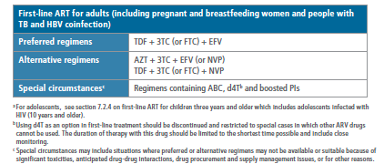
WHO 1st Line ART Recommendations (2013)
WHO Consolidated Treatment Guidelines, 2013
Notes:
These regimens are listed in the 2013 WHO Consolidated Treatment Guidelines. Updated guidelines are anticipated in late 2015 or early 2016.

Slide 47
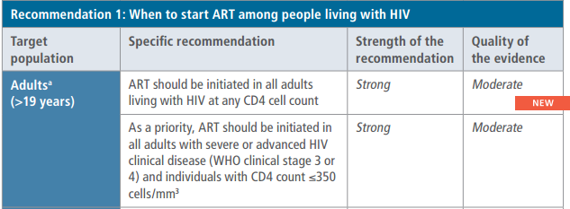
WHO ART Recommendations - 2015
WHO Guideline on When to Start Antiretroviral Therapy and on Pre-Exposure Prophylaxis for HIV, 2015
Notes:
These regimens are listed in the 2013 WHO Consolidated Treatment Guidelines. Updated guidelines are anticipated in late 2015 or early 2016.

Slide 48
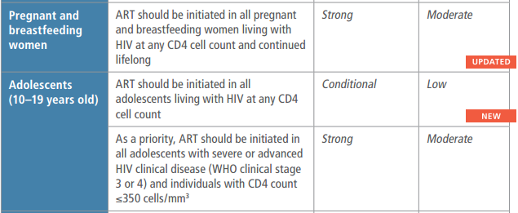
WHO ART Recommendations - 2015
WHO Guideline on When to Start Antiretroviral Therapy and on Pre-Exposure Prophylaxis for HIV, 2015
Notes:
These regimens are listed in the 2013 WHO Consolidated Treatment Guidelines. Updated guidelines are anticipated in late 2015 or early 2016.

Slide 49
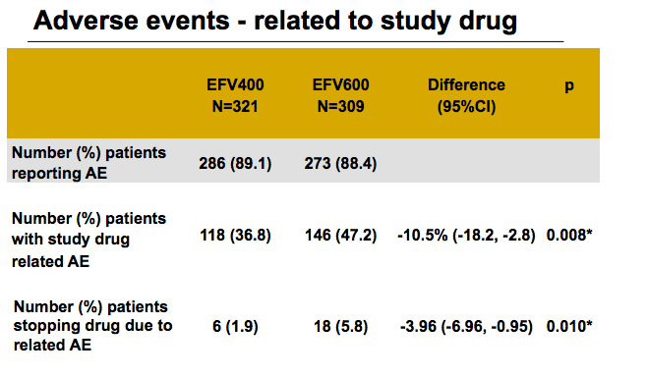
ENCORE1
Randomized international study (N = 630 adults) randomized to receive efavirenz 400 mg vs 600 mg with tenofovir and emtricitabine
No difference in viral suppression
400 mg group had significantly fewer adverse events and fewer patients stopping treatment for adverse events
ENCORE1 Study Group. Lancet. 2014
Notes:
Important clinical trial providing support for use of low-dose efavirenz.
Efficacy of 400 mg efavirenz versus standard 600 mg dose in HIV-infected, antiretroviral-naive adults (ENCORE1): a randomised, double-blind, placebo-controlled, non-inferiority trial
Background
The optimum dose of key antiretroviral drugs is often overlooked during product development. The ENCORE1 study compared the efficacy and safety of reduced dose efavirenz with standard dose efavirenz in combination with tenofovir and emtricitabine as first-line treatment for HIV infection. An effective and safe reduced dose could yield meaningful cost savings.
Methods
ENCORE1 is a continuing non-inferiority trial in HIV-1-infected antiretroviral-naive adults in 38 clinical sites in 13 countries. Participants (plasma HIV-RNA >1000 log10 copies per mL, CD4 T-cell count 50–500 cells per μL) were randomly assigned by a computer-generated sequence with a blocking factor of four (stratified by clinical site and by screening viral load) to receive tenofovir plus emtricitabine with either a reduced daily dose (400 mg) or a standard dose (600 mg) of efavirenz. Participants, physicians, and all other trial staff were masked to treatment group. The primary endpoint was the difference in proportions of participants with plasma HIV-RNA of less than 200 copies per mL at 48 weeks. Treatment groups were regarded as non-inferior if the lower limit of the 95% CI for the difference in viral load was less than −10% by modified intention-to-treat analysis. Adverse events were summarised by treatment. This trial is registered with ClinicalTrials.gov, number NCT01011413.
Findings
The modified intention-to-treat analysis consisted of 630 patients (efavirenz 400=321; efavirenz 600=309). 32% were women; 37% were African, 33% were Asian, and 30% were white. The mean baseline CD4 cell count was 273 cells per μL (SD 99) and median plasma HIV-RNA was 4·75 log10 copies per mL (IQR 0·88). The proportion of participants with a viral load below 200 copies per mL at week 48 was 94·1% for efavirenz 400 mg and 92·2% for 600 mg (difference 1·85%, 95% CI −2·1 to 5·79). CD4 T-cell counts at week 48 were significantly higher for the 400 mg group than for the 600 mg group (mean difference 25 cells per μL, 95% CI 6–44; p=0·01). We recorded no difference in grade or number of patients reporting adverse events (efavirenz 400=89·1%, efavirenz 600=88·4%; difference 0·75%, 95% CI −4·19 to 5·69; p=0·77). Study drug-related adverse events were significantly more frequent in the 600 mg group than in the 400 mg group (146% [47] vs 118 [37]), difference −10·5%, 95% CI −18·2 to −2·8; p=0·01) and significantly fewer patients with these events stopped treatment (400 mg=6 [2%], 600 mg=18 [6%], difference −3·96%, 95% CI −6·96 to −0·95; p=0·01).
Interpretation
Our findings suggest that a reduced dose of 400 mg efavirenz is non-inferior to the standard dose of 600 mg, when combined with tenofovir and emtricitabine during 48 weeks in ART-naive adults with HIV-1 infection. Adverse events related to the study drug were more frequent with 600 mg efavirenz than with 400 mg. Lower dose efavirenz should be recommended as part of routine care.

Slide 50
Drug Resistance Testing
HIV drug resistance testing is recommended at entry into care or prior to ART initiation, and when virologic failure is confirmed
Transmitted or treatment-emergent HIV drug resistance may limit the response to ART
Resistance testing for an individual is recommended in contexts where there is availability of second- and third-line ART
Where routine access to HIV drug resistance testing is restricted, population-based surveillance is recommended.
IAPAC Guidelines for Optimizing the HIV Care Continuum for Adults and Adolescents , 2015
Notes:
These recommendations and notes are adapted from the IAPAC Guidelines for Optimizing the HIV Care Continuum for Adults and Adolescents, 2015
Recommendation 24: Viral load testing every six months is recommended as the preferred tool for monitoring ART response. [B II]
Suppression of viral replication is the key therapeutic goal as it is the driver of individual and public health outcomes. Plasma HIV-1-RNA level is the preferred monitoring laboratory tool and should be used after ART initiation as a means to monitor the response to treatment (164). However, lack of availability of viral load testing should not delay the initiation of ART. HIV-1-RNA level should reach below the limit of quantitation by 6 months of ART initiation. Among individuals who are on stable ART with a CD4 count >350 cells/mm³ and who have been virologically suppressed for 2 years, viral load monitoring can be performed every 6–12 months (164, 165).
Recommendation 25: CD4 count level is not recommended as a criterion for ART initiation. [A I]
CD4 count monitoring is optional for individuals who are on stable ART and who have been virologically suppressed for more than 2 years (166, 167). If available, assessment of CD4 count is recommended to direct prevention of opportunistic infections. However, the initiation of ART for prophylaxis against opportunistic infections should not be denied or deferred if CD4 count testing is not available.
Recommendation 26: HIV drug resistance testing is recommended at entry into care or prior to ART initiation, and when virologic failure is confirmed.
Where routine access to HIV drug resistance testing is restricted, population-based surveillance is recommended. [BII]
Transmitted or treatment-emergent HIV drug resistance may limit the response to ART. Transmitted drug resistance is well documented in both resource-rich and resource-limited settings (155, 168). Treatment-emergent resistance is a major determinant of virologic failure (169, 170). The use of resistance testing in this setting has been shown to improve clinical response to subsequent lines of ART (171). Resistance testing for an individual is recommended in contexts where there is availability of second- and third-line medicines (172). In settings where most people do not have access to ART and/or there is limited access to viral load testing, it is advisable to expand access to these interventions while preparing for the medium- and long-term goal of improving access to resistance testing and alternative ART regimens for individual patients before and while they are on ART. In resource-limited settings where individual pre-ART resistance testing is not routinely available, regular population-based surveillance of transmitted resistance in the country is recommended in order to provide information for policy and programmatic considerations. Population-based resistance surveillance can provide important information for decision-making about the selection of initial and subsequent ART regimens, the population-level efficacy of ART regimens, as well as PrEP and PEP (173).

Slide 51
Practical Considerations
ART is recommended for all PLHIV
Early initiation associated with decreased risk of complications (e.g., TB)
Patients on stable ART rarely transmit HIV
Viral load testing is preferred for monitoring ART
Viral suppression to below level of detection is the goal of ART
Should be monitored at least every 6 months
Tenofovir + emtricitabine (or lamivudine) + efavirenz is standard WHO-recommended first-line ART

Slide 52
Defining Treatment Failure and Selecting 2nd Line ART
Module 5

Slide 53
Learning Objectives
Define “HIV treatment failure” (virologic failure)
Describe how ART monitoring should be optimally performed
Discuss the use of second-line ART and which medications are recommended by WHO

Slide 54
Defining & Monitoring Treatment Failure
Treatment failure is defined by a persistently detectable viral load exceeding 1,000 copies/ml (e.g., two consecutive viral load measurements within a three-month interval, with adherence support between measurements) after at least six months of using ARV drugs
Viral load testing every six months is recommended as the preferred tool for monitoring ART response
If viral load is not routinely available, CD4 count and clinical monitoring should be used to diagnose treatment failure²
WHO Consolidated Treatment Guidelines, 2013;
WHO Consolidated Guidelines on HIV Prevention, Diagnosis, Treatment and Care for Key Populations, 2014

Slide 55
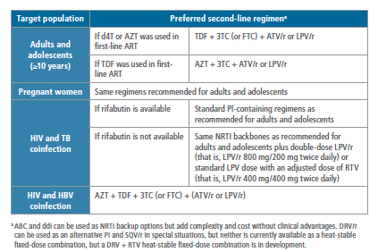
WHO 2nd Line ART Recommendations (2013)
WHO Consolidated Treatment Guidelines, 2013
Notes:
This table summarizes preferred second-line ART regimens in the 2013 WHO Consolidated Treatment Guidelines. Updated guidelines are anticipated in late 2015 or early 2016.

Slide 56
Considerations for Engaging Key Populations in HIV Care
Module 6

Slide 57
Learning Objectives
Discuss common challenges to engagement in care for key populations
Summarize guidance for engaging key populations across the HIV care continuum

Slide 58
Common Challenges
Population-specific policies/programs needed to address:
Pervasive stigma and discrimination
Violence, including intimate partner violence
Mistrust of medical providers or health systems
Unmet needs of daily living (e.g., food and shelter)
Lack of access to culturally appropriate services
Un- or under-addressed co-morbidities
Suboptimal access to evidence-based interventions
IAPAC Guidelines for Optimizing the HIV Care Continuum for Adults and Adolescents, 2015
Notes:
These notes are adapted from the IAPAC Guidelines for Optimizing the HIV Care Continuum for Adults and Adolescents, 2015
Although challenges may vary across key affected populations, a number are common to many, including pervasive stigma and discrimination (1,2), violence (3,4), mistrust of medical providers or systems (5), unmet basic needs of daily living (e.g., food and shelter) (6, 7), lack of access to culturally appropriate services (5), under-addressed co-morbidities (8,9), and suboptimal access to evidence-based interventions due to these not being offered or brought to an appropriate level of scale (10, 11). Population-specific programs and policies that address these challenges are urgently needed. Further, although a growing body of evidence indicates that peer-delivered programs often help extend the reach, coverage, acceptability and effectiveness of a range of programs (12-14), these approaches remain underutilized.
Chan KY, Stoove MA, Sringernyuang L, Reidpath DD. Stigmatization of AIDS patients: disentangling Thai nursing students' attitudes towards HIV/AIDS, drug use, and commercial sex. AIDS Behav. 2008 Jan; 12(1):146-57
Genberg BL, Hlavka Z, Konda KA, Maman S, Chariyalertsak S, Chingono A, et al. A comparison of HIV/AIDS-related stigma in four countries: negative attitudes and perceived acts of discrimination towards people living with HIV/AIDS. Soc Sci Med. 2009 Jun; 68(12):2279-87
Shannon K, Csete J. Violence, condom negotiation, and HIV/STI risk among sex workers. JAMA. 2010 Aug 4; 304(5):573-4.
Kouyoumdjian FG, Findlay N, Schwandt M, Calzavara LM. A Systematic Review of the Relationships between Intimate Partner Violence and HIV/AIDS. PLoS ONE. 2013. 8(11):e81044.
Eaton LA, Driffin DD, Kegler C, Smith H, Conway-Washington C, White D, et al. The role of stigma and medical mistrust in the routine health care engagement of black men who have sex with men. Am J Public Health. 2015 Feb; 105(2):e75-82.
Weiser SD, Yuan C, Guzman D, Frongillo EA, Riley ED, Bangsberg DR, et al. Food insecurity and HIV clinical outcomes in a longitudinal study of urban homeless and marginally housed HIV-infected individuals. AIDS. 2013 Nov 28; 27(18):2953-8.
Palepu A, Milloy MJ, Kerr T, Zhang R, Wood E. Homelessness and adherence to antiretroviral therapy among a cohort of HIV-infected injection drug users. J Urban Health. 2011 Jun; 88(3):545-55.
Nelson P, Mathers B, Cowie B, Hagan H, Jarlais DD, Horyniak D, et al. The epidemiology of viral hepatitis among people who inject drugs: Results of global systematic reviews. Lancet. 2011 07/27; 378(9791):571-83.
Jittimanee SX, Nateniyom S, Kittikraisak W, Burapat C, Akksilp S, Chumpathat N, et al. Social stigma and knowledge of tuberculosis and HIV among patients with both diseases in Thailand. PLoS One. 2009; 4(7):e6360.
Strathdee SA, Hallett TB, Bobrova N, Rhodes T, Booth R, Abdool R, et al. HIV and risk environment for injecting drug users: the past, present, and future. Lancet. 2010 Jul 24; 376(9737):268-84.
Kerr T, Fairbairn N, Hayashi K, Suwannawong P, Kaplan K, Zhang R, et al. Difficulty accessing syringes and syringe borrowing among injection drug users in Bangkok, Thailand. Drug Alcohol Rev. 2010 Mar; 29(2):157-61.
Garfein RS, Golub ET, Greenberg AE, Hagan H, Hanson DL, Hudson SM, et al. A peer-education intervention to reduce injection risk behaviors for HIV and hepatitis C virus infection in young injection drug users. AIDS. 2007 Sep 12; 21(14):1923-32.
Hayashi K, Wood E, Wiebe L, Qi J, Kerr T. An external evaluation of a peer-run outreach-based syringe exchange in Vancouver, Canada. Int J Drug Policy. 2010 Sep; 21(5):418-21.
Broadhead RS, Heckathorn DD, Weakliem DL, Anthony DL, Madray H, Mills RJ, et al. Harnessing peer networks as an instrument for AIDS prevention: results from a peer-driven intervention. Public Health Rep. 1998 Jun; 113 Suppl 1:42-57.

Slide 59
Key Populations (for purposes of this training course)
Pregnant women
Adolescents
Men who have sex with men (MSM)
Transgender individuals
Sex workers
Substance users
Incarcerated populations

Slide 60
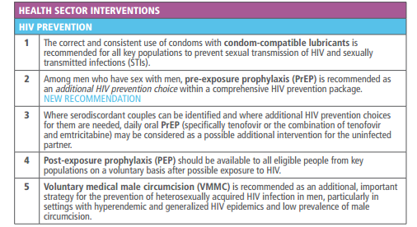
WHO Recommendations – Key Populations
WHO Consolidated Guidelines on HIV Prevention, Diagnosis, Treatment and Care for Key Populations, 2014

Slide 61
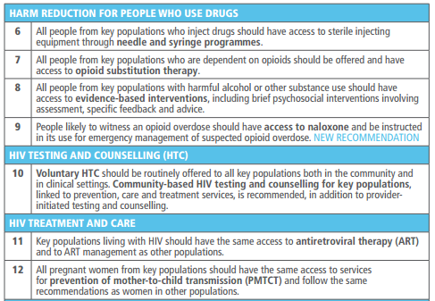
WHO Recommendations – Key Populations (continued)
WHO Consolidated Guidelines on HIV Prevention, Diagnosis, Treatment and Care for Key Populations, 2014

Slide 62
WHO Recommendations – Key Populations (continued)
WHO Consolidated Guidelines on HIV Prevention, Diagnosis, Treatment and Care for Key Populations, 2014

Slide 63
WHO HIV Testing Recommendations: Pregnant and Post-Partum Women
Provider-initiated HIV testing should be a routine part of care in antenatal, childbirth, postpartum, and pediatric care in high prevalence settings
Where breastfeeding is the norm, lactating HIV-negative mothers should be tested periodically
Couples and partners testing services are recommended in antenatal settings
WHO Consolidated Guidelines on HIV Testing Services, 2015

Slide 64
Considerations for Pregnant Women
Prioritize and increase women’s access to and retention in HIV services along the continuum of HIV care, including through gender-sensitive programming
Integrate community-based support services for women within HIV care, including peer-based programs and family-based programs that engage partners and family members; at a minimum, offer direct referral to such services for women living with HIV
Screen for and implement interventions to address food insecurity among women living with HIV
Screen for physical and emotional abuse and violence (or the risk of experiencing violence) among women across the HIV care continuum
IAPAC Guidelines for Optimizing the HIV Care Continuum for Adults and Adolescents, 2015
Notes:
These recommendations and notes are adapted from the IAPAC Guidelines for Optimizing the HIV Care Continuum for Adults and Adolescents, 2015
Recommendation 41: Gender-sensitive programming to prioritize and increase access to and retention in HIV services for women, including pregnant and breastfeeding women living with HIV, should be considered [B III].
Interventions to scale-up access to and retention in HIV treatment and care for pregnant and breastfeeding women living with HIV are recommended, and should include socioeconomic support. [B II]
Women, especially pregnant women, continue to face unacceptable gaps in access across the HIV care continuum (274). Women’s engagement in the continuum is greatly impacted by gender norms and roles (275). Women often face gendered pressures to share medications or prioritize the nutritional needs of other family members (275-277). Gender-sensitive programming and interventions that address such issues are recommended as part of a comprehensive HIV response (278, 279). Education and counseling about the benefits of ART, particularly for women in better health, remains important (280). Pregnant and breastfeeding women continue to be lost to follow-up across the continuum (135, 280). Women engaged in HIV treatment and care earlier in pregnancy are less likely to be lost to follow-up (184) or to have infants who contract HIV (281, 282). Efforts are thus needed to ensure that pregnant and breastfeeding women living with HIV initiate ART as soon as possible to prevent loss to follow-up (135, 283), suggesting the need for programs that address socioeconomic barriers to ART access for pregnant and breastfeeding women.
Recommendation 42: Integration of community-based support services for women within HIV care should be considered, including peer-based programs and family-based programs that engage partners and family members. [C IV]
Access to social support can increase women’s use of and benefits from both HIV- and non-HIV-related care. Among women living with HIV in Zimbabwe, those enrolled in an HIV support group were more likely to access care and treatment (281) and, among women living with HIV in the United States, women who attended support groups in non-medical model agencies (as in community settings) were more likely to be retained than those receiving case management and supportive services in medical model agencies (284, 285). Ideally, support services and HIV care services should be located physically near each other to facilitate access.

Slide 65
Considerations for Pregnant Women (continued)
Conduct non-stigmatizing discussions of pregnancy and parenting choices and the provision of family planning services to support the full range of sexual and reproductive rights of women living with HIV
Implement interventions to scale-up access to and retention in HIV care and treatment for pregnant and breastfeeding women living with HIV; such interventions should also include socioeconomic support
Scale-up pediatric HIV services for infants born to HIV-positive mothers to promote both child and maternal health
Tailor ART prescribing practices to consider women’s use of other medications (e.g., contraceptives), as well as potential side effects in women
Address the challenges faced by younger women living with HIV across the HIV care continuum
IAPAC Guidelines for Optimizing the HIV Care Continuum for Adults and Adolescents, 2015
Notes:
These recommendations and notes are adapted from the IAPAC HIV Care Continuum Guidelines, 2015
Recommendation 43: Screening for and interventions to address violence (or the risk of experiencing violence) against women within the healthcare setting are recommended.
Women often face concerns regarding violence within the context of receiving a positive test for HIV or disclosing their HIV status (286, 287). Concerns about violence are associated with taking and adhering to ART among women (287-289), as well as other determinants of women’s health (e.g., mental health, condom use, HIV risk, immune functioning) (290). Evidence for the effectiveness of the use of screening tools for violence against women is mixed (291). However, given the evidence available, we recommend that screening should be undertaken for women who have experienced violence or who may be at risk of experiencing violence (291, 292). Women should subsequently be referred to available counseling and safety resources, including as part of planning for safe and voluntary disclosure to intimate partners and other family members to facilitate linkage to care, and use of and adherence to ART (293). Evidence from RCTs suggests that PrEP reduces HIV incidence and can be particularly beneficial for women whose sex partners refuse to use condoms or who have difficulties in disclosing status (294). Moreover, low adherence to PEP has been found among people experiencing sexual assault, a key issue among women (295), suggesting the critical importance of addressing violence alongside HIV prevention.
Recommendation 44: Non-stigmatizing counseling regarding conception plans and pregnancy should be considered in tandem with offering family planning services for women living with HIV.
The linkage of HIV and sexual and reproductive health programs has many positive intervention effects on the HIV care continuum, including increased uptake of HIV testing (296). Fears of disclosure, loss of confidentiality, and infrequent provider-initiated discussions about pregnancy can be barriers to accessing family planning services for women living with HIV (297-299). Qualitative research has linked stigma to fear of disclosure of HIV status, limited engagement in treatment for prevention of mother-to-child transmission (PMTCT), and adherence to treatment (300, 301).
Women and men living with HIV are sexually active, and have high use of or unmet needs for contraceptives, as well as availability of and accessibility to the full range of options available for contraception. Many women and men living with HIV also have a strong desire to become pregnant and/or parent children (274, 302-304). Associations between and women’s engagement in HIV pregnancy prevention, treatment and care (305, 306) also highlight the opportunity that pregnancy presents to engage women in the HIV care continuum. Engaging all women living with HIV in ART is the ideal approach to PMTCT.

Slide 66
Treatment for Pregnant and Breastfeeding Women
A once-daily fixed-dose combination of TDF + 3TC (or FTC) + EFV is recommended as 1st line ART for first trimester of pregnancy
The recommendation applies both to lifelong treatment and to ART initiated for PMTCT and then stopped
Infants of mothers who are receiving ART and are breastfeeding should receive six weeks of infant prophylaxis with daily NVP
If infants are receiving replacement feeding, they should be given four to six weeks of infant prophylaxis with daily NVP (or twice-daily AZT); infant prophylaxis should begin at birth or when HIV exposure is recognized postpartum
WHO Consolidated Treatment Guidelines, 2013
Notes:
These regimens are listed in the 2013 WHO Consolidated Treatment Guidelines. Updated guidelines are anticipated in late 2015 or early 2016.

Slide 67
Considerations for Adolescents
Remove adult-assisted consent to HIV testing and counseling in minor adolescents with the capacity to consent
Adolescent-centered services are recommended in both clinical and community-based settings delivered by staff who understand and respect consent and confidentiality
Develop a healthcare transition plan between pediatric and adult care
IAPAC Guidelines for Optimizing the HIV Care Continuum for Adults and Adolescents, 2015
Notes:
These recommendations and notes are adapted from the IAPAC Guidelines for Optimizing the HIV Care Continuum for Adults and Adolescents, 2015

Slide 68
Key Population Considerations
MSM
Develop and adopt standards for the provision of culturally competent care and the dissemination of information/educational materials in clinical programs for all MSM to address medical mistrust, promote confidentiality, and minimize stigma, with specific attention to MSM from racial or ethnic minority populations
Offer supporting services in community-based settings in order to reach MSM who may not access HIV testing services in clinical settings
Offer STI testing, including screening for syphilis, Chlamydia, and Gonorrhea in all relevant anatomical sites; screen for viral hepatitis and vaccinate susceptible MSM for (HAV and HBV); vaccinate MSM aged less than 26 for HPV; provide anal examination for HPV-associated pathology
Facilitate the linkage to care of MSM youth at HIV testing sites through direct referral to MSM peer navigators
IAPAC Guidelines for Optimizing the HIV Care Continuum for Adults and Adolescents, 2015
Notes:
These recommendations and notes are adapted from the IAPAC Guidelines for Optimizing the HIV Care Continuum for Adults and Adolescents, 2015

Slide 69
Key Population Considerations (continued)
Transgender Individuals
Develop and adopt standards for the provision of culturally competent care and the dissemination of information/educational materials in clinical programs for transgender individuals to address medical mistrust, promote confidentiality, and correct misperceptions regarding HIV treatment and transgender-specific medical care
Consult with or refer HIV-positive transgender individuals on ART who wish to start hormone therapy to a clinician experienced in transgender medical care
IAPAC Guidelines for Optimizing the HIV Care Continuum for Adults and Adolescents, 2015
Notes:
These recommendations and notes are adapted from the IAPAC Guidelines for Optimizing the HIV Care Continuum for Adults and Adolescents, 2015

Slide 70
Key Population Considerations (continued)
Sex Workers
Tailor HIV prevention, treatment, and care interventions for sex workers, including voluntary HIV, STI, and viral hepatitis (HBV and HCV) screening, condom promotion, and access to ART
Implement programs to scale-up access and address barriers to ART which are led by and for sex workers living with HIV
IAPAC Guidelines for Optimizing the HIV Care Continuum for Adults and Adolescents, 2015
Notes:
These recommendations and notes are adapted from the IAPAC Guidelines for Optimizing the HIV Care Continuum for Adults and Adolescents, 2015

Slide 71
Key Population Considerations (continued)
Substance Users
Scale-up evidence-based treatment for substance use, in particular opioid substitution therapies
Implement time-limited DAART with substance users at high risk of non-adherence
Conduct comprehensive and integrated assessments for and provide treatment of co-morbid psychiatric illnesses, in particular depression, among substance users
IAPAC Guidelines for Optimizing the HIV Care Continuum for Adults and Adolescents, 2015
Notes:
These recommendations and notes are adapted from the IAPAC Guidelines for Optimizing the HIV Care Continuum for Adults and Adolescents, 2015

Slide 72
Key Population Considerations (continued)
Incarcerated Populations
Offer universal HIV testing, particularly in jurisdictions with hyper-endemic rates of incarceration, so that the offer of HIV testing in correctional healthcare settings mirrors that in community health settings
Implement interventions to prevent HIV transmission among populations that move into, dwell in, or leave correctional facilities, while delivering general interventions that decrease intimate partner/sexual violence, promote harm reduction, and address substance use
Ensure that health services in jails and prisons follow international guidelines for HIV care, including for the management of HIV comorbidities that occur at high frequency in incarcerated populations
Promote two-way, comprehensive communication between correctional and community HIV providers to ensure that there are no gaps in care, treatment, and support services as people transition to and from their communities and correctional facilities
IAPAC Guidelines for Optimizing the HIV Care Continuum for Adults and Adolescents, 2015
Notes:
These recommendations and notes are adapted from the IAPAC Guidelines for Optimizing the HIV Care Continuum for Adults and Adolescents, 2015

Slide 73
Achieving Long-Term Retention and Engagement in HIV Care
Module 7

Slide 74
Learning Objectives
Identify barriers to retention in the HIV care
Describe clinic-level interventions to improve engagement in care
Discuss strategies to mitigate loss to follow-up and facilitate re-engagement in HIV care

Slide 75
Introduction
Barriers to HIV treatment engagement are common across countries, even when local resource bases may differ widely
Efficiently keeping people engaged in their care is more critical than ever, as resources are ultimately limited in every setting, and growing numbers of PLHIV are in need lifelong quality care
Notes:
Recommendations for this component of the HIV care continuum cluster in the domains of treatment retention monitoring, health systems, and context of care, including the persistence of stigma (1). A number of barriers to HIV treatment engagement are common across countries, even when local resource bases may differ widely. Yet the need to efficiently keep people engaged in their care is more critical than ever, as resources are ultimately limited in every setting, and growing numbers of PLHIV need lifelong care.
(1) Sayles JN, Wong MD, Kinsler JJ, Martins D, Cunningham WE. The association of stigma with self-reported access to medical care and antiretroviral therapy adherence in persons living with HIV/AIDS. J Gen Intern Med. 2009 Oct; 24(10):1101-8.

Slide 76
Long-Term Retention in Care
Retention in care is associated with improved individual health outcomes and may reduce community-level viral burden, with implications for secondary prevention
Systematic monitoring of retention in HIV care is recommended for all patients
Although monitoring retention is routinely recommended, specific details, such as retention measures to be used and desired visit frequency, vary among jurisdictions and programs and should be in harmony with national and international guidelines
IAPAC Guidelines for Optimizing the HIV Care Continuum for Adults and Adolescents, 2015
Notes:
These recommendations and notes are adapted from the IAPAC Guidelines for Optimizing the HIV Care Continuum for Adults and Adolescents, 2015
Recommendation 29: Systematic monitoring of retention in HIV care is recommended for all patients [A II].
Retention in HIV care should be considered as a quality indicator. [B III]
Measuring retention using electronic health record and other health system data, as well as clinic databases/surveillance systems for clinical monitoring and population-level tracking, is recommended. [B II]
Tracking the retention of clients in HIV care is important for both clinical and health services purposes, and could be considered a part of quality-of-care indicators at both clinic- and surveillance-system levels (181). An integrated public health surveillance and electronic health record system was able to use the system to provide alerts to medical providers when their clients had been out of care for longer than 12 months (182). Identifying optimal thresholds of being ‘out of care’ or lost to follow-up remains important; a 12-week delay in visit, based on pharmacy registry data in South Africa, was considered optimal (183). Pharmacy tracking data can also include lack of refills (184, 185) and interruptions in laboratory monitoring (186) as warning signs of loss to follow-up.
Hu YW, Kinsler JJ, Sheng Z, Kang T, Bingham T, Frye DM. Using laboratory surveillance data to estimate engagement in care among persons living with HIV in Los Angeles County, 2009. AIDS Patient Care STDS. 2012 Aug; 26(8):471-8.
182.Herwehe J, Wilbright W, Abrams A, Bergson S, Foxhood J, Kaiser M, et al. Implementation of an innovative, integrated electronic medical record(EMR) and public health information exchange for HIV/AIDS. J Am Med Inform Assoc. 2012 May-Jun; 19(3):448-52.
183.Nglazi MD, Kaplan R, Wood R, Bekker L-G, Lawn SD. Identification of losses to follow-up in a community-based antiretroviral therapy clinic in South Africa using a computerized pharmacy tracking system. BMC Infectious Diseases. 2010.10:329.
184.El-Khatib Z, Ekstrom AM, Coovadia A, Abrams EJ, Petzold M, Katzenstein D, et al. Adherence and virologic suppression during the first 24 weeks on antiretroviral therapy among women in Johannesburg, South Africa - a prospective cohort study. BMC Public Health. 2011; 11:88.
185.Palombi L, Marazzi MC, Guidotti G, Germano P, Buonomo E, Scarcella P, et al. Incidence and predictors of death, retention, and switch to second-line regimens in antiretroviral- treated patients in sub-Saharan African Sites with comprehensive monitoring availability. Clin Infect Dis. 2009 Jan 1; 48(1):115-22.

Slide 77
Adherence Monitoring
Routine ART adherence monitoring is recommended in all patients
Measurement methods include:
Tracking pharmacy/clinic visits
Measuring viral load as the primary adherence monitoring metric
Collection of self-reported adherence data
Collecting pharmacy refill data
Pill count, electronic drug monitoring, or ARV drug concentrations in biological samples are NOT routinely recommended
IAPAC Guidelines for Optimizing the HIV Care Continuum for Adults and Adolescents, 2015
Notes:
These recommendations and notes are adapted from the IAPAC Guidelines for Optimizing the HIV Care Continuum for Adults and Adolescents, 2015
Recommendation 30: Routine ART adherence monitoring is recommended in all patients. [A II]
While tracking pharmacy/clinic visits is recommended, viral load is recommended as the primary adherence monitoring metric. [B II]
Routine collection of self-reported adherence data from patients is recommended. [A II]
Pharmacy refill data are recommended for adherence monitoring. [B II]
Pill count, electronic drug monitoring, or ARV drug concentrations in biological samples are not routinely recommended. [B II]
ART adherence is a reliable predictor of adherence to clinic visits, and can be tracked using clinical, immunological, as well as pharmacy and clinic visit measures. Viral load suppression is the most reliable indicator of adherence. Viral load surveillance data can be successfully used to monitor engagement and retention in care, and improve linkage and retention efforts in local communities (181). Patient self-report is the most widely used method for evaluating medication adherence (187). However, a literature review indicated that it is better to use pharmacy data than self-reported adherence (188). This review also suggests that pharmacy measures that incorporate the number of days for which ART was prescribed without counting of the remaining pills are good methods to assess adherence to ART. Physician estimate of their patients’ ART adherence is not an effective measure (189).

Slide 78
Long-Term Engagement
Information and communication technologies and staff-/peer-delivered counseling are recommended
Mobile health technology using weekly interactive components (e.g., 2-way SMS)
Alarm devices as reminders for PLHIV with memory impairment
Proactive engagement and re-engagement of patients who miss clinic appointments and/or are lost to follow-up is recommended
Includes intensive outreach for those not engaged in care within one month of a new HIV diagnosis
IAPAC Guidelines for Optimizing the HIV Care Continuum for Adults and Adolescents, 2015
Notes:
These recommendations and notes are adapted from the IAPAC Guidelines for Optimizing the HIV Care Continuum for Adults and Adolescents, 2015
Recommendation 31: Information and communication technologies and staff-/peer-delivered counseling are recommended. [B II]
Mobile health technology using weekly interactive components (e.g., two-way SMS) is recommended. [B I]
Alarm devices are recommended as reminders for PLHIV with memory impairment. [A I]
The availability and reach of mobile communication has increased worldwide, including in sub-Saharan Africa, where two thirds of PLHIV reside. A systematic review found that technology-based approaches supporting self-care among PLHIV may improve adherence to ART, especially when these approaches utilized multiple components and facilitated communication with healthcare providers (190). Once-a-week text message or SMS reminders may be the optimal periodicity (191). There is evidence (191-194) that weekly two-way SMS improves adherence and virological outcomes in HIV-infected adults in Kenya. Evidence from two RCTs (195, 196) shows that there is no significant impact of using an alarm on poor adherence or viral failure, except in PLHIV with memory impairment. In fact, appointment reminders alone were found to be useful in a small RCT (197) but only among non-homeless, non-depressed clients in a much larger RCT (198). A cross-sectional survey also found higher adherence associated with Internet health information-seeking behaviors (199).

Slide 79
Monitoring ART Adherence
Self-reported adherence is less strongly associated with treatment responses than are electronic drug monitor- or pharmacy-based measures, but relative ease of implementation supports its use in clinical care
Careful attention must be paid to collecting self-report data in a manner that makes reasonable demands on memory
Questionnaires should inquire only about specific doses taken over a short time interval (e.g., in the previous week) and about global measures of adherence over a longer time interval (e.g., in the previous month)

Slide 80
Adherence Tools for Patients
Adherence tools are more beneficial when combined with education & counseling
Individual one-on-one ART education
One-on-one adherence support:
May include telephone-based counseling and/or home visits
Expand one-on-one counseling to include discordant partners, as necessary
Group education and group counseling
Peer support
Pillboxes, dose planners, reminder alarm devices, and electronic drug monitors

Slide 81
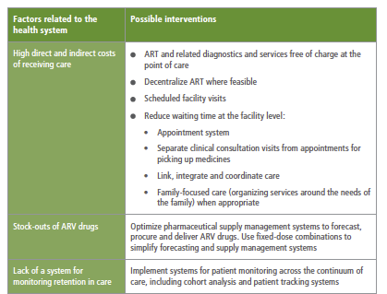
Improving Retention in Care
WHO-recommended interventions:
Reduce waiting time
Link, integrate, coordinate care
Family-focused care
Implement patient monitoring across HIV care continuum
WHO Consolidated Guidelines on the Use of Antiretroviral Drugs for Treating and Preventing HIV Infection, 2013

