Slide 1
HCV Clinical Management
TRAINER(S)

Slide 2




IAPAC African Regional Capacity-Building Hub
  Based in Johannesburg, South Africa
  Mission: Strengthen clinician capacity to deliver HIV, HBV, and HCV treatment
  Partners include:
Supported through an educational grant from:

Slide 3
Virology of Hepatitis C virus
Module 1

Slide 4
Learning Objectives
Understand the global burden of HCV disease
  Prevalence and distribution
Describe the hepatitis C virus
  Basic virological characteristics
  Genotype distribution
ListHCV transmission risks
Explain the HCV lifecycle
  Viral proteins and enzymes

Slide 5
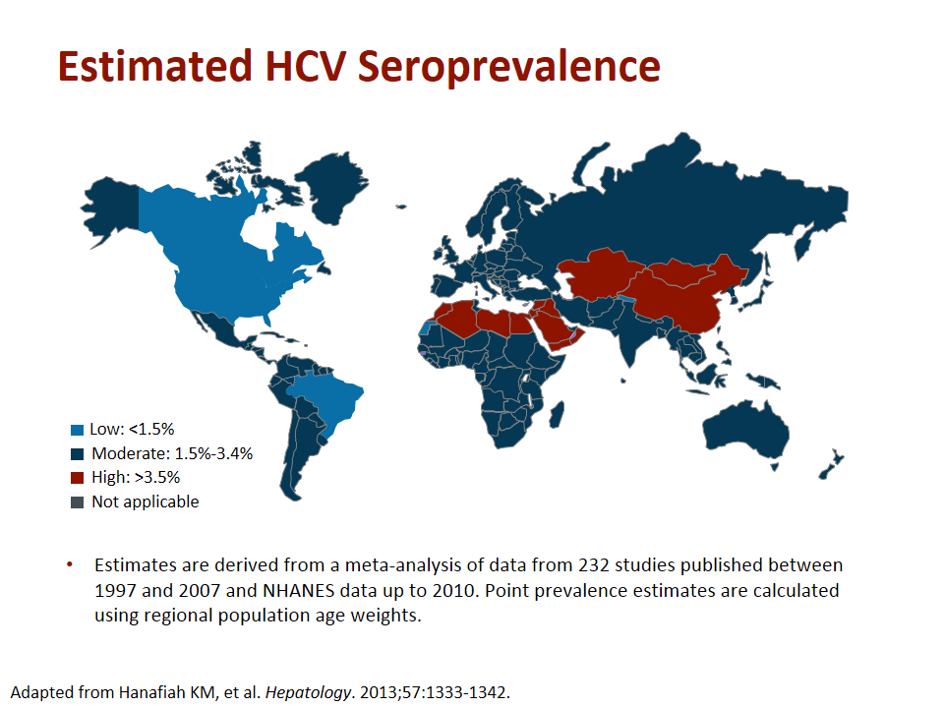
Estimated Global HCV Prevalence
170 million people
Adapted from Hanafiah KM et al. Hepatology. 2013
Notes:
Approximately 170 million people globally are chronically infected with hepatitis C. It represents 3% of the global population with varying prevalences in different parts of the world from very high prevalence in Egypt, Eastern Europe and Brazil to more low prevalence countries with seroprevalence less that 1%.

Slide 6
Global Burden of HCV Disease
Europe
8.9 million
(1.03%)
Western Pacific
62.2 million
(3.9%)
The Americas
13.1 million
(1.7%)
Southeast Asia
32.3 million
(2.15%)
Eastern Mediterranean
21.3 million
(4.6%)
Africa
31.9 million
(5.3%)
Farci P, et al. Semin Liver Dis. 2000;20:103-126. Wasley A, et al. Semin Liver Dis. 2000.
Notes:
6
It is estimated by the World Health Organization that approximately 170 million individuals, or 3.1% of the world population, are infected with HCV—more than 5 times the number of people living with HIV. There is an estimated 3–4 million new infections occurring each year.
There is considerable geographic variation in the prevalence of HCV infection. In the Americas, approximately 1.7% of the population is currently living with HCV and genotypes 1 (~75%), 2 and 3 dominate . Areas of higher prevalence include some countries of Africa, the eastern Mediterranean, southeast Asia, and the western Pacific. In Egypt, there are some areas in which one out of every 5 individuals has chronic hepatitis C. The virus spread in Egypt drastically as a result of unsafe injection practices during a campaign to eradicate schistosomiasis.

Slide 7
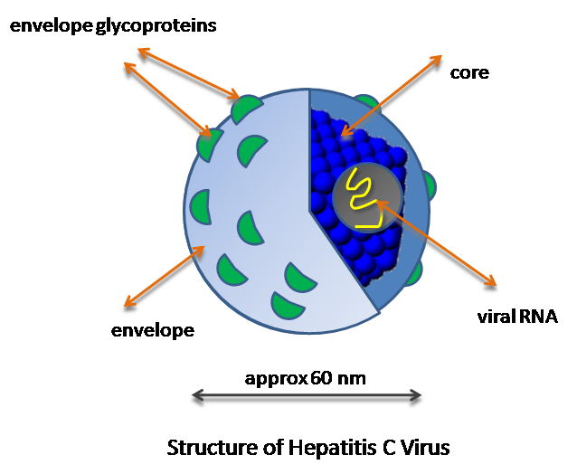
HCV Viral Structure
RNA genome
Nucleocapsid
(core) protein
Approximately 50nm
Envelope
Notes:
HCV viral structure
Structurally, the HCV genome is an unsegmented, linear, single strand of positive-sense RNA. The genome is approximately 9.6 kilobase (kb) in length, coding for a polyprotein of about 3000 amino acid residues. The HCV surrounds its RNA with a protective coat or nucleocapsid.

Slide 8
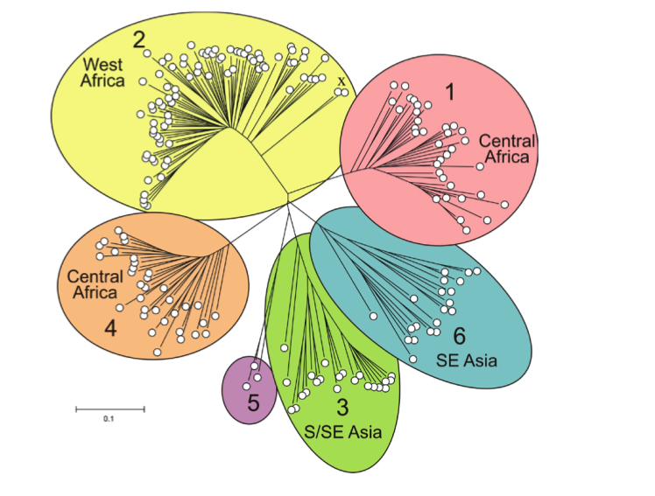
Hepatitis C Virus
Single-stranded, positive sense, RNA virus
  Flaviviridae family
No RNA polymerase proofreading ability
  Forms heterogeneous viral populations or quasispecies
Half-life: ≈2.7 hours
Daily production: 10¹² virions
3000-amino acid polyprotein
Great genetic diversity
  Six genotypes: 1,2,3,4,5,6; >80 subtypes: a, b, c, etc.
~ 50 nm
Choo QL, et al. Science. 1989;244:359-362.
Notes:
8
The hepatitis C virus (HCV) was first identified in 1989. It is a spherical, enveloped RNA virus belonging to the Flaviviridae family. The virion is a spherical, enveloped virus of approximately 50 nm in diameter with an estimated half-life (t½) of 2.7 hours. Daily, 10 trillion (i.e., 10¹²) virions are produced and cleared in an untreated individual with HCV infection. Hepatitis C virus is a major cause of chronic liver disease in the developed countries. One of the most important features of HCV is its high degree of genetic variability. In fact, hepatitis C is the most genetically diverse virus known to infect man. The genetic diversity of the virus refers to the variability in the RNA sequence, or the information that codes for the virus. Variations in the HCV genome fall into specific patterns that have been clustered into several major distinct genotypes designated 1 through 6. Some of these genotypes are further divided into subtypes, such as subtype 1a and 1b. There is only approximately 60% similarity in the genetic material, or RNA nucleotide sequence, between the different genotypes. The distribution of HCV genotypes and subtypes varies in different parts of the world and certain genotypes predominate in certain regions. HCV has 6 genotypes (GT) and a large number of subtypes
These have impact of disease pathogenesis and treatment outcomes. Genotype 1,2,4 and 5 have their origins in Africa. Genotype 1 and 2 predominate in many parts of Africa, while GT4 is common in Egypt and Central Africa. Genotype 5 is almost exclusive to Southern Africa
This variability of HCV has important diagnosis and clinical implications. For instance, viral sequences can be used to track a common source of infection: when 2 strains are almost identical, it is almost certain they came from the same source. In addition, response to antiviral treatment varies according to genotypes

Slide 9
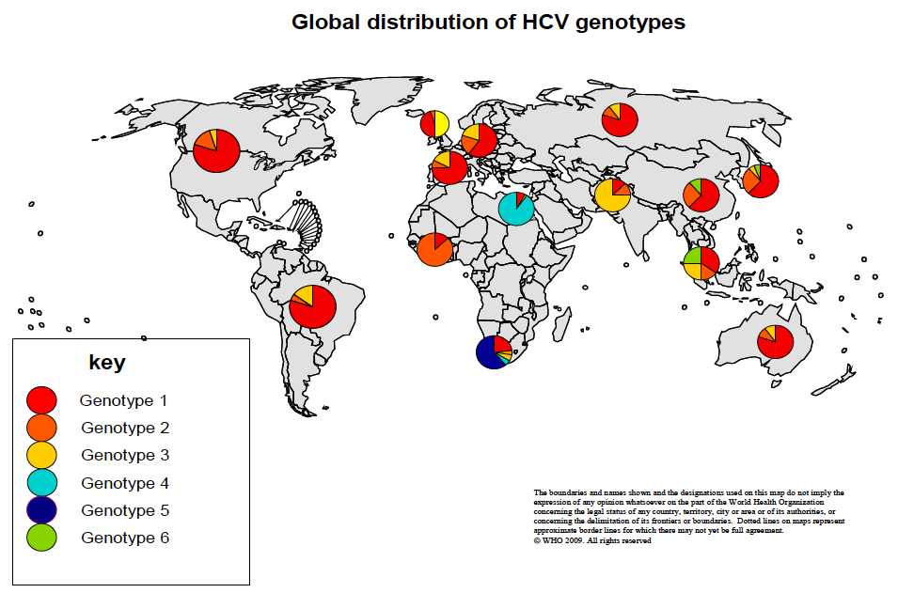
Global HCV Genotype Distribution
Hoofnagle J. Hepatology 2002; 36: S21
Notes:
Genotype prevalence varies according to geographic region – Genotype 1 (mostly subtype 1a) is common in Northern Europe and the United States. Genotype 2 is found worldwide but is particularly common in Northern Italy and Japan. Genotype 3 is most frequent in the Indian subcontinent, genotype 4 is the most common in Africa and the Middle East, genotype 5 is found in South Africa, and genotype 6 is found in South East Asia. In the United States, genotype 1 accounts for approximately 75% of cases of chronic hepatitis C. Genotypes 1b, 2a, and 2b have worldwide distributions. Genotype 4 dominates Egypt with genotypes 1 and 4 seen in many parts of Africa.

Slide 10
Risk Factors for HCV infection
Injecting drug use
Blood/blood products <1992 or where blood safety is inadequate
Unsafe medical or dental interventions e.g. unsafe injection use
Traditional practices
Tattooing and body piercing using unsterilized equipment
Needle stick injuries (healthcare workers)
Perinatal/mother to child
Haemodialysis
Sexual transmission (notably men who have sex with men)
Notes:
Risk factors for HCV infection
The predominant risk factor for the transmission of HCV infection is intravenous drug abuse through transfer of infected blood by sharing of syringes and needles. Risk is as high as 90% after 5 years of injection drug use.
Transfusion associated hepatitis (so called non-A, non-B) was found to be hepatitis C in 1990. The risk has declined with blood safety and screening and since 1997 no cases of post transfusion hepatitis have been reported where proper safety is practiced. In countires where blood safety through screening is inadequate, the risks remain high.
Vertical transmission of the virus from an infected mother to an infant is considered to be low risk (5–6%) however this risk is increased to around 20% in HIV–HCV co-infected mothers.
Patients receiving chronic haemodialysis therapy are also considered low risk (10%).
In African countries, traditional practices (circumcision, scarification rituals) is thought to be a high risk practice.
Household transmission (through percutaneous/mucosal exposure to blood and sharing of contaminated personal items such as razors, toothbrushes, nail-grooming equipment) can also occur but is rare. Additionally, certain occupations involve risk of HCV transmission, including healthcare, emergency medical, and public service work. Combined, these modes of HCV transmission account for an additional 10% of cases.
In the remaining 10% of patients with HCV infection, the source of the infection cannot be identified,.
Although the role of sexual activity in HCV transmission remains undefined, 20% or less of HCV-infected individuals report sexual exposures in the absence of percutaneous risk factors. Men who have Sex with Men are a growing high risk group with mini-outbreaks of hepatitis C described.

Slide 11
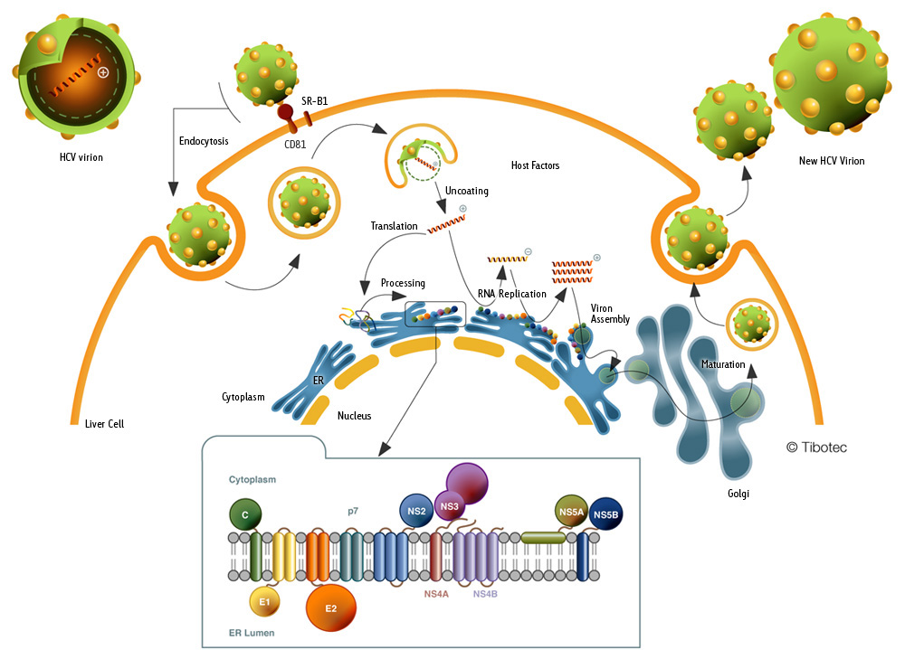
HCV Lifecycle Overview
Courtesy of Tibotec
Notes:
Steps in the HCV life cycle:
HCV virus infects human - circulates in the blood as a lipoviral particle.
It enters the hepatocytes by binding its envelope proteins (E1, E2) to CD81, SR-B1, claudin and occludin co-receptors.
Cytoplasmic release and uncoating of RNA genome
IRES-mediated (internal ribosomal entry site) translation and polyprotein processing by cellular and viral proteases ( into 10 viral proteins)
5. RNA replication (creation of minus strand template followed by production of plus strand RNA copies) occurs at an endoplasmic reticulum membrane−derived replication complex (the membranous web), which includes the lipid droplet (LD) and nonstructural viral proteins NS4A−NS5B.
6. Packaging and assembly by the Golgi apparatus and subsequently released by the cell.
7. Virion maturation
Release from host cell

Slide 12
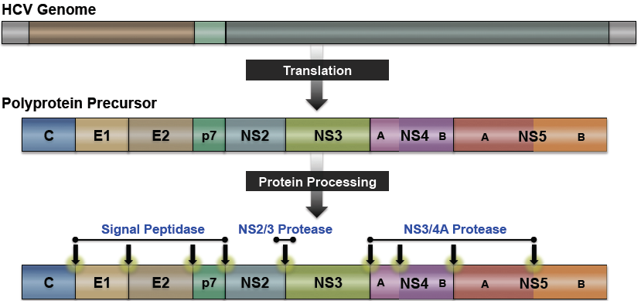
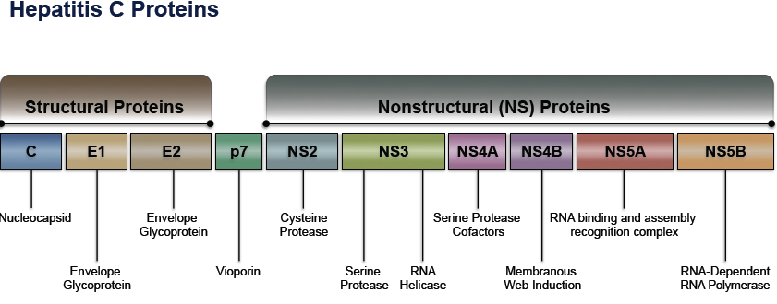
Lifecycle: Viral Polyprotein
The viral RNA undergoes translation resulting in a single viral polyprotein.
Notes:
The viral genome is a positive-sense, single-stranded RNA genome. After translation, a single viral polypeptide is generated. The structural proteins are cleaved by host proteases. The NS2/3 autoprotease cleaves the NS2−NS3 junction. The NS3/4A protease initially serves as an autoprotease and separates NS3−NS4A, but then subsequently cleaves the remaining nonstructural proteins. The viral polyprotein has 3 structural ( C, E1 and E2) and 7 nonstructural proteins(p7, NS2, NS3, NS4A, NS4B, NS5A and NS5B). The nonstructural proteins together with host enzymes are the ones responsible for viral replication and assembly.

Slide 13
Viral Enzymes
NS3/4A protease assists in the downstream cleavage of viral peptides. It also has ability to cleave and inactivate host proteins that aid in antiviral activity (IRF-3)
NS5B RNA-dependent RNA polymerase (RdRp) facilitate viral replication by copying a positive strand RNA into negative strand intermediate ( a template for more viral RNA genomes)
NS5B RdRp lacks proof reading capabilities and therefore mutations of HCV genome occurs at a rate of 10⁻⁴ per nucleotide
NS5A “replicase” assists in viral replication and viral assembly.
Notes:
These viral enzymes are the targets for Direct acting antivirals (DAA). Understanding HCV viral structure and its replication has revolutionized therapeutic advances in managing hepatitis C.

Slide 14
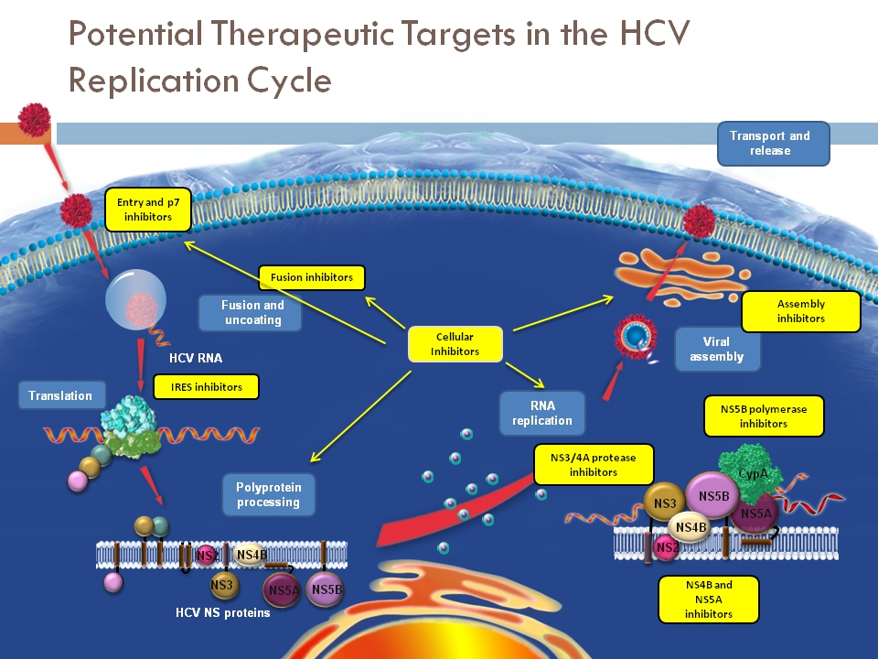
Potential Sites for HCV Therapeutic Targets
Notes:
In this slide one can see the numerous targets that exist for therapeutically tackling the virus. To date this has been through activating cellular mechanisms to target the virus through using Interferon. The viral enzymes have emerged as the most useful means of doing this through the use of inhibitors of the non-structural proteins NS3/4A, NS5A and NS5B.

Slide 15
Screening and Testing for and Assessment of HCV
Module 2

Slide 16
Learning Objectives
1. Explain HCV screening as a public health priority
2. Identify who should be screened for HCV
3. List HCV diagnostic tools
4. Describe HCV genotyping
5. Discuss the role of liver biopsy
6. Discuss non-invasive tests

Slide 17
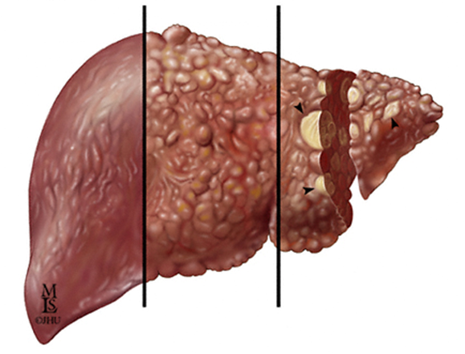
Natural History of Chronic HCV Infection
^{Fibrosis}
^{Cirrhosis}
^{Hepatocellular Carcinoma}
^{(with cirrhosis)}
Decompensated cirrhosis:
1. Ascites
2. Bleeding varices
3. Hepatic encephalopathy
4. Jaundice
.
1. Highleyman L. Hepatitis C Support Project. http://www.hcvadvocate.org/hepatitis/factsheets_pdf/Fibrosis.pdf.
2. Bataller R et al. J Clin Invest. 2005;115:209-218;
3. Medline Plus. http://www.nlm.nih.gov/medlineplus/enxy.article/000280.htm.
4. Centers for Disease Control and Prevention. http://www.cdc.gov/hepatitis/HCV/HCVfaq.htm..
Notes:
The reason we concern ourselves with hepatitis C is the long natural history that in many results in progressive liver disease, leading to cirrhosis. Once cirrhotic, the risk of HCC is between 1-4% per annum. All this occurs silently in most patients and hence the only way this can be prevented is by screening patients to find those with active hepatitis C virus infection.

Slide 18
Purpose of Screening
Identifying 170 million persons with HCV worldwide (<15% are aware)
Europe
8.9 million
(1.03%)
Western Pacific
62.2 million
(3.9%)
Americas
13.1 million
(1.7%)
Southeast Asia
32.3 million
(2.15%)
Eastern Mediterranean
21.3 million
(4.6%)
Africa
31.9 million
(5.3%)
World Health Organization. Wkly Epid Rec .1999;74:425-427. World Health Organization. Hepatitis C: Global Prevalence: Update. 2003. Farci P, et al. Semin Liver Dis. 2000;20:103-126. Wasley A, et al. Semin Liver Dis. 2000;20:1-16.
Notes:
The World Health Organization has estimated that approximately 170 million persons are infected with HCV worldwide. The distribution of HCV infection is not uniform around the world. In most places, approximately 1% to 2% of the population is infected with HCV, but some regions, such as Egypt, are burdened with rates that range from 10% to 20%. HCV screening is the first step in identifying the 170 million HCV-infected persons worldwide. Less than 15% of people are aware of their HCV infection. The gateway to cure is to identify those with infection.

Slide 19
HCV Screening Is the First Step on the Road to a Cure for HCV Infection
Cure
Assessment
Testing
Treatment
Counselling
Screening
Notes:
HCV screening is the first step on a long road to a cure, as shown. Once screening has identified patients at risk for HCV infection, HCV testing must be performed. Then, among persons found to be positive, counseling must be provided to prevent transmission to others and to prevent further harm to that particular individual. The need for treatment is then assessed, along with the benefits and risks of treatment. At the end of this long process, some patients can be cured. Therefore, HCV screening is important because it is the very first step of this process of engaging someone in management and treatment.
Treatment to achieve cure is the best way to reduce the risk of developing complications of hepatitis C!

Slide 20
Who to Screen?
3 approaches
Population screening, including antenatal
Risk-factor based screening e.g., PWID, MSM, prisoners
Birth cohort screening
No current universal screening program
Risk based screening: population dependent
Birth cohort - in USA and Japan
Notes:
Before you test, you must decide who to screen. There are 3 broad mechanisms to screen. Population based screening, risk factor or birth cohort screening. Population based screening or universal screening is not feasible. Only 2 countries, the USA and Japan are doing birth cohort screening. Risk factor based screening is the most efficient way of screening. To do this you need to identify those most at risk.

Slide 21
Risk Factors: Who to Screen?
Parenteral
IDU
Transfusions
Sexual
Multiple partners
Rectal contact
Perinatal
High viral load
HIV (+)
Traumatic
HIV (+)
Use of a CSW
MSM
Nasal cocaine
Needle stick injury
Tattoos
Body piercing
Manicures
Household items
Hemodialysis
Notes:
Risk factors can be generically packaged into parenteral, sexual and perinatal risk.
Current CDC, US Preventive Service Task Force and AASLD recommend that all person born between 1945 and 1965 receive one time testing for HCV. Anti HCV screening in other populations should be based on risk assessment with one time HCV testing for all individuals with above risk behavior, conditions, or exposure associated with high risk of HCV acquisition. Injecting drug users and HIV positive men who have sex with men should be tested annually.
A challenge in sub-Saharan Africa is that IDU is not common and in many instances the mode of acquisition of HCV is unknown as likely relates to unsafe medical practices and traditional practices. The traditional practices include ritual circumcision, scarification, unsterilized injection equipment and infusion of inadequately screened blood and blood products , traditional practices

Slide 22
USA: Who Should Be Tested for HCV?
CDC
Everyone born 1945-1965 (one-time)
Persons who ever injected illegal drugs
Persons who received clotting factor concentrates produced before 1987
Chronic (long-term) hemodialysis
Persons with persistently abnormal ALT levels
Recipients of transfusions or organ transplants prior to 1992
Persons with recognized occupational exposures
Children born to HCV-positive women
HIV-positive persons
USPSTF Grade B Recommendations*
Everyone born from 1945 through 1965 (one-time)
Past/present injection drug use
Sex with an IDU; other high-risk sex
Blood transfusion prior to 1992
Persons with hemophilia
Longterm hemodialysis
Born to HCV-infected mother
Incarceration
Intranasal drug use
Receiving unregulated tattoo
Occupational percutaneous exposure
Surgery before universal precautions implementation
* Only pertains to persons with normal liver enzymes; if elevated liver enzymes need HBV and HCV testing
Smith at al. Ann Intern Med 2012; 157:817-822. Moyer et al. Ann Intern Med
Notes:
As an example, the slide notes the screening guidelines for the USA as suggested by the CDC and US Preventive Services Task Force. It may not be relevant to sub-Saharan Africa but does create a template to understand a testing program.

Slide 23
Sub-Saharan Africa
Who Should be Screened for HCV?
Remains unclear
Persons with persistently abnormal ALT levels.
Recipients of transfusions (prior) to ???
Persons with recognized occupational exposures e.g. HCWs
Exposure to unsafe injection or medical practices
Children born to HCV-positive women
HIV positive persons
? Traditional practices
Persons who ever injected illegal drugs
Notes:
The question of who should be tested in sSA remains unclear given the reasons noted in the previous slides. This lists some risk groups that are more relevant to the sSA environment although as noted it is a challenging issue.

Slide 24
Hepatitis C Virus: Diagnostic Testing
 | DIAGNOSTIC TEST TYPE
Specifications | Serologic | Virologic
Mode of detection | Antibodies | Virus
Sensitivity | > 95% | > 98%
Specificity | Variable | > 98%
Detection postexposure | 2-6 months | 2-6 weeks
Use | Screening | Confirmation
Notes:
Once a patient or patient population is identified for screening a test is performed. This lists the 2 types of tests available: serologic tests and virologic tests.
Serologic tests measure circulating antibodies within the blood stream of patients exposed to HCV. Antibodies develop very early in the infection—typically 2-6 months after exposure—depending on levels of immune suppression. Serologic tests are generally used for screening because they are cheaper and are very sensitive.
Virologic tests measure virus levels, and they are both highly sensitive and highly specific. Again, there can be intermittent viremia early after infection so a true, persistently positive virus test for individuals recently exposed to HCV will be present approximately 2-6 weeks after exposure. Virologic tests are used to confirm active infection after the screening test is positive. They are designed to detect HCV RNA.

Slide 25
HCV Antibody Testing
ELISA screening tests
Detect circulating HCV antibodies
Sensitivity: 97% to 100%
Positive predictive value
  95% with risk factors and elevated ALT
  50% without risk factors and normal ALT
False Positives More Likely in: | False Negatives More Likely in:
Previous cleared infection | Severely immunosuppressed patients
Autoimmune disease | Transplantation recipients
HIV positive | Patients with chronic renal failure on dialysis
 | HIV positive
Carithers RL Jr, et al. Semin Liver Dis. 2000;20:159-171.
Pawlotsky JM. Hepatology. 2002;36(suppl 1):S65-S73.
Notes:
25
ALT, alanine aminotransferase; ELISA, enzyme-linked immunosorbent assays
Serologic tests are highly sensitive, but the specificity varies depending on the patient population being evaluated. Enzyme-linked immunoassays are designed to detect circulating antibodies in the plasma or in the serum. The tests are highly sensitive and have a predictive value that is especially high in individuals with HCV risk factors. As shown in the table, false-positives occur most often when HCV testing is done in low-risk populations, such as blood donors or persons without risk factors who have insurance physicals. False-negatives can occur in individuals who have difficulty forming HCV antibodies, such as severely immunocompromised patients, HIV-infected individuals, and patients on chronic dialysis.

Slide 26
HCV Confirmation Test
Detection of HCV RNA
All persons with positive anti-HCV antibody test must undergo additional testing for the presence of the HCV itself to determine whether current infection is present and whether there is an indication for treatment
HCV PCR is the most common method to detect viral RNA
It is also used to quantify the virus for treatment monitoring purpose
HCV PCR is not widely accessible and costs ≥100 USD per test
A great need exists for an affordable:
  Point Of Care HCV Viral load or HCV Ag test (with good sensitivity)
  Flexible PCR platforms (Multi-test: HBV-HIV-HCV)
Notes:
Once a person screens positive for HCV, confirmation needs to occur through RNA detection. Many such tests exist and are noted on the next slide. PCR can be both qualitative and quantitative. The problem is that PCR testing is expensive and a great need exists to develop sensitive and high quality tests – perhaps using multiplex systems where HCV, HBV and HIV can be tested on a single platform. This would be the ideal in sSA. HCV antigen testing is an attractive option as it is both a diagnostic and confirmatory test in one. There is however some issues with sensitivity as HCV RNA levels fall below 1000IU.

Slide 27
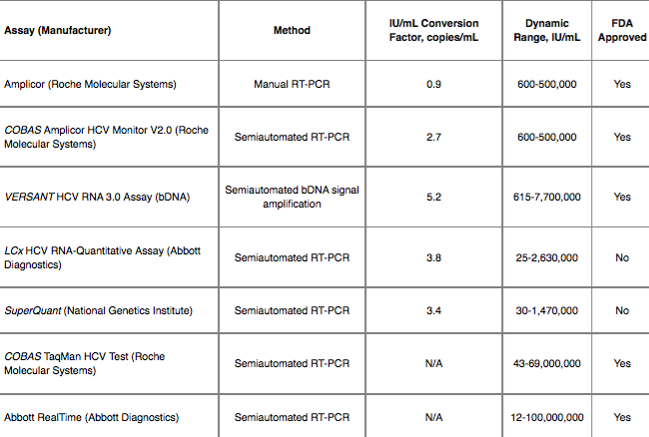
Molecular Testing
Recommended for all individuals who test positive for anti HCV antibody
Should also be done in high risk group who present with acute hepatitis
Notes:
As noted above, these are some examples of the tests available.

Slide 28
Determination of HCV Genotype
HCV genotype – currently:
  Determines choice of regimen
  Predictor of response
  Influence duration of therapy
All patients should have genotype determined prior to initiating therapy
Pan-genotypic treatment potentially eliminates need for genotyping
e.g., InnoLipa
Notes:
A HCV RNA positive person then needs to be genotyped as this is a major factor that still governs treatment choice.
This slide illustrates how HCV RNA is genotyped with an InnoLiPA, or a line probe, assay. After the virus is amplified through PCR, it is then placed on a cellulose strip where various types of hepatitis C antigens have been impregnated. The HCV anneals to the specific genotype, providing a positive reaction and identifying the genotype species.
The benefit of future pangenotypic DAA therapy will be the possibility of no longer needing to do genotyping as therapy would be effective irrespective of genotype.

Slide 29
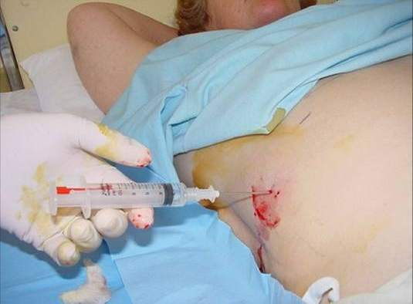
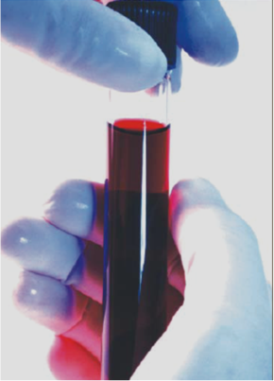
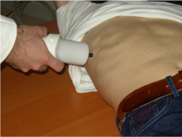
Fibrosis Assessment = Disease Severity
Liver Biopsy
Serum Biomarkers
FibroScan
Notes:
The last component of assessing patients is measuring the stage of liver disease or disease severity. The degree of liver fibrosis is the major component of assessing severity and is done either invasively e.g. liver biopsy or non-invasively with biomarkers or using transient elastography

Slide 30
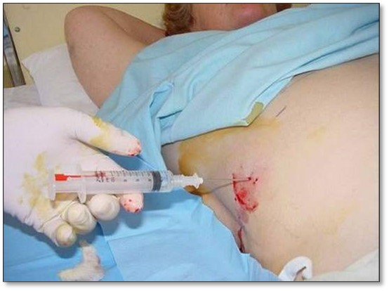
Liver Biopsy
Remains the gold standard
Invasive
Only test that can accurately assess:
  Severity of inflammation
  Degree of fibrosis
Notes:
The final way to assess liver disease severity in hepatitis C is with liver biopsy. This is the only test able to accurately assess severity of inflammation and degree of fibrosis. The problem is it is invasive and subject to sampling error. Also in sSA histopathology services are often unavailable.

Slide 31
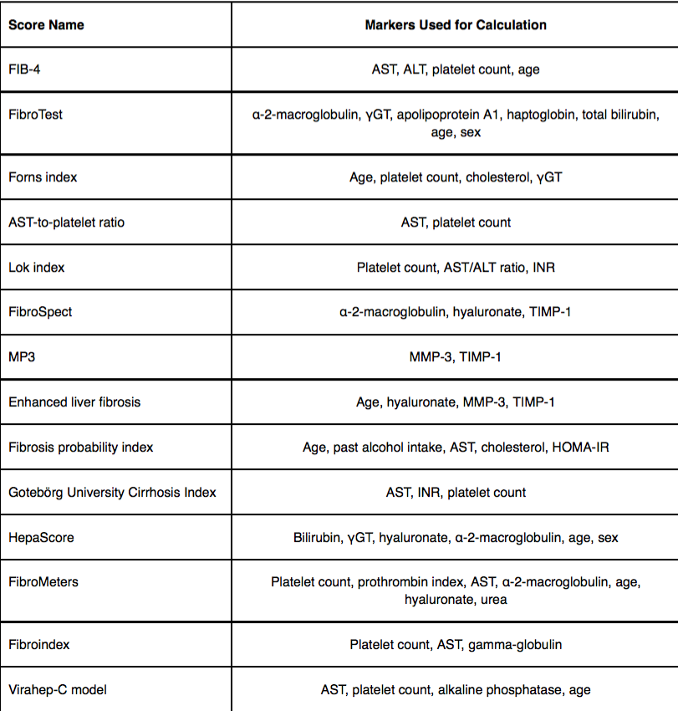
Noninvasive Serum-Based Biomarkers
FibroTest
  Combines 5 markers: α₂-macroglobulin, haptoglobin, GGT, total bilirubin, apolipoprotein A1
FibroSpect II
  Combines 3 markers: α2-macroglobulin,
  hyaluronic acid, tissue inhibitor of
  metalloproteinase-1
APRI
  AST-to-platelets ratio index
Forns fibrosis index
  Age, platelet count, GGT, cholesterol
FIB-4
  Combines 4 markers: platelets, ALT, AST, age
Notes:
ALT, alanine aminotransferase; APRI, aspartate aminotransferase–to-platelet ratio index; AST, aspartate aminotransferase; GGT, gamma-glutamyl transferase.
Several noninvasive serum‑based tests for the detection of fibrosis, some of which are included in this list and others in the table. These include the FibroTest, which combines 5 markers: alpha‑2 macroglobulin, haptoglobin, gamma-glutamyl transferase (GGT), total bilirubin and apolipoprotein A1; the FibroSpect II, which combines 3 markers: alpha‑2 macroglobulin, hyaluronic acid, and tissue inhibitor of metalloproteinase‑1; the aspartate aminotransferase to platelet ratio index (APRI), which is the aspartate aminotransferase (AST)–to‑platelets ratio index; the Forns fibrosis index, which combines age, platelet count, GGT, and cholesterol; and the FIB-4, which combines platelets, ALT, AST, and age.
These scores are best used at extremes of fibrosis. They can be easily calculated from daily biochemistry. Commonly used scores are FibroTest, Fib-4 and AST-to-platelet ratio.
Tests like APRI are cheaper and available are able to be done in resource constrained countries.

Slide 32
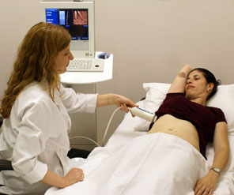
Transient Elastography
Noninvasive Alternative to Assess Liver Fibrosis
Elastography
  Ultrasound transducer probe induces
  elastic wave through the liver
  Velocity of the wave is evaluated in a region
  located from 2.5-6.5 cm below the skin surface
Liver biopsy is able to examine 1/50,000 of the liver, elastography is able to examine 1/500 of the liver
Potential confounders: visceral adiposity, steatosis, cholestasis, significant inflammation
Sensitivity is improved when combined with noninvasive biomarker scores
Examination time <10 minutes
Median value:
10 successful acquisitions
Notes:
With transient elastography, an ultrasound transducer probe induces an elastic wave through the liver. The velocity of the wave is then evaluated in a region that is located approximately 2.5-6.5 centimeters below the skin surface. The advantage of elastography compared with biopsy is that it may be able to examine, through multiple interrogation points and a larger volume of interrogation, upwards of 1/500th of the volume of the liver. Biopsy, on the other hand, is able to examine but a very small volume of the liver because it is a limited core.
Fibroscan also known as Transient Elastography was first approved by FDA in 2003. it is a quick non invasive procedure that requires minimal fasting (2hours). It is an ideal tool for resource limited areas, requires no admission and is performed as outpatient procedure that usually takes about 10 minutes. results are immediately available making it possible to decide there and there who warrants immediate attention.
Fibroscan, although costly as a single item, is very valuable in sSA to rapidly upscale therapy in guiding selection for treatment prioritization

Slide 33
HCV Treatment/Cure Landscape
Module 3

Slide 34
Learning Objectives
1. Describe the concept that achieving an SVR equates to a cure
2. Explain how SVR in patients with chronic HCV results in long-term clinical benefits
3. Review the first 2 decades of therapy with Peg-IFN and Ribavirin
4. Understand that interferon based therapy is unrealistic for many parts of Africa
5. Identify where in the lifecycle of HCV the new DAA therapies act
6. List the guiding principles of all oral DAA therapy
7. Express the indications for DAA therapy
8. Define adverse effects of specific DAA agents
9. Discuss how to avoid/manage drug-drug interactions

Slide 35
Aim of HCV Treatment = Cure
Notes:
The good news is that the primary aim of treatment for hepatitis c is to achieve a sustained virological response or SVR. Unlike HIV or HBV, the lifecycle of hepatitis c favours the development of resistance, not persistence (no genomic persistence of virus) and thus cure is possible rather than long term suppression.

Slide 36
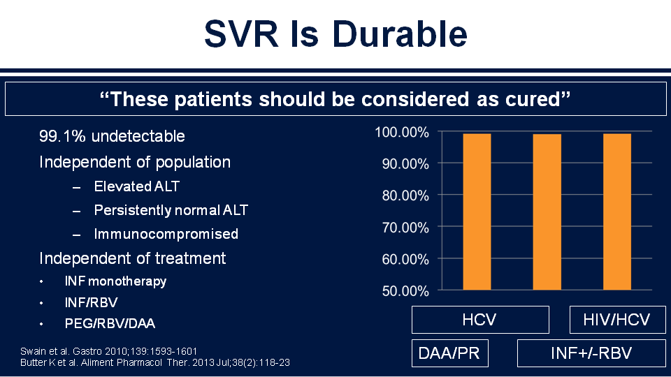
SVR is Durable
Notes:
Achieving an SVR (by whichever means) does equate to a cure as is shown in this slide. >99% of those achieving an SVR remain HCV RNA negative. More recent work from the sofosbuvir trials confirmed this suggesting that more than half of those who “relapsed” after achieving an SVR did so because of re-infection rather than viral relapse.

Slide 37
SVR (Cure) and Improved Outcomes
SVR
  Durable
  Improved quality of life
  Leads to improved histology
  Leads to clinical benefits
    Reduced risk of death
    Decreases decompensation
    Prevents de novo esophageal varices
    Decreases risk of hepatocellular carcinoma
Bruno S, et al. Hepatology. 2010;51:2069-2076. Veldt BJ, et al. Ann Intern Med. 2007;147:677-684. Maylin S, et al. Gastroenterology. 2008;135:821-829.
Notes:
SVR, as already noted, is durable. However it has long-term benefits in terms of liver related morbidity and mortality.

Slide 38
SVR (Cure) Improves Health
Advanced fibrosis
  Multicenter study^{[1]}
    5 hospitals (Europe, Canada)
  530 patients with HCV
    IFN regimens 1990-2003
    Advanced fibrosis or cirrhosis
    Median follow-up: 8.4 yrs
Early-stage disease
  Extra-hepatic manifestations^{[2]}
  Health-related quality of life^{[3]}
30
26
27.4
21.8
20
Percent
10
8.9
5.1
1.9
0
All cause mortality
Liver-related mortality or transplant
HCC
10-Yr Cumulative Incidence^{[1]}
SVR No SVR
1. van der Meer AJ, et al. JAMA. 2012;308:2584-2593. 2. van der Meer AJ. Expert Rev Gastroenterol Hepatol. 2015;9:559-566.
3. Younossi Z, et al. Clin Gastroenterol Hepatol. 2014;12:1349-1359.
Notes:
And so what do we gain by treating hepatitis C? This is the often-quoted study that was focused on patients with advanced fibrosis, and it was a multicenter study from 5 centers in Europe and Canada, in the interferon era with 530 patients who were treated with a median follow-up of 8.4 years. They looked at the 10-year cumulative incidence of events and saw reductions in liver cancer, liver-related morbidity/mortality with transplant, but also they saw a decrease in all-cause mortality. Hence the 10-year incidence is 26% down to 8.9%, so making the strong case that it’s more than just your liver, there’s a benefit to hepatitis C therapy.
But then what about the patients with early-stage disease? More and more data is accumulating – one sees a benefit from the extrahepatic manifestations and more in patient-reported outcomes looking at the quality of life of patients and seeing there are benefits in the early-stage as well.
In short, it is best to treat hepatitis C.

Slide 39
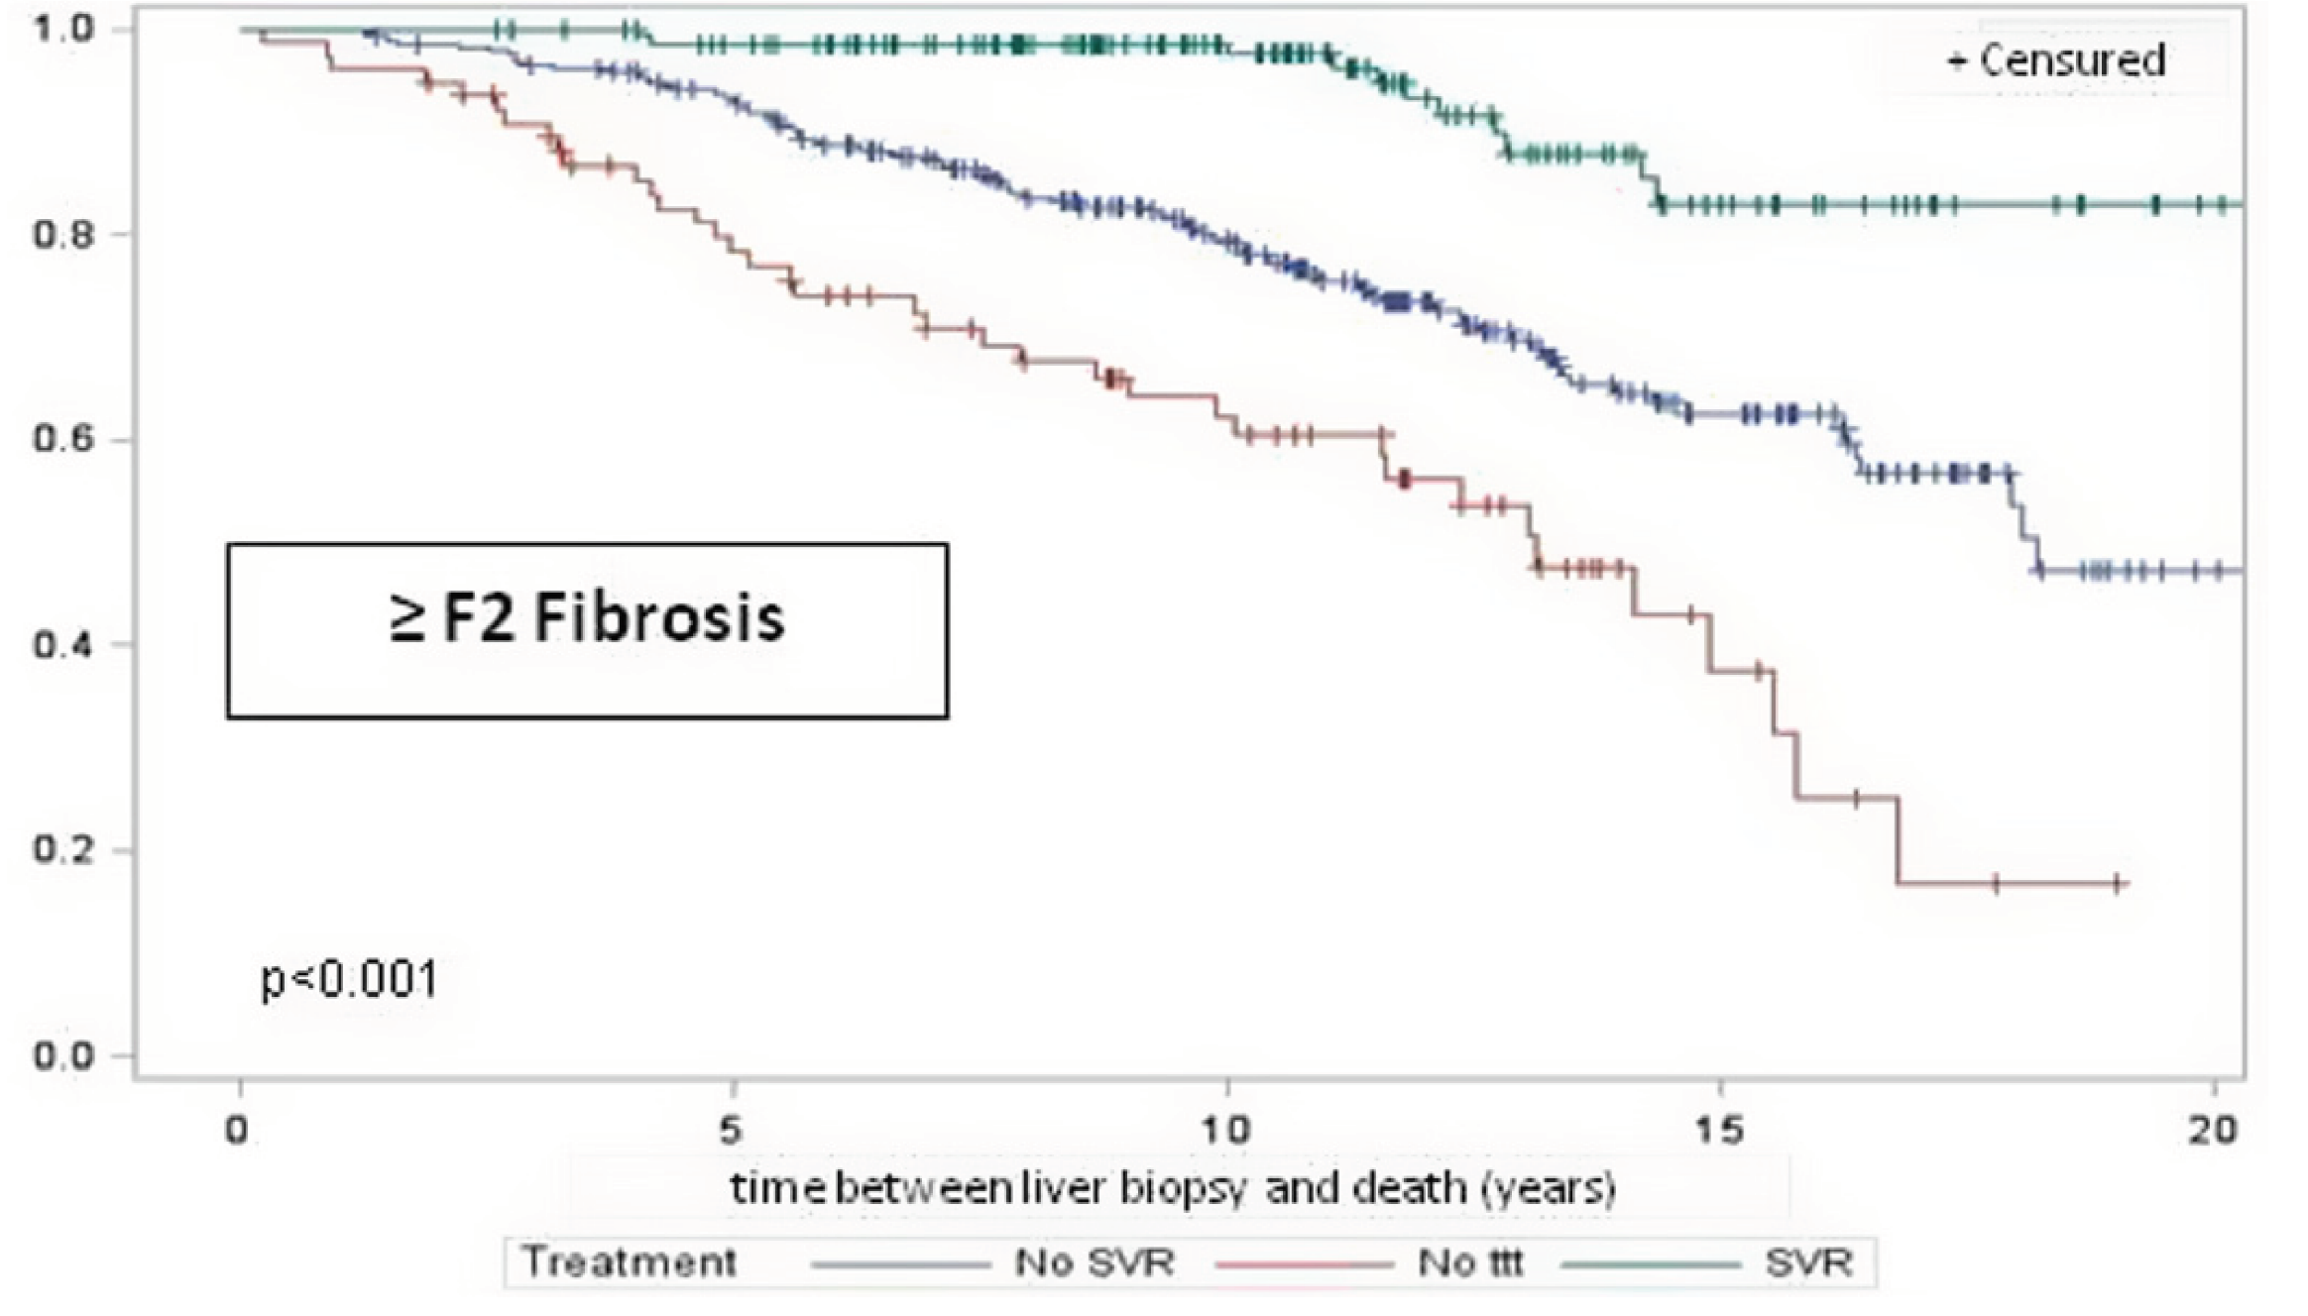
HCV Therapy in Patients with Marked Fibrosis?
83%
4,293 patients with chronic HCV from Rennes since 1992
biopsy at baseline, observation for 20 years in
n = 1,381 (52% GT1)
63%
Survival
38%
Jézéquel et al., EASL 2015, #P0709
Notes:
To further reinforce the benefit of treating patients, even with advanced disease, this very recent study presented at the recent EASL meeting demonstrated the benefit of treating beyond F2 fibrosis with those that achieve and those that doesn't achieve SVR has a very significant difference in long-term mortality.

Slide 40
PEG-IFN + RBV
All genotypes
PEG-IFN α2a + RBV
Treatment era of Pegylated-Interferon and Ribavirin summary (1989 – 2011):
SVR rates increase over time but 30–50% of patients do not achieve SVR
PEG-IFNα-2b + RBV
100
90
80
70
60
63%
66%
50
56%
SVR (%)
54%
40
30
20
10
n=511 453 436 134
0
n=
2001
2002
2004
2005
Manns¹
Fried²
Hadziyannis³
Zeuzem⁴
1. Manns M, et al. Lancet 2001; 358: 958; 2. Fried M, et al. N Engl J Med 2002; 347: 975;
3. Hadziyannis S, et al. Ann Intern Med 2004; 140: 346 4. Zeuzem S, et al. J Hepatol 2005; 43: 250
Notes:
The first 2 decades after the discovery of hepatitis C, treatment was initially interferon and later pegylated interferon and ribavirin based. SVR rates were initially very poor with interferon only therapy but with pegylated interferon and ribavirin, SVR rates increase over time however 30–50% of patients did not achieve SVR.
When one looks at the data, the percentage of patients achieving SVR steadily increased with the standard of care treatment of Peg-IFN and Ribavirin. In 2005 - 66% of patients treated achieved an SVR compared to 63% in 2004 and 56% in 2002.
In addition the side effect profile of interferon and need for monitoring whilst on therapy is substantial and not available in many countries in sub-Saharan Africa. This has made in need for easier to use, lower side effect profile and more efficacious therapies to be available.

Slide 41
HCV Lifecycle – DAA Targets
NS5A inhibitors
Block replication complex formation and assembly
Receptor binding
and endocytosis
Transport
and release
Fusion and
uncoating
Translation and
polyprotein processing
(+) RNA
ER lumen
Virion
assembly
LD
LD
NS3/4 protease inhibitors
LD
NS5B polymerase inhibitors
Nucleoside/nucleotide
Nonnucleoside
Membranous
web
ER lumen
RNA replication
Manns MP, et al. Nat Rev Drug Discov. 2007;6:991-1000.
Notes:
Unlike viruses such as HBV, hepatitis C has a number of potential drug targets that has lead to several classes of Direct-Acting Antivirals or DAAs being developed.
Looking at the schematic of the HCV life cycle, you can see that after the virus enters the cell, the viral RNA is translated into the viral proteins. These are the cleaved by the virally encoded protease. The first direct-acting antivirals were inhibitors of the NS3/4A protease.
Subsequently, the viral RNA is replicated via a viral NS5B polymerase. This is a second target with both nucleotide polymerase inhibitors and non-nucleotide or nonnucleoside polymerase inhibitors developed, acting via a different mechanism of action but targeting the same enzyme.
After viral replication, the virus must be assembled and part of the replication complex involved in assembly is the nonstructural 5A protein (NS5A). This forms the 3rd major DAA class.
In summary the DAAs consist of the 1. protease inhibitors, 2. nucleotide and non-nucleotide polymerase inhibitors (NS5B) and 3. NS5A inhibitors.

Slide 42
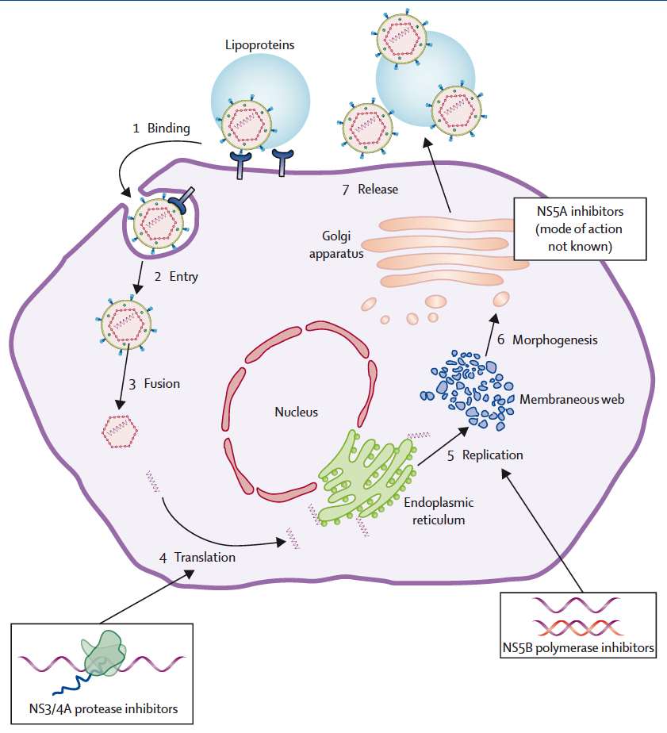
HCV Lifecycle – The DAAs
...asvir
Daclatasvir
Ledipasvir
Ombitasvir
...previr
Simeprevir
Paritaprevir/r
Asunaprevir
Telaprevir
Boceprevir
...buvir
Sofosbuvir
Dasabuvir
Cornberg M and Manns MP, Lancet 2014.
Notes:
The 3 major classes of DAAs currently in use include the Protease Inhibitors (suffixed by “previr”) and include the first generation Telaprevir/Boceprevir. These were add-on therapies to Peg-IFN and Ribavirin and whilst SVR rates improved to 75%, they were genotype 1 specific, had a high pill burden and compounded existing toxicities such as anaemia and potentially life threatening rash. This therapy in the sub-Saharan African context is completely unrealistic full stop. The first of the second generation protease inhibitors, was simeprevir, approved by the FDA in December 2013. Paritaprevir is used in conjunction with low dose ritonavir in a controlled but positive drug-drug interaction way so as to boost levels of paritaprevir. A similar example in HIV management is the use of ritonavir to boost Atazanavir levels.
NS5B polymerase inhibitors are suffixed by “buvir”. The nucleotide polymerase inhibitor Sofosbuvir, was approved by the FDA in December 2013 and has revolutionized hepatitis C management. The only non-nucleoside polymerase inhibitor currently in use is Dasabuvir.
He NS5A inhibitors are suffixed by “asvir” and include Daclatasvir, Ledipasvir and Ombitasvir.
Expected soon are the new Protease Inhibitor Grazoprevir and the new NS5A inhibitor Elbasvir.
Other classes of potential targets include antisense oligonucleotides such as Miravirsen and Cyclophilin Inhibitors.

Slide 43
Key Characteristics of the DAA Agents
C
E1
E2
p7
NS2
NS3
NS4A
NS4B
NS5A
NS5B
NS3/4A Protease Inhibitors (PI)
High potency
Limited genotypic coverage
Low barrier to resistance
NS5B Nucleos(t)ide Inhibitors (NI)
Intermediate potency
Pangenotypic coverage
High barrier to resistance
NS5A Inhibitors
High potency
Multigenotypic coverage
Low barrier to resistance
NS5B Nonnucleoside Inhibitors (NNI)
Intermediate potency
Limited genotypic coverage
Low barrier to resistance
Notes:
The NS3/4A protease inhibitors and the NS5A are both very potent inhibitors of hepatitis C replication, but the barriers to resistance are low. The NS5B nucleoside and nucleotide polymerase inhibitors have intermediate to high potency and a high barrier to resistance. The NI NS5B DAAs bind to the catalytic site and hence have a very high barrier to resistance. The non-nuc NS5B don’t bind directly to the polymerase at the active site and their barrier to resistance is lower.
Resistance to the DAAs can occur. With the NS3/4A protease inhibitors, resistance associated variants (RAVs) decline and by 48 weeks only 9% of the population of virus contains RAVs to protease inhibitors. However with NS5A inhibitors, RAVs are replication fit and persist indefinitely rendering a class effect and lack of future use of any NS5As should treatment fail. RAVs to Sofosbuvir are not replication fit and can be potentially reused again in future regimens.

Slide 44
DAAs in 2015/2016
Protease Inhibitors | Polymerase inhibitors |  | NS5A inhibitors
 | Nucleotide | Non-nucleoside
Telaprevir/ Boceprevir | Sofosbuvir | Dasabuvir | Daclatasvir
Simeprevir |  |  | Ledipasvir
Paritaprevir/ Ritonavir |  |  | Ombitasvir
Asunaprevir |  |  | Elbasvir
Grazoprevir |  |  | GS5816
Notes:
This lists the major DAAs in 2015/16 in a tabular form in their various classes. Telaprevir and Boceprevir were the first generation DAA Protease Inhibitors and dramatically improved SVR rates when added to Peg-IFN and Ribavirin. However they are difficult to use and were genotype 1 specific. In addition the pill burden is high and side effects with Peg-IFN and Ribavirin were additive and significant.
The first new generation DAA approved was Simeprevir and Sofosbuvir (circa December 2013). Following this the first NS5A inhibitor, Daclatasvir was released. The triple combination of Paritaprevir (Ritonavir boosted), Ombitasvir and Dasabuvir (so-called 3D) and the Fixed Dose Combo (FDC) of Sofosbuvir/Ledipasvir (Harvoni) has followed in late 2014/early 2015. By end 2015, the combination of Grazoprevir/Elbasvir is anticipated with the pangenotypic GS5816 expected in 2016.

Slide 45

The Treatment Landscape in 2015
Sofosbuvir + daclatasvir
2015
Agents
Sofosbuvir + ribavirin ± pegIFN
Ombitasvir/
paritaprevir/
ritonavir + dasabuvir
Simeprevir + sofosbuvir
Ledipasvir/ sofosbuvir
Notes:
In 2015 the treatment landscape looks something like this. We have sofosbuvir with ribavirin, sometimes with interferon although as I have said there is no role for this in sub-Saharan Africa. There is ledipasvir/sofosbuvir; ombitasvir/paritaprevir/ritonavir with dasabuvir; and simeprevir and sofosbuvir.
Sofosbuvir/daclatasvir is now approved in both the USA and Europe.

Slide 46
Oral DAA Regimens – Guiding Principles
Combine drugs from different classes
  Protease (NS3/4A) inhibitors
  Polymerase (NS5B) inhibitors
  NS5A inhibitors
Multiple drugs combined to produce greater efficacy and reduce risk of viral resistance (not unlike HIV ART)
Notes:
The underlying principles of therapy are very akin to what we have learnt in the treatment of HIV in that we use a combination of drugs from different classes to produce greater efficacy whilst reducing the risk of resistance.

Slide 47
Indications for HCV Treatment
Treatment prioritization needs to be applied in resource-limited settings
Treatment priority | Patient group
Treatment should be prioritized | . Patients with significant fibrosis (F3) or cirrhosis (F4), including decompensated cirrhosis . Patients with HIV coinfection . Patients with HBV coinfection . Patients with an indication for liver transplantation . Patients with HCV recurrence after liver transplantation . Patients with clinically significant extra-hepatic manifestations . Patients with debilitating fatigue . Individuals at risk of transmitting HCV
Treatment is justified | . Patients with moderate fibrosis (F2)
Treatment can be deferred | . Patients with no or mild disease (F0-F1) and none of the above-mentioned extra-hepatic manifestations
Treatment is not recommended | . Patients with limited life expectancy due to non-liver related comorbidities
Adapted from EASL Treatment Recommendations HCV, April 2015
Notes:
Essentially everyone who has hepatitis C should be treated. The benefits of treating hepatitis C outside of it causing liver disease, are many. However resource constraints are a reality and thus treatment should be prioritized. Those with the highest level of priority include advanced fibrosis/cirrhosis (F3 or F4), post organ transplant, hepatitis C related renal disease and cryoglubulinemia. Those with a high level of priority include HIV or HBV coinfected, co-existing other forms of liver disease, type 2 diabetes, F2 fibrosis or debilitating fatigue. There are still some groups of patients in whom treatment can be deferred especially those in whom even better treatments are still anticipated e.g. Chronic kidney disease.
So there’s been a lot of talk about whom to treat, and I think in general we would recommend that everybody with hepatitis C should get treated, and that is a clear statement that all of us would want to make. The AASLD/IDSA guidance group did look at the fact that there will be situations in which there are limitations on resources, and so how should you prioritize patients, and basically it’s on who’s most likely to have the complications in the near future. What we see with that is that the group with highest priority are those who already have advanced fibrosis (F3 or F4), those with organ transplants, and those with complications of some of the extrahepatic manifestations, whether it’s cryoglobulinemia or glomerulonephritis.
There are other groups with high priority, again based upon their risk for complications, including those with HIV, METAVIR F2, HBV coinfection, coexisting liver disease, type 2 diabetes, porphyria cutanea tarda, and also those with debilitating fatigue.

Slide 48
Treatment with Intent to
Prevent Transmission to Others
Active injection drug users
Incarcerated people
Men who have sex with men with high-risk sexual practices
Patients on long-term haemodialysis
HCV-infected women of childbearing age who wish to be pregnant
Notes:
This is a somewhat novel idea and suggests treatment for the listed risk groups as a means to prevent transmission to others and in so attenuate risks to others.

Slide 49
Adverse Effects of DAAs
3D
Rash
Sofosbuvir
Fatigue
SOF/LDV
Fatigue
Pruritis
Photosensitivity
Unconjugated hyperbilirubinemia
Fatigue
Nausea
Headache
Ribavirin
  Hemolytic anaemia
  Rash
  Insomnia
  Asthenia
  Teratogenic
Notes:
In general the DAAs are extremely well tolerated, and adverse effects, as listed, are infrequent occurring in < 10% of patients. The side effects are ribavirin are significant and hence Ribavirin free regimens are better tolerated.

Slide 50
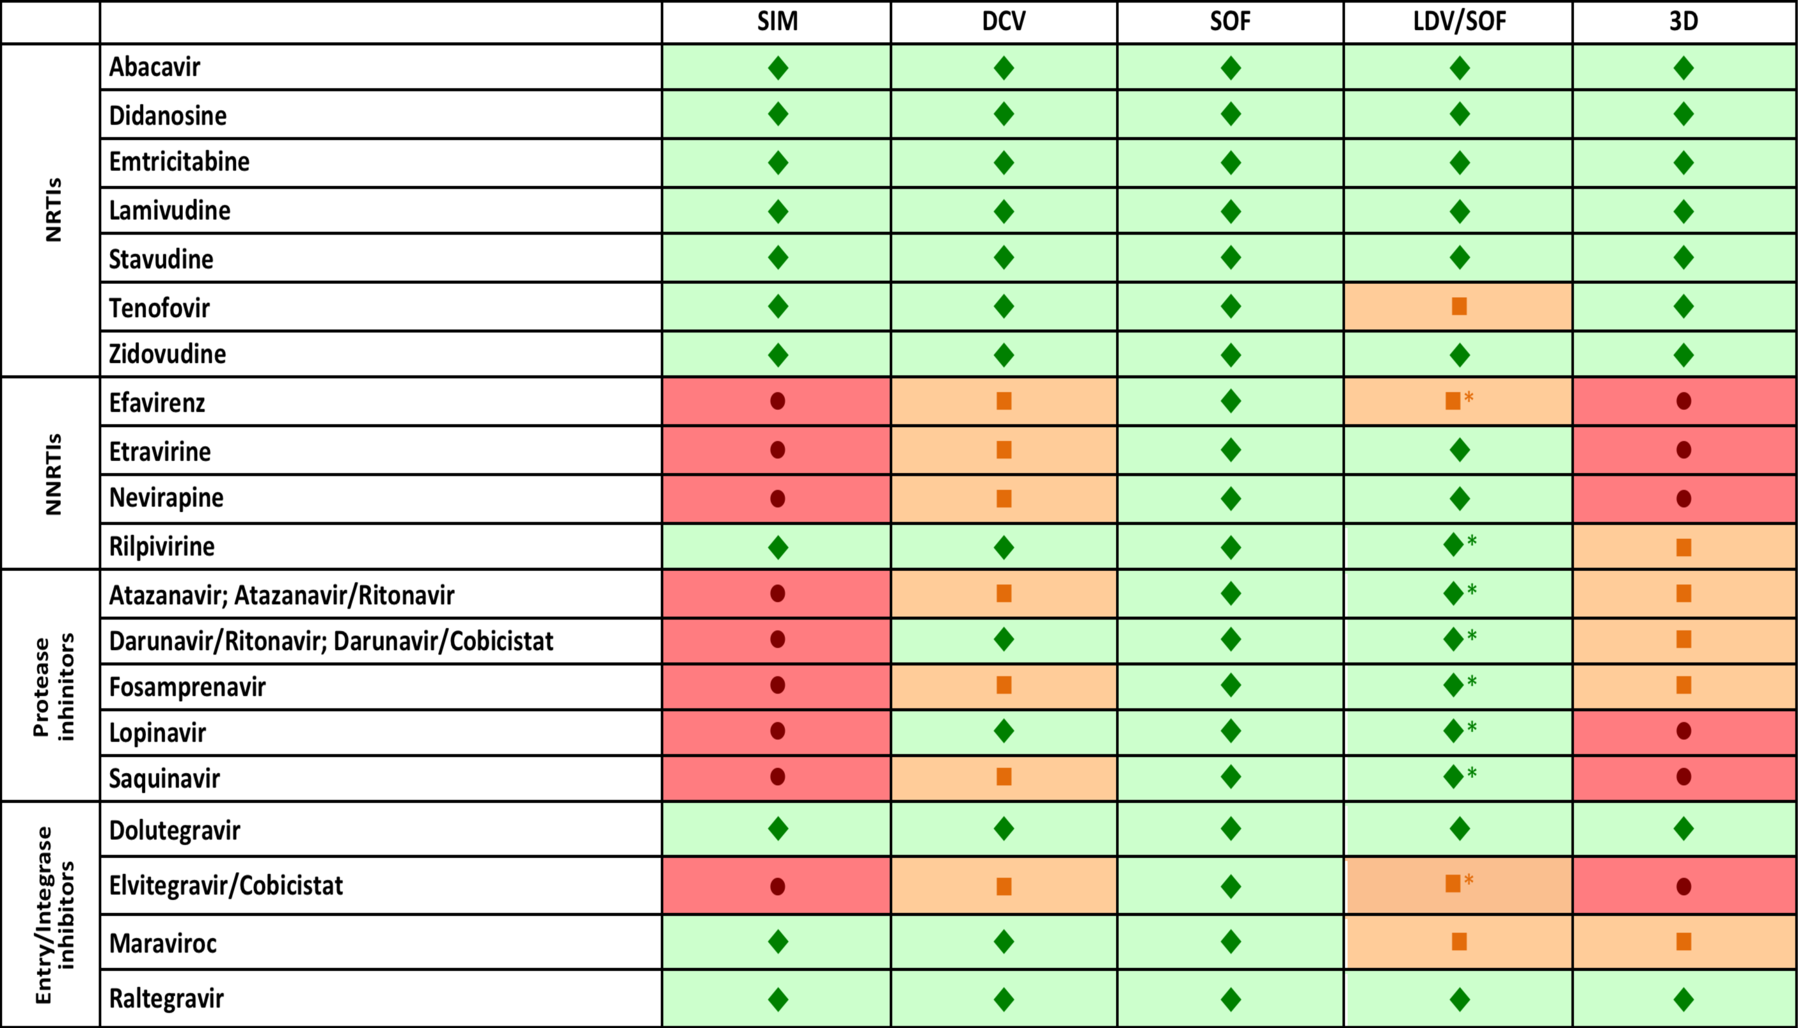
Drug-Drug Interactions with ARVs
Notes:
Drug drug interactions or DDIs are an important consideration with DAAs. These are a few examples on DDIs with ART. Hence a complete drug history is critical and using an online resource such as
http://www.hep-druginteractions.org
Is very useful and an absolute necessity in ensuring there are no adverse DDIs in your patient.

Slide 51
Immediate Future HCV Treatment Landscape
Sofosbuvir + GS-5816
Grazoprevir +
elbasvir
Daclatasvir + asunaprevir + beclabuvir
Sofosbuvir + daclatasvir
Paritaprevir/
ritonavir + dasabuvir + ombitasvir
Sofosbuvir + ribavirin
Sofosbuvir + ledipasvir
Simeprevir + sofosbuvir
Notes:
Coming soon and in development is sofosbuvir with GS-5816, which is a new NS5A inhibitor – a true pangenotypic regimen. Grazoprevir and elbasvir, a protease inhibitor with an NS5A inhibitor – will allow for much shorter durations in some patients.; and daclatasvir/asunaprevir/beclabuvir an NS5A inhibitor with a protease inhibitor and a nonnuc polymerase inhibitor –allowing for treatment without Ribavirin.
This highlights the VERY rapidly changing treatment environment.

Slide 52
Chronic HCV Treatment
Module 4

Slide 53
Learning Objectives
1. Describe the indications for HCV treatment
2. Identify what clinical data are needed to make a treatment decision
3. Explain treatment options for non-cirrhotic, cirrhotic, treatment-naïve, and treatment-experienced patients
4. State selected data that underpins HCV treatment options
5. Recognize what contributes to HCV treatment failures

Slide 54
Indications for HCV Treatment
Treatment prioritization needs to be applied in resource-limited settings
Treatment priority | Patient group
Treatment should be prioritized | . Patients with significant fibrosis (F3) or cirrhosis (F4), including decompensated cirrhosis . Patients with HIV coinfection . Patients with HBV coinfection . Patients with an indication for liver transplantation . Patients with HCV recurrence after liver transplantation . Patients with clinically significant extra-hepatic manifestations . Patients with debilitating fatigue . Individuals at risk of transmitting HCV
Treatment is justified | . Patients with moderate fibrosis (F2)
Treatment can be deferred | . Patients with no or mild disease (F0-F1) and none of the above-mentioned extra-hepatic manifestations
Treatment is not recommended | . Patients with limited life expectancy due to non-liver related comorbidities
Adapted from EASL Treatment Recommendations HCV, April 2015
Notes:
Essentially everyone who has hepatitis C should be treated. The benefits of treating hepatitis C outside of it causing liver disease, are many. However resource constraints are a reality and thus treatment should be prioritized. Those with the highest level of priority include advanced fibrosis/cirrhosis (F3 or F4), post organ transplant, hepatitis C related renal disease and cryoglubulinemia. Those with a high level of priority include HIV or HBV coinfected, co-existing other forms of liver disease, type 2 diabetes, F2 fibrosis or debilitating fatigue. There are still some groups of patients in whom treatment can be deferred especially those in whom even better treatments are still anticipated e.g. Chronic kidney disease.
So there’s been a lot of talk about whom to treat, and I think in general we would recommend that everybody with hepatitis C should get treated, and that is a clear statement that all of us would want to make. The AASLD/IDSA guidance group did look at the fact that there will be situations in which there are limitations on resources, and so how should you prioritize patients, and basically it’s on who’s most likely to have the complications in the near future. What we see with that is that the group with highest priority are those who already have advanced fibrosis (F3 or F4), those with organ transplants, and those with complications of some of the extrahepatic manifestations, whether it’s cryoglobulinemia or glomerulonephritis.
There are other groups with high priority, again based upon their risk for complications, including those with HIV, METAVIR F2, HBV coinfection, coexisting liver disease, type 2 diabetes, porphyria cutanea tarda, and also those with debilitating fatigue.

Slide 55
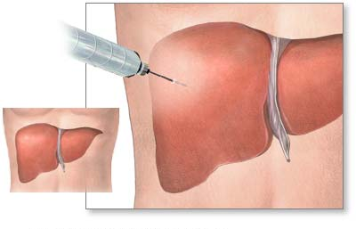
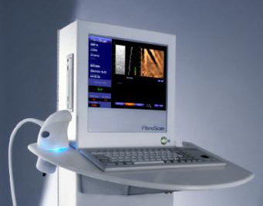
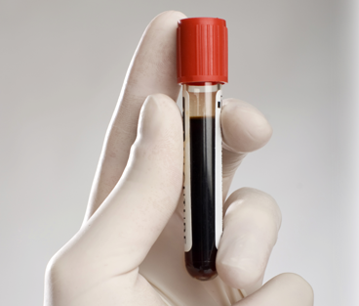
Important Data in Choosing a Regimen
HCV treatment history
  Peg-Interferon and ribavirin regimen?
  Previous Protease Inhibitor?
Fibrosis stage?
  Options for fibrosis assessment
  If cirrhosis, is it decompensated?
http://www.hcvguidelines.org
Notes:
Before we get into the actual treatment choices, there is some key information that is still required. Needed is the genotype and treatment history. If the patient has been treated with interferon and ribavirin in the past, that will impact the regimen and the duration potentially. First-generation of protease inhibitor exposure is very important to know, as that will guide treatment decision.
We need to know fibrosis stage. There are a number of ways this can be performed: liver biopsy, transient elastography, or biomarkers. Transient elastography (Fibroscan) is an attractive option in sub-Saharan Africa although cost remains a factor. If the patient has cirrhosis, then you’re going to want to know if they’re decompensated, and particularly if they have Child-Pugh B and C decompensated cirrhosis.

Slide 56
Non-Cirrhotic
*Treatment-Naïve or Peg-IFN/Ribavirin-Experienced Genotype 1, 4, 5
Regimen | HCV Genotype
 | 1a | 1b | 4 | 5
LDV/SOF | 8-12 wks,† no RBV |  | 12 wks, no RBV | 12 wks, no RBV
OBV/PTV/RTV + DSV | 12 wks + RBV | 12 wks, no RBV | Not recommended | Not recommended
OBV/PTV/RTV | Not recommended |  | 12 wks + RBV | Not recommended
SOF + SMV | 12 wks, no RBV |  | 12 wks, no RBV | Not recommended
SOF + DCV | 12 wks, no RBV |  | 12 wks, no RBV | 12 wks, no RBV
DCV, daclatasvir; DSV, dasabuvir; LDV, ledipasvir; OBV, ombitasvir; PTV, paritaprevir; RBV, ribavirin; RTV, ritonavir; SMV, simeprevir; SOF, sofosbuvir;
*Recommendations the same for HCV-monoinfected and HCV/HIV-coinfected patients.
†8 wks may be used in treatment-naïve patients without cirrhosis if baseline HCV RNA <6 million IU/mL, but should be done with caution, especially in patients with F3 fibrosis.
European Association for the Study of Liver Disease Hepatitis C Treatment Guidelines. April 2015.
Notes:
For now, it remains necessary to base treatment decisions on genotype (and sub-genotype) and whether the patient is cirrhotic or not. Additional factors include prior treatment, the presence of renal dysfunction and whether or not ribavirin is required and/or tolerated. Listed in the table (based on the EASL guidelines) are options for non-cirrhotic treatment naïve or PEG-RBV experienced patients. As a rule Ribavirin can be dropped from most regimens except when treating genotype 1a with the 3D combination of OBV/PTV/RTV/DSV. Treatment durations are mostly 12 weeks. Importantly treatment recommendations are equal for both mon and co-infected HCV patients with HIV highlighting the fact that HIV-HCV no longer constitutes a difficult to treat or cure group.

Slide 57
ION 1, 2, and 3
Sofosbuvir/Ledipasvir ± RBV in Treatment-Naïve and -Experienced GT 1 Patients
Naïve
Prior Rx (incl PI) failures
8 weeks adequate for noncirrhotic treatment-naive pts with HCV VL, 6 million IU/ml.
RBV provides no benefit.
No SOF resistance observed; most virologic failures have LDV resistance
98
97
99
99
100
94
96
94
93
95
80
60
SVR 12 (%)
40
20
209/
214
211/
217
102/
109
107/
111
108/
109
110/
111
202/
215
201/
216
206/
216
0
S/L
S/L/R
S/L
S/L/R
S/L
S/L/R
S/L
S/L/R
S/L
12 wks
12 wks
24 wks
8 wks
12 wks
1. Afdhal N, et al. N Engl J Med. 2014;370:1889-1898. 2. Afdhal N, et al. N Engl J Med. 2014;370:1483-1493. 3. Kowdley KV, et al. N Engl J Med. 2014;370:1879-1888.
Notes:
LDV, ledipasvir; PI, protease inhibitor; RBV or R, ribavirin; SOF, sofosbuvir; S/L, sofosbuvir/ledipasvir; S/L+R, sofosbuvir, ledipasvir, ribavirin; SVR, sustained virologic response;
This reviews the landmark ION studies with sofosbuvir, ledipasvir with and without ribavirin in treatment-naive patients and prior treatment failures.
ION 1 looked at treatment with sofosbuvir and ledipasvir with and without ribavirin for differing treatment durations of 12 and 24 weeks. SVR rates across the board were extremely high and the conclusion from ION 1 was that 12 weeks was just as effective as 24, that ribavirin was not necessary for treatment of these patients.
ION 3 took a slightly different approach and avoided patients that had cirrhosis and included so-called easier-to-treat patients with fibrosis stages of 0-3. These patients were randomized to receive either sofosbuvir plus ledipasvir—sofosbuvir plus ledipasvir plus ribavirin for 8 weeks and compared to a 12-week treatment course of sofosbuvir plus ledipasvir. What we saw here was a non-inferiority powered study that showed no inferiority between the regimens. However, numerically there was an increased rate of relapse in patients on the 8-week treatment compared to the 12-week treatment. Once again, ribavirin proved no benefit. No sofosbuvir resistance was observed and the most frequent virological failures did have NS5A resistance, which gives some resistance to ledipasvir.
The treatment failure patients in ION-2 were studied in a similar design to ION 1, with 12 vs 24 weeks with and without ribavirin, but these were patients that have failed prior interferon and ribavirin therapy, and in many cases, almost 60% had also failed a protease inhibitor such as telaprevir or boceprevir.
Here what we see is that in the 24-week arm, the SVR rate approached 100%. In the 12-week arms, what we observed was numerically a reduced rate of response of 94% and 96%. And there were some relapsers in the 12-week treatment arms. Again, ribavirin appeared to have no impact. When we look closer at these treatment failures, we find that the majority of these treatment failures actually had cirrhosis.

Slide 58
SAPPHIRE I & II
PTV/RTV/OBV + DSV + RBV for 12 Weeks in Non-Cirrhotic Patients
SAPPHIRE I: Naive Pts^{[1]}
SAPPHIRE II: P/R Failures (49% Nulls)^{[2]}
100
96
98
100
96
96
97
95
80
80
60
60
SVR12 (%)
SVR12 (%)
40
40
20
20
286/
297
n/N =
455/
473
307/
322
148/
151
n/N =
166/
173
119/
123
0
All
GT1a
GT1b
0
All
GT1a
GT1b
1. Feld J, et al. N Engl J Med. 2014;370:1594-1603. 2. Zeuzem S, et al. N Engl J Med. 2014;370:1604-1614.
Notes:
GT, genotype; OBV, ombitasvir; P/R, peginterferon/ribavirin; PTV, paritaprevir; RBV, ribavirin; RTV, ritonavir; SVR, sustained virologic response
This is data from SAPPHIRE I and SAPPHIRE II. And they both showed the same thing. Both naive patients and peg/ribavirin failures of whom 49% were null responders, but in whom there were no PI failures, had an excellent response rate of around 96%. It is a little bit more complicated since it is a 5-drug regimen, which consists of 3 pills in the morning, plus ribavirin, 1 pill in the evening plus ribavirin.

Slide 59
OPTIMIST-1
SVR by Patient Subgroup
Safety and tolerability consistent with previous reports
SMV + SOF 12 wks
SMV + SOF 8 wks
95
97
96
97
97
100
97
96
96
97
100
97
92
93
92
85
84
84
80
77
79
77
73
64
60
SVR12 (%)
40
20
n/N =
112/
115
88/
103
38/
40
40/
52
112/
116
92/
116
44/
46
36/49
68/70
56/67
38/39
36/39
43/43
38/41
83/86
72/86
24/26
18/28
54/56
46/48
96/99
82/107
0
Naive
Exp’d
1a
1a + Q80K
1a no Q80K
1b
CC
CT
TT
< 4 x 10⁶ IU/mL
≥ 4 x 10⁶ IU/mL
Tx History
HCV GT
IL28B GT
Baseline HCV RNA
Kwo P, et al. EASL 2015.
Notes:
GT, genotype; HCV, hepatitis C virus; SMV, simeprevir; SOF, sofosbuvir; SVR, sustained virologic response.
This complex data on the combination of Sofosbuvir and Simeprevir was presented at EASL 2015. It supports the use of this combination for 12 weeks – not 8 weeks. Factors such as IL28B genotype, genotype 1 subtype and baseline HCV RNA make is a complex regimen to use in sub-Saharna Africa.

Slide 60
Ledipasvir/Sofosbuvir for
12 weeks in GT4 or 5 HCV
Open-label, single-arm study: 12 wks LDV/SOF 90/400 mg QD
Treatment-naïve or -experienced with GT4 or 5 HCV, cirrhosis permitted
SVR12, % (n/N) | Genotype 4 | Genotype 5
All | 93 (41/44) | 95 (39/41)
Treatment-naive | 96 (21/22) | 95 (20/21)
Treatment-experienced | 91 (20/22) | 95 (19/20)
Non-cirrhotic | 91 (31/34) | 97 (31/32)
Cirrhotic | 100 (10/10) | 89 (8/9)
Abergel A, et al. EASL 2015. Abstract O056.
Notes:
GT, genotype; HCV, hepatitis C virus; LDV/SOF; ledipasvir/sofosbuvir; QD, once daily; SVR, sustained virologic response; Tx, treatment.
This was the first data to suggest that LDV/SOF is effective in GT 4 and 5 patients. Numbers small but no other data available.

Slide 61
Compensated Cirrhosis
*Treatment-Naive or Peg-IFN/Ribavirin-Experienced Genotype 1, 4, 5
Regimen | HCV Genotype
 | 1a |  | 1b | 4 | 5 or 6
LDV/SOF | 12 wks + RBV or 24 wks, no RBV or 24 wks + RBV if negative predictors |  |  | 12 wks + RBV or 24 wks, no RBV or 24 wks + RBV if negative predictors | 12 wks + RBV or 24 wks, no RBV or 24 wks + RBV if negative predictors
OBV/PTV/RTV + DSV | 24 wks + RBV | 12 wks + RBV |  | Not recommended | Not recommended
OBV/PTV/RTV | Not recommended |  |  | 24 wks + RBV | Not recommended
SOF + SMV | 12 wks + RBV or 24 wks, no RBV |  |  | 12 wks + RBV or 24 wks, no RBV | Not recommended
SOF + DCV | 12 wks + RBV or 24 wks, no RBV |  |  | 12 wks + RBV or 24 wks, no RBV | 12 wks + RBV or 24 wks, no RBV
DCV, daclatasvir; DSV, dasabuvir; LDV, ledipasvir; OBV, ombitasvir; PTV, paritaprevir; RBV, ribavirin; RTV, ritonavir; SMV, simeprevir; SOF, sofosbuvir;
*Recommendations the same for HCV-monoinfected and HCV/HIV-coinfected patients.
Notes:
In patients with compensated cirrhosis and genotype 1,4,or 5, extended periods of treatment are required (~24 weeks) and ribavirin is required in several regimens as add on therapy to improve response rates. Only 1 therapy is proven for decompensated cirrhosis viz. Sofosbuvir/Ledipasvir. This is demonstrated in the next slide.

Slide 62
Ledipasvir/Sofosbuvir + RBV in Patients with Child B/C Liver Cirrhosis
SOLAR-1
SOLAR-2
SVR12 (%)
26/30
22/26
24/27
24/25
19/22
17/21
18/20
14/20
LDV/SOF + RBV
12 wks
LDV/SOF + RBV
24 wks
LDV/SOF + RBV
12 wks
LDV/SOF + RBV
24 wks
CTP B
CTP C
Comparable efficacy between SOLAR-1 and SOLAR-2 studies
Notes:
In the small SOLAR studies, good response rates are seen with SOF/LDV in Childs B and less so with Child C cirrhosis.

Slide 63
Treatment-Naïve or Peg-IFN/
Ribavirin-Experienced GT 2 or 3
Regimen | No Cirrhosis |  | Compensated Cirrhosis (Child-Pugh A)
 | GT2 | GT3 | GT2 | GT3
SOF + RBV† | 12 wks | 24 wks | 16-20 wks | Not recommended
SOF + DCV | 12 wks, no RBV | 12 wks, no RBV | 12 wks, no RBV | 24 wks + RBV
DCV, daclatasvir; RBV, ribavirin; SOF, sofosbuvir
*Recommendations the same for HCV-monoinfected and HCV/HIV-coinfected pts.
†Best first-line option for genotype 2 HCV; other options may be useful in patients with GT 2 HCV who experience Rx failure on sofosbuvir plus ribavirin.
Suboptimal for genotype 3 HCV, particularly in patients with cirrhosis and previous failure of Peg-IFN/Ribavirin
Adapted from EASL Treatment Guidelines, April 2015.
Notes:
Genotype 2 infection essentially requires 12 weeks of Sofosbuvir and ribavirin. Extending therapy may be needed in those with cirrhosis although if the combination of Sofosbuvir and Daclatasvir is used, 12 weeks can suffice in both cirrhotics and non-cirrhotics. Genotype 3 remains a challenge and whilst similar combinations are used, extended periods of 24 weeks are required.

Slide 64
BOSON Study
SVR with SOF-Based Treatment in GT3 by
Treatment History and Cirrhosis Status
SOF + RBV 16 wks
SOF + RBV 24 wks
SOF + PegIFN/RBV 12 wks
90
96
91
94
100
83
82
82
86
76
77
80
57
47
60
SVR12 (%)
40
20
n/N =
58/
70
65/
72
68/
71
12/
21
18/
22
21/
23
41/
54
44/
54
49/
52
17/
36
26/
34
30/
35
0
No Cirrhosis
Cirrhosis
No Cirrhosis
Cirrhosis
Treatment-Naïve
Treatment-Experienced
Foster GR, et al. EASL 2015
Notes:
GT, genotype; pegIFN, peginterferon; RBV, ribavirin; SOF, sofosbuvir;
Genotype 3 needs to be focused on a little more. The BOSON study, presented at EASL 2015, looked at GT3 patients with different sofosbuvir regimen. It’s a randomized controlled trial. The patients could receive sofosbuvir and ribavirin for 16 weeks, sofosbuvir and ribavirin for 24 weeks, or sofosbuvir with peginterferon and ribavirin for 12 weeks. It includes treatment-experienced and treatment-naive patients with and without cirrhosis. And if we look across the groups — you see the 24-week group of sofosbuvir/ribavirin does quite well. BUT the best outcomes are when Interferon is added. This has implications fro current decision making but in the sub-Saharan African context, likely doesn’t apply – including the fact that GT 3 is an uncommon genotype.

Slide 65
Daclastavir + Sofosbuvir in
Treatment-Naïve and -Experienced GT 3 HCV
ALLY-3¹ study
Patients:
  Treatment-naïve and -experienced
    Prior sofosbuvir included
    Prior NS5A inhibitors excluded
  Cirrhosis: 21%
  2 open-label cohorts
  Phase III
Regimen:
  Daclatasvir + sofosbuvir once daily for 12 wwkes
No Cirrhosis Cirrhosis
100
97
94
80
69
58
60
SVR12 (%)
40
20
73
75
32
34
0
Naïve
Experienced
EASL recommendations for DCV + SOF in GT3²
  No cirrhosis: DCV + SOF for 12 weeks
  Compensated cirrhosis: DCV + SOF + RBV for 24 weeks
Notes:
DCV, daclatasvir; GT, genotype; HCV, hepatitis C virus; SOF, sofosbuvir
Daclatasvir and Sofosbuvir was recently FDA registered fro GT 3 and in the ALLY-3 there were treatment-naive and -experienced patients, some with prior sofosbuvir included as well. Cirrhosis in 21% of the patients. It was an open-label study with 2 cohorts receiving daclatasvir and sofosbuvir once daily for 12 weeks.
In patients without cirrhosis SVR rates of over 90% and typically in those with cirrhosis, whether naive or treatment experienced, lower response rates are observed. Hence it is recommended that for non -cirrhotics daclatasvir and sofosbuvir can be used for 12 weeks but with compensated cirrhosis, daclatasvir plus sofosbuvir plus ribavirin for 24 weeks is recommended.

Slide 66
Treatment Efficacy >90% in Most Patients
1
2
3
4
5/6
HCV Genotype
Notes:
Summary slide: this highlights most of the combinations
One can see that in the commonly used regimens, efficacy is beyond 90% in most of the regimens and >90% SVR has eseentially become the new benchmark.
OBV-PTV/r + DSB = 3D comibation
LDV+SOF = Ledipasvir + Sofosbuvir
SMV+SOF = Simeprevir + Sofosbuvir
SOF+RBV = Sofosbuvir + Ribavirin

Slide 67
Real-World Data – SVR <100%
How Should We Deal with DAA Failures?
Data from the English EAP in patients with decompensated liver cirrhosis
86 81 82 60 %
80 71 74 73 %
59 43 70 71 %
N 252 28 172 15
164 21 45 5
Foster et al, EASL 2015
Notes:
This fascinating data from EASL suggest that the SVR rates achieved in the trials is not necessarily duplicated in the real world. This highlights the importance of properly selecting patients for therapy to achieve maximum success so as to limit treatment failures.

Slide 68
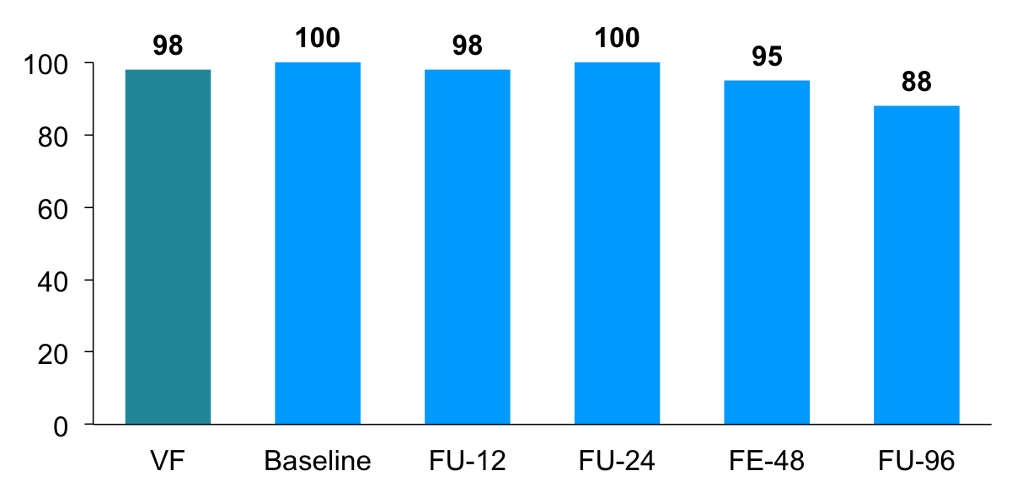
Therapy-Associated Resistance Variants:
Experiences from the Ledipasvir Trials
Registry studies with ledipasvir
Patients With NS5A RAVs (%)
62/63
58/58
42/43
45/45
58/61
56/64
Parent study
Registry study
NS5A RAVs persisted in majority of patients for 96 weeks
Wyles et al., EASL 2015
Notes:
This demonstrates that NS5A resistance mutations persist – defectively once you fail you have blown the use of further drugs from this class potentially. Decisions about retreatment are not easy and based on very limited data.

Slide 69
Retreatment of SOF/LDV Failures with 24 Weeks of SOF/LDV
24 wks. SOF/LDV after virological failure to SOF/LDV +/- RBV
n=41, cirrhosis n=19, failure to 8 (n=30) or 12 weeks (n=11) SOF/LDV +/-RBV
HCV RNA <LLOQ (%)
13/41
39/41
41/41
40/41
30/41
29/41
Lawitz et al., EASL 2015
Notes:
Relapse rates are high if you retreat with SOF/LDV for 24 weeks of treatment after initial treatment failure.

Slide 70
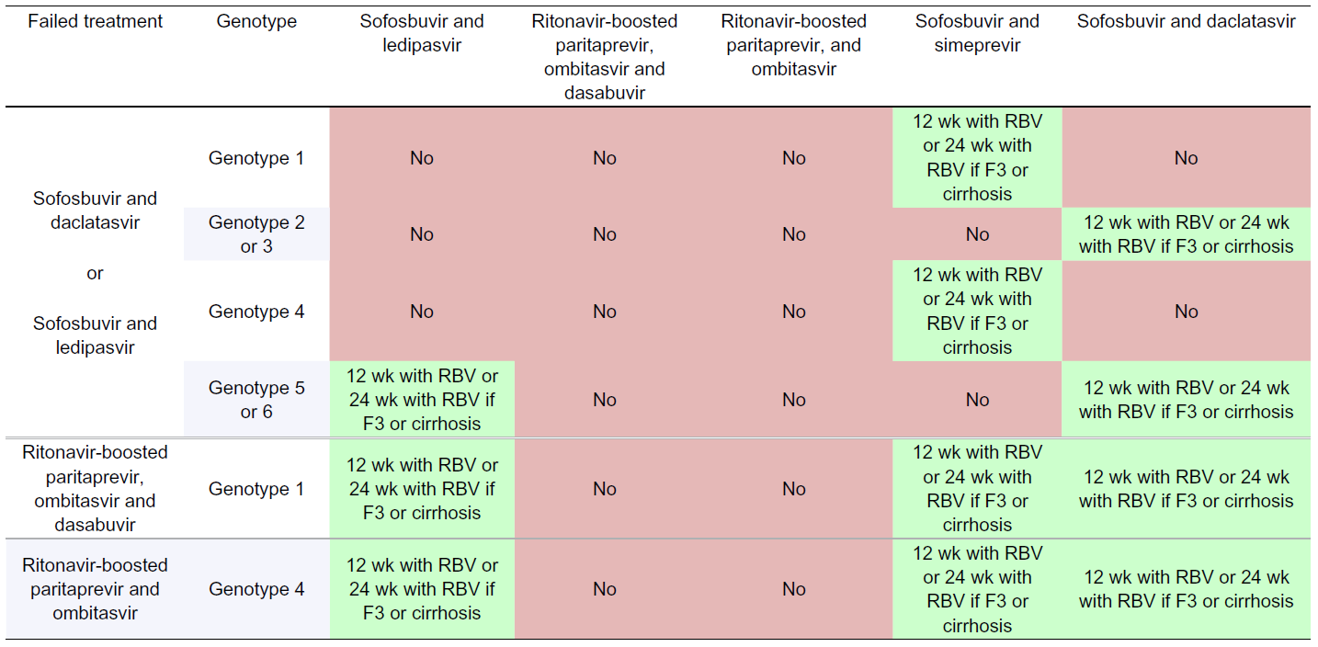
Retreatment after DAA Failure
EASL Treatment Recommendations HCV, April 2015
Notes:
These are the current recommendations for retreatment -this may change rapidly as new data becomes available

Slide 71
HCV Management in Specific Populations
Module 5

Slide 72
Learning Objectives
1. Understand the changing nature of difficult to treat and difficult to cure patients in the DAA era
2. Explain the difference between compensated and decompensated cirrhosis
3. Define chronic kidney disease and HCV-related impaired renal function
4. Identify management options for HCV/HIV coinfection
5. Describe the emerging problem of NS5A treatment failures

Slide 73
Changing Paradigm of Difficult to Cure/Treat HCV
 | PAST PEG-IFN/RIBAVIRIN ERA | PRESENT DAA ALL ORAL ERA
DIFFICULT TO CURE | Cirrhosis Genotype 1 High viral load IL28B TT Treatment experienced HIV Post transplant | Advanced/decompensated cirrhosis Genotype 3, advanced fibrosis/cirrhosis DAA failure
DIFFICULT TO TREAT | Elderly Decompensated cirrhosis Autoimmune disease IFN or Ribavirin intolerant | Chronic kidney disease/ESKD Potential Drug-Drug Interactions Ribavirin intolerant
DIFFICULT TO ACCESS |  | No access to new DAA therapies
Notes:
There has been a seismic change in the nature of those considered difficult to treat or cure in the PEG-IFN/RBV era of HCV therapy and now in the DAA era of chronic HCV infection.
Patients who posed great difficulty to achieve SVR in included all the typical features that were negatively predictive for SVR viz cirrhosis, G1, high VL, IL28B TT genotype, HIV co-infection or testament failures (e.g. null responders). Patients who were difficult to treat had contraindications to Interferon and/or Ribavirin viz. autoimmune disease, decompensated cirrhosis etc. This has changed significantly in the era of DAA HCV therapy. The difficult to treat group to achieve SVR has whittled down to those with advanced, decompensated disease and DAA failure. Patients in whom SVR is achievable but are more challenging to manage include those with renal dysfunction or in whom Ribavirin may be needed or where multiple concomitant drugs are still required (e.g. HIV ART etc) that pose a risk of drug-drug interactions with the potential to influence efficacy of the DAAs. It seems prudent also to raise the issue of access as a factor that creates “difficulty” in achieving SVR.

Slide 74
Special Populations
Compensated and decompensated cirrhosis
Impaired renal function
HCV/HIV coinfection
DAA failure
Notes:
This module will focus on 4 special populations as listed above. Currently the most challenging are decompensated cirrhosis and patients with DAA failure.

Slide 75
Patients with Cirrhosis
Patients with compensated disease (Childs-Pugh A, MELD < 15) achieve similar SVR rates to those without cirrhosis
SVR may prevent further decompensation
Decompensation associated with reduced response to therapy
Important to recognize clinical, laboratory, and radiological signs of decompensation:
  Worsening jaundice, ascites, INR increasing
AASLD/IDSA. HCV Management. http://www.hcvguidelines.org.
Notes:
The good news is that compensated cirrhotics pose less of a challenge to treat than do decompensated cirrhotics. More importantly achieving SVR in this population alters long term prognosis. Correctly assessing patients in terms of their clinical, Childs Pugh or MELD status is necessary as decompensation alters rates of achieving SVR.

Slide 76
Compensated Cirrhosis
Recommendations in Module 4
SVR rates almost equal to that of non-cirrhotics
Notes:
I will not repeat the management of compensated cirrhosis – that is covered in the treatment guidelines in Module 4. As has been stated, SVR rates are as effective although longer durations of treatment and/or the addition of Ribavirin may be required.

Slide 77
Effect of Treatment Duration and RBV with LDV/SOF in GT 1 Cirrhosis
Pooled data (ONESTAR, ELECTRON, ELECTRON-2, 337-0113, ION-1, ION-2, SIRIUS)
No difference in SVR rate by HCV subtype
12 wks of LDV/SOF
12 wks of LDV/SOF + RBV
24 wks of LDV/SOF
24 wks of LDV/SOF + RBV
98
100
98
97
100
96
98
100
100
92
96
96
90
80
60
SVR12 (%)
40
20
n =
118
204
133
58
47
45
33
36
71
159
100
22
0
Total
Treatment Naive
Treatment Experienced
Reddy KR, et al. Hepatology. 2015;62:79-86.
Notes:
GT, genotype; LDV, ledipasvir; RBV, ribavirin; SOF, sofosbuvir
This graph represents pooled data from a number of studies utilizing LDV/SOF and has extracted the patients with cirrhosis. It is got GT 1 only but demonstrates the point that compensated cirrhotics do as well as non-cirrhotics however may require longer periods of Rx ± the use of Ribavirin - especially treatment experienced patients.

Slide 78
Effect of Treatment Duration with
OMV/PTV/RTV + DSV in GT-1 Cirrhosis
OMV/PTV/RTV + DSV + RBV x 12 wks
OMV/PTV/RTV + DSV + RBV x 24 wks
GT1b
GT1a
100
100
100
100
100
100
100
100
100
100
100
92
93
93
93
86
80
80
60
SVR12 (%)
40
20
n/N =
22/22
18/
18
25/
25
20/
20
6/
7
3/
3
14/
14
10/
10
59/
64
52/
56
14/
15
13/
13
11/
11
10/
10
40/
50
39/
42
0
Naive
Relapser
Partial
Null
Naive
Relapser
Partial
Null
Tx Experienced
Tx Experienced
Poordad F, et al. N Engl J Med. 2014;370:1973-1982. Poordad F, et al. EASL 2014. Abstract O163.
Notes:
DSV, dasabuvir; GT, genotype; OMV, ombitasvir; PTV, paritaprevir; RBV, ribavirin; RTV, ritonavir.
This data demonstrates the outcome of compensated cirrhotics using the AbbVie 3D combination therapy viz. OMB/PTV/rtv plus DSV and RBV. The most striking feature are the excellent results with prior treatment failures and especially null responder cirrhotics who achieve SVR at high rates. This is a remarkable result in a group previously almost impossible to treat. Treatment experienced patients are stratified according to their mode of treatment failure previously.
Data is divided into GT 1a and 1b – demonstrating a reduction in SVR in null responder GT1a vs GT1b.
The need for GT1 subgenotyping thus exist when using this combination.

Slide 79
Daclatasvir and Sofosbuvir ± Ribavirin in GT1
Treatment naive or treatment experienced
GT1
All Genotypes
95
100
82
100
92
94
80
80
60
60
56
SVR12 (%)
40
40
20
37/45
39/41
20
n/N =
n/N =
11/
12
30/
32
9/
16
0
0
Advanced
Cirrhosis
Post-transplant
A
B
C
Child-Pugh Class
Poordad F, et al. EASL 2015. Abstract LO8. ALLY-1 study
Notes:
DCV, daclatasvir; GT, genotype; HCV, hepatitis C virus; RBV, ribavirin; SOF, sofosbuvir.
The data for SOF-DCV in the ALLY-1 study highlights that SVR is achievable in compensated cirrhosis but with advanced liver disease SVR rates fall – underpinning the difficulty that this group still poses.

Slide 80
Decompensated Cirrhosis:
AASLD/IDSA Recommendations
Refer to an experienced HCV practitioner (ideally liver transplant center)
Avoid IFN, TVR, BOC, SMV, OMV/PTV/RTV + DSV, or monotherapy with RBV or DAA
Population | RBV Eligible |  | RBV Ineligible
 | DCV + SOF | LDV/SOF | DCV + SOF
GT1/4 | 12 wks + low-dose RBV* | 12 wks + low-dose RBV* | 24 wks
GT1/4, SOF failure | Not recommended | 24 wks + low-dose RBV* | Not recommended
*Initial dose of 600 mg/day, increased as tolerated.
AASLD/IDSA. HCV guidelines.
Notes:
AASLD, American Association for the Study of Liver Diseases; IDSA, Infectious Diseases Society of America; BOC, boceprevir; DAA, direct-acting antiviral; DSV, dasabuvir; GT, genotype; HCV, hepatitis C virus; IFN, interferon; LDV, ledipasvir; OMV, ombitasvir; PTV, paritaprevir; RBV, ribavirin; RTV, ritonavir; SMV, simepravir; SOF, sofosbuvir; TVR, telaprevir.
These are the current Rx recommendations for decompensated disease for GT 1 and 4. If ribavirin can be used, 12 weeks of Rx is recommended. If not Rx is extended to 24 weeks. Any patients with prior SOF failure warrant 24 weeks with SOF/LDV. Supportive data follows in the next slide

Slide 81
Decompensated Cirrhosis: GT 1 and 4 Trial Data
LDV/SOF + RBV 12 wks
LDV/SOF + RBV 24 wks
100
87
89
86
90
100
96
87
85
80
80
72
60
60
SVR12 (%)
SVR12 (%)
40
40
20
26/ 30
24/ 27
19/ 22
18/ 20
20
20/23
22/23
17/20
13/18
n/N =
n/N =
0
0
CTP B
CTP C
CTP B
CTP C
SOLAR-1: GT 1 and 4^{[1]}
SOLAR-2: GT 1^{[2]}
1. Flamm SL, et al. AASLD 2014. Abstract 239. 2. Manns M, et al. EASL 2015. Abstract G02.
Notes:
CTP, Child-Turcotte-Pugh; LDV, ledipasvir; RBV, ribavirin; SOF, sofosbuvir.
Data from the SOLAR studies supports the recommendations of 12 vs. 24 weeks provided RBV is tolerated. Also again, as CTP worsens, so does SVR rate.
So in summary, decompensated liver disease remains better responsive that before In terms of SVR rates but is no where near the consistent >90% SVR rates seen in compensated disease. Furthermore this is the very group you want to achieve SVR in.

Slide 82
Hepatitis and Renal Disease
HCV infection can cause renal disease or be associated with renal disease
  Mixed cryoglobulinemia
  Membranoproliferative glomerulonephritis (MPGN)
  Polyarteritis nodosa
Possibly HCV associated
  Focal segmental glomerulosclerosis
  Proliferative or Membranous glomerulonephritis
HCV and diabetes association
HCV infection independently associated with increased mortality in hemodialysis patients
Increased rate of progression to cirrhosis and risk of hepatocellular cancer
1. Ozkok A, et al. World J Gastroenterol. 2014;20:7544-7554. 2. Saadoun D, et al. Arthritis Care Res (Hoboken). 2011;63:427-435. 3. Satapathy SK, et al. J Clin Exp Hepatol. 2014;4:8-13.
Notes:
HCV is associated with either glomerulonephritides or small vessel vasculitides such as cryglobulinemia that can all affect the kidney. HCV is also associated with large vessel vasculitis such as Polyarteritis Nodosa - equally affecting kidney function. HCV also has an association with Diabetes and thus a secondary cause of renal disease.
Renal disease complicates HCV therapy and in turn renal disease complicates liver disease in that it is associated with accelerated progression of liver disease.
To date managing HCV in renal disease has been very challenging. Using Peg-IFN was problematic and ribavirin associated anemia accentuated already existing anemia but in turn resulted in effect in having to use much lower RBV doses than what is ideal.
New data is now emerging in managing patients with renal disease.

Slide 83
OMV/PTV/RTV + DSV ± RBV in Treatment-Naive,
Non-Cirrhotic GT1 with CKD
Interim analysis of multicenter, open-label phase IIIb study in patients with eGFR <30 mL/min (N = 20)
  GT1a: OBV/PTV/RTV + DSV + RBV 200 mg daily for 12 weeks and GT1b: OBV/PTV/RTV + DSV for 12 weeks
SVR4: 10/10 pts reaching post-treatment week 4 - SVR12: 2/2 pts reaching post-treatment week 12
Pt | 1 | 2 | 3 | 4 | 5 | 6 | 7 | 8 | 9 | 10 | 11 | 12 | 13 | 14 | 15 | 16 | 17 | 18 | 19 | 20
GT | 1a | 1a | 1a | 1a | 1b | 1a | 1a | 1a | 1a | 1a | 1b | 1a | 1a | 1a | 1b | 1b | 1b | 1b | 1b | 1a
Renal Stage | 4 | 4 | 5 | 5 | 5 | 5 | 5 | 4 | 5 | 5 | 5 | 5 | 4 | 4 | 5 | 4 | 5 | 5 | 5 | 5
BL (x 1000) | 746 | 25300 | 17100 | 3520 | 2980 | 429 | 1730 | 43300 | 12600 | 6670 | 9820 | 292 | 6980 | 2570 | 3680 | 383 | 1230 | 6500 | 1850 | 4210
W1
W2
W4
W8
W12EOT
PTW4
PTW12
PTW24
HCV RNA:
≥ 25 IU/mL
< 25 IU/mL
Undetectable
Pockros PJ, et al. EASL 2015. Abstract L01 – RUBY-1 study
Notes:
BL, baseline; CKD, chronic kidney disease; DSV, dasabuvir; EOT, end of treatment; GT, genotype; OMV, ombitasvir; PTV, paritaprevir; PTW, posttreatment week; RBV, ribavirin; RTV, ritonavir; SVR, sustained virologic response; Tx, treatment; W, week.
A recent study, the RUBY-1 study, was reported at the EASL meeting. 20 patients with GT 1 infection were treated with the 3D combo plus very low dose RBV – in advanced CKD stages . Strikingly the majority were virally undetectable at 4 weeks on Rx. Almost half, had 4 week data post EOT and all had SVR. Only 2 patients had reached 12 weeks post EOT – both had SVR.
This data is promising – more data in the next slide

Slide 84
Hematologic Effect of RBV and Overall Safety
No Rx-related serious side effects, discontinuations, or significant changes in liver or renal function to date
  2 reported serious AEs not attributable to study treatment
Most AEs mild to moderate
RBV dose interruption in 8/13 GT1a pts (6 in first 4 weeks)
3
GT1b (DAA only)
2
GT1a (DAA + RBV)
1
Mean Hb Change From Baseline (g/dL)
AEs Occurring in > 3 Pts, n | GT1a: OBV/PTV/RTV + DSV + RBV (n = 13) | GT1b: OBV/PTV/ RTV + DSV (n = 7)
Anemia | 8 | 0
Fatigue | 4 | 2
Diarrhea | 4 | 1
Nausea | 5 | 0
0
-1
-2
-3
W1
W4
W2
BL
W3
W6
W8
PTW4
W12/EOT
GT1b: n =
7
7
7
7
7
7
5
2
2
GT1a: n =
13
13
13
13
13
12
12
12
9
Pockros PJ, et al. EASL 2015. Abstract L01.
Notes:
BL, baseline; DAA, direct-acting antiviral; DSV, dasabuvir; EOT, end of treatment; GT, genotype; OBV/PTV/RTV, ombitasvir/paritaprevir/ritonavir; RBV, ribavirin; SAE, serious adverse effect; tx, treatment.
In the study, no serious AEs were reported. Unsurprisingly anemia did occur in those on RBV but no discontinuations occurred.

Slide 85
Dosing Recommendations in Renal Impairment
OBV/PTV/RTV + DSV: No dose adjustment required with mild, moderate, or severe renal impairment (CrCl ≥ 15 mL/min)
LDV/SOF and SMV + SOF: No dose adjustment required with mild or moderate renal impairment (CrCl≥30mL/min)
  Safety and efficacy not established in severe renal impairment or hemodialysis
DCV: No dose adjustment required with any degree of renal impairment (CrCl: ≥15 mL/min)
RBV: Dose adjustment required for CrCl <50 mL/min
CrCl | RBV Dose
30-50 mL/min | Alternating 200 mg and 400 mg every other day
< 30 mL/min | 200 mg/day
Hemodialysis | 200 mg/day
AASLD/IDSA. HCV guidelines.
Notes:
DSV, dasabuvir; CrCl, creatinine clearance; eGFR, estimated glomerular filtration rate; LDV, ledipasvir; OBV, ombitasvir; PTV, paritaprevir; RBV, ribavirin; RTV, ritonavir; SOF, sofosbuvir.
Listed are the current AASLD/IDA recommendations for dosing of DAAs in renal impairment. Notably the major issue is RBV dosing when used.

Slide 86
HCV/HIV Coinfection
No longer considered difficult to cure
Same recommendations as in HCV mono-infected patients
Consider drug–drug interactions
  Avoid combination of LDV and tenofovir if CrCl < 60 mL/min or if receiving tenofovir with RTV-boosted PIs
  When LDV/SOF and tenofovir are co-administered with ART - monitor for nephrotoxicity
  Adjust/withhold RTV if receiving a boosted PI with OMV/PTV/RTV + DSV
  Adjust DCV with atazanavir/RTV, efavirenz, or etravirine
DCV + SOF ± RBV is recommended when ART regimen changes cannot be made to accommodate other DAAs
AASLD/IDSA. HCV guidelines.
Notes:
AASLD, American Association for the Study of Liver Diseases; ART, antiretroviral therapy; CrCl, creatinine clearance; DAA, direct-acting antiviral; DCV, daclatasvir; DSV, dasabuvir; HCV, hepatitis C virus; IDSA, Infectious Diseases Society of America; LDV, ledipasvir; OMV, ombitasvir; PI, protease inhibitor; PTV, paritaprevir; RTV, ritonavir; SMV, simepravir.
Basic principles in managing HIV-HCV are as listed. As noted, co-infection no longer poses a significant problem to treat as SVR rates approximate those of mon-infected patients. Challenges arise with drug-drug interactions and if significant, DCV-SOF becomes a default option.

Slide 87
LDV/SOF for 12 Weeks in HCV/HIV Coinfection
GT1 or 4 HCV, 20% with compensated cirrhosis, 55% treatment experienced
100
96
95
97
96
94
80
60
SVR12 (%)
40
20
n/N =
321/
335
142/
150
179/
185
258/
268
63/
67
0
Overall
Naive
Exp’d
No
Cirrhosis
Cirrhosis
Naggie S, et al. CROI 2015. Abstract 152LB – ION-4 study
Notes:
GT, genotype; HCV, hepatitis C virus; LDV, ledipasvir; SOF, sofosbuvir; SVR, sustained virologic response.
LDV/SOF in co-infected in the ION-4 study underlines the issue of SVR rates being equal to mono-infection. This is similar for treatment naïve vs. treatment experienced patients as well as in compensated cirrhosis. This is for Gt 1 and 4 patients

Slide 88
OMV/PTV/RTV + DSV + RBV for 12 vs 24 Weeks in GT1 HCV/HIV Coinfection
65% HCV treatment-naïve patients in 12-week arm, 69% in 24-week arm
19% patients with METAVIR F4 fibrosis
100
97
97
94
OMV/PTV/RTV + DSV + RBV 12 weeks
OMV/PTV/RTV + DSV + RBV 24 weeks
91
80
60
Pts (%)
40
20
n/N =
30/31
31/32
29/31
29/32
0
EOTR
SVR12
Sulkowski M, et al. JAMA. 2015;313:1223-1231
Notes:
DSV, dasabuvir; EOTR, end-of-treatment response; GT, genotype; HCV, hepatitis C virus; OMV, ombitasvir; PTV, paritaprevir; RBV, ribavirin; RTV, ritonavir.
Similar data is seen in using the Abbvie 3D combo in GT-1 patients. This trial included patients who were cirrhotic as well (19%). 24 weeks of Rx had a reduced rate of rer

Slide 89
SOF + DCV in HCV/HIV Coinfection
GT1
GT1-4
100
96
98
97
98
80
76
76
60
SVR12 (%)
40
20
n/N =
80/83
43/44
31/41
98/101
51/52
38/50
0
12-Wk
Naïve
12-Wk
Exp’d
8-Wk
Naïve
12-Wk
Naïve
12-Wk
Exp’d
8-Wk
Naïve
N Engl J Med. 2015;373:714-25
Wyles DL, et al. NEJM 2015;373:714-25.
Notes:
DCV, daclatasvir; GT, genotype; HCV, hepatitis C virus; SOF, sofosbuvir.
The ALLY-2 study demonstrated the need for 12 weeks of Rx with DCV-SOF but this trial did include GT 1,2,3 and 4. Reducing to 8 weeks increased the relapse rate.

Slide 90
Treatment Failure with NS5A Inhibitor
AASLD/IDSA Recommendations for GT-1
If minimal liver disease, defer treatment, pending further data
If cirrhotic or treatment otherwise urgent, resistance testing for RAVs that confer decreased susceptibility to NS3 PIs, NS5As recommended
  If both NS5A and NS3 RAVs detected, treatment within clinical trial recommended
Previous Treatment, Cirrhosis Status | DCV + SOF | LDV/SOF | OMV/PTV/RTV + DSV | SMV + SOF
NS5A, cirrhosis or urgent treatment required | Not recommended | If no NS5A RAVs: 24 wks + RBV | Not recommended | If NS5A RAVs but no NS3 RAVs: 24 wks + RBV
AASLD/IDSA. HCV guidelines.
Notes:
AASLD, American Association for the Study of Liver Diseases; DCV, daclatasvir; DSV, dasabuvir; GT, genotype; HCV, hepatitis C virus; IDSA, Infectious Diseases Society of America; LDV, ledipasvir; OMV, ombitasvir; PTV, paritaprevir; RAV, resistance associated variant; RBV, ribavirin; RTV, ritonavir; SMV, simeprevir; SOF, sofosbuvir.
This is early days for the potential emerging problem with those who fail DAA Rx. This slide is a snapshot for NS5A resistance.
RAV testing is needed and for many countries in the developing world, this will simply not be possible. Where available, it guides further treatment options as listed.

