Slide 1
HBV Clinical Management
[TRAINER(S) NAME(S)]

Slide 2




IAPAC African Regional Capacity-Building Hub
  Based in Johannesburg, South Africa
  Mission: Strengthen clinician capacity to deliver HIV, HBV, and HCV treatment
  Partners include:
Supported through an educational grant from:

Slide 3
Hepatitis B Virology
Module 1

Slide 4
Learning Objectives
Understand HBV characteristics
Describe the HBV replication cycle
Discuss HBV genotype distribution and impact
Explain clinical significance of HBV genotypes and subgenotypes
Define serologic and immunologic markers of HBV infection

Slide 5
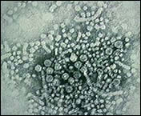
Hepatitis B Virus
Enveloped partially dsDNA virus
Member of the Hepadnaviridae family
Found in blood and all body fluids
100 times more infectious than HIV
Able to survive in dried blood for longer than 1 week
Notes:
Characteristics of hepadnaviridae viruses: 1) small viruses, 2) possess DNA-dependent polymerases and 3) have reverse transcriptase properties.

Slide 6
HBV Genome
Hepadnavirus
3213
Enveloped partially dsDNA virus (42nm)
Compact genomic structure (± 3.2 kb)
4 overlapping open reading frames
Reverse transcriptase/ DNA polymerase domain overlaps with surface gene
Encodes 4 sets of viral proteins – HBsAg, HB core Ag, viral polymerase and HBx protein
preS2
157
preS1
2856
polymerase
S
EcoRI
3221, 1
2458
YMDD
(+)
834
2309
RNA
primer
(-)
DR1
DR2
core
1903
1622
1376
precore
1816
1837
X
MMWR. 2003;52:1-33. Ott MJ and Aruda M. J Pediatr Health Care. 1999;13:211-216; Ribeiro RM, et al. Microbes and Infection. 2002;4:829-835
Notes:
The HBV genome is composed of 4 overlapping open reading frames. It’s reverse transcriptase/DNA polymerase domain overlaps with the gene encoding the Hepatitis B surface antigen. The genome encodes HBsAg, HBcAg, the viral polymerase and the HBx protein. The virus circulates in serum as a 42-nm, double-shelled particle, with an outer envelope component of HBsAg and an inner nucleocapsid component of hepatitis B core antigen (HBcAg). HBV DNA can be detected in serum and is used to monitor viral replication. HBeAg, unlike HBsAg and HBcAg, is not particulate, but rather is detectable as a soluble protein in serum.
6

Slide 7
HBV Replication Cycle
HBV virions bind to the hepatocyte receptor – sodium taurocholate co-transporting polypeptide – and are internalized
In nucleus genome repaired to form cccDNA
Translation of viral mRNA to proteins in cytoplasm
NEJM March 2004, 350;11
Notes:
Following acute exposure, HBV enters the hepatocyte via binding to receptor sodium taurocholate co-transporting polypeptide, is internalised and translocates to the nucleus.
In the nucleus, partially dsDNA is converted into covalently closed circular DNA (extrachromosomal cccDNA). cccDNA is the transcriptional template for viral mRNAs. Translation occurs in the cytoplasm resulting in the polymerase, core and pre-core, envelope and x proteins. In the Endoplasmic reticulum, the genome is packaged together with polymerase and a protein kinase into core particles where it serves as a template for reverse transcription of the negative strand of DNA. Then RNA is reverse transcribed. New virions are secreted from the cell via the Golgi apparatus or in another pathway, the nucleocapsids deliver their genome to the nucleus thus replenishing the intranuclear pool of covalently closed circular DNA (cccDNA). This makes the clearance of HBV very difficult, even with antiviral therapies, compared to HCV infection which can be cured.

Slide 8
HBV Replication Cycle (continued)
Incorporation into ER and reverse transcription of RNA
Budding and secretion of of viral cores to ER, and packaging in Golgi apparatus or
Recycling of genome to nucleus with repletion of intranuclear cccDNA
NEJM March 2004, 350;11

Slide 9

Geographic
Distribution:
HBV
Genotypes
Alexandra Valsamakis Clin. Microbiol.
Rev. 2007;20:426-439
Notes:
Geographic distribution of HBV genotypes. Letter sizes indicate relative prevalences in regions with multiple genotypes.

Slide 10
HBV
Genotypes in Africa
Hepatology Research 2007; 37: S9-19

Slide 11
Impact of HBV Genotype on
Disease Progression
Genotype C
  More frequently associated with severe liver
  disease and HCC than genotype B
Genotype
  Associated with seroconversion from HBeAg
  to anti-HBe at younger age than genotype C
Genotypes A and B
  Higher rates of antiviral response and HBeAg loss following pegIFN alfa than genotypes D and C
HBV Genotyping
Line Probe Assay
Marker line
Conj. control
1
Amp. control
2
3
Genotype A
4
5
Genotype B
6
7
Genotype C
8
9
Genotype D
10
11
Genotype E
12
13
Genotype F
14
15
Genotype G
16
Keeffe EB, et al. Clin Gastroenterol Hepatol. 2006;4:936-962.
Notes:
11
11
anti-HBe, hepatitis B e antigen antibody; HBeAg, hepatitis B e antigen; HBV, hepatitis B virus; HCC, hepatocellular carcinoma.
The impact of HBV genotype on disease progression in patients with chronic hepatitis B.
Genotype C, which is common in Asia, is more frequently associated with severe liver disease and occurrence of hepatocellular carcinoma than genotype B. Genotype B, also common in Asia, is associated with seroconversion from HBeAg positive to anti‑HBe at a younger age than those patients with genotype C. Both genotype A, which is common in the United States and Western Europe, and genotype B are associated with higher rates of antiviral response and loss of HBeAg in response to peginterferon alfa therapy than genotypes D or C.

Slide 12
sSA: HBV Genotypes and Subgenotypes
Clinical Outcomes
Genotypes A, D and E: Predominant hepatitis B genotypes in Africa
Genotype A accounts for 90% of HBV infections in Southern, Eastern, and Central Africa
mean age of those infected with genotype A was 6.5 years younger than those with non-A
predisposes to chronicity with an elevated risk of HCC
increased response rates to IFN

Slide 13
sSA: HBV Genotypes and Subgenotypes
Clinical Outcomes (continued)
Genotype D – reduced response rates to IFN; acute infection
associated with increased risk of ALF
Genotype E – West Africa
Genotypes D, A, F and (in Asia) B – higher rates of HBeAg seroconversion
[

Slide 14
sSA: HBV Genotypes and Subgenotypes
Clinical Outcomes (continued)
HBV Sub-Genotypes in Africa
South Africa (A,D): A1, A2, A3
CAR (A,D,E): A1, D4
Gambia, Nigeria, Congo, Rwanda, Cameroon (A): A4, A5, A6, A7
Morocco (A,D): D1, D7, A2
Egypt (D): D1
Tunisia (D,F)
Clinical Outcomes
Carriers with subgenotype A1 have lower HBV DNA than subgenotype A2 or genotype D
Relative risk of HCC is 4 times higher with subgenotype A1 than non-A

Slide 15
HBV Genotypes: Clinical Outcomes
Genotypes B and C Common in Asia
From UpToDate – adapted from Anna SF Lok, MD and Chi Jen Chu, MD

Slide 16
HBV Serologic Markers
HBsAg
General infection marker
First serologic marker to appear
Infection considered chronic if persistent for > 6 months
Indicative of number of infected hepatocytes
HBeAg
Indicates active replication of virus – high infectivity
Nucleocapsid antigen
Absent in precore or basal core promoter mutations
Notes:
16
anti-HBc/HBcAb, hepatitis B core antigen antibody; anti-HBe/HBeAb, hepatitis B e antigen antibody; anti-HBs/HBsAb, hepatitis B surface antigen antibody; HBeAg, hepatitis B e antigen; HBsAg, hepatitis B surface antigen; HBV, hepatitis B virus.
Hepatitis B surface antigen is the general hepatitis B infection marker and the first serologic marker to appear. The definition of chronic hepatitis B is the presence of HBsAg for more than 6 months. The presence of HBeAg indicates active replication of the virus, and we now know that HBeAg is absent in some patients carrying spontaneous mutation variants of HBV, despite having active replication and a high HBV DNA. The presence of total hepatitis B core antigen (HBcAb) is evidence of previous exposure to HBV.
Some labs report HBcAb total wh ich is acomposite of IgM core Ab + IgGcore Ab, therefore if HBcAb total is positive but IgM core Ab isnegative, this indicates past infection.
The presence of anti‑HBs usually indicates recovery and/or immunity to HBV. HBsAb is also detectable after immunity is conferred by hepatitis B vaccinations. Rare chronic carriers of hepatitis B may present both HBsAg and anti‑HBs. Lastly, the anti–HBe-antibody generally indicates that virus is no longer replicating in patients who have wild‑type chronic hepatitis B. However, in those patients who have HBeAg‑negative chronic hepatitis B, they will be anti‑HBe positive despite having active viral replication.
In HBeAg negative patients with high or fluctuating HBV viral loads, this may indicate the presence of HBV mutations. In these patients monitor the ALT closely, looking for ALT increases. These patients should have mutational analysis and be considered for liver biopsy.
IgM core Ab can also become positive during a flare, but is usually then only a low positive.

Slide 17
HBV Serologic Markers (continued)
Anti-HBs (HBsAb)
Recovery and/or immunity to HBV
Detectable after immunity conferred by HBV vaccination
Anti-HBe (HBeAb)
Generally indicates virus is no longer replicating
Present in HBeAg negative disease
Anti-HBc total (HBcAb total)
IgG core Ab
Past exposure to HBV
IgM Core Ab
Acute infection or reactivation
Notes:
17
anti-HBc/HBcAb, hepatitis B core antigen antibody; anti-HBe/HBeAb, hepatitis B e antigen antibody; anti-HBs/HBsAb, hepatitis B surface antigen antibody; HBeAg, hepatitis B e antigen; HBsAg, hepatitis B surface antigen; HBV, hepatitis B virus.
Hepatitis B surface antigen is the general hepatitis B infection marker and the first serologic marker to appear. The definition of chronic hepatitis B is the presence of HBsAg for more than 6 months. The presence of HBeAg indicates active replication of the virus, and we now know that HBeAg is absent in some patients carrying spontaneous mutation variants of HBV, despite having active replication and a high HBV DNA. The presence of total hepatitis B core antigen (HBcAb) is evidence of previous exposure to HBV.
Some labs report HBcAb total wh ich is acomposite of IgM core Ab + IgGcore Ab, therefore if HBcAb total is positive but IgM core Ab isnegative, this indicates past infection.
The presence of anti‑HBs usually indicates recovery and/or immunity to HBV. HBsAb is also detectable after immunity is conferred by hepatitis B vaccinations. Rare chronic carriers of hepatitis B may present both HBsAg and anti‑HBs. Lastly, the anti–HBe-antibody generally indicates that virus is no longer replicating in patients who have wild‑type chronic hepatitis B. However, in those patients who have HBeAg‑negative chronic hepatitis B, they will be anti‑HBe positive despite having active viral replication.
In HBeAg negative patients with high or fluctuating HBV viral loads, this may indicate the presence of HBV mutations. In these patients monitor the ALT closely, looking for ALT increases. These patients should have mutational analysis and be considered for liver biopsy.
IgM core Ab can also become positive during a flare, but is usually then only a low positive.

Slide 18
Immunologic Markers:
Chronic HBV Infection
Marker | Immune Tolerant | Chronic HBV Disease |  | Immune control | Occult HBV
 |  | Immune Clearance HBeAg Positive | Immune Escape HBeAg Negative
HBsAg |  |  |  | 
HBeAg |  | 
Anti-HBe |  |  |  | 
Anti-HBc IgG |  |  |  |  | 
HBV DNA IU/ml | >200 000 | >20 000 | > 2 000 | < 2 000 | < 200
ALT | Normal | ↑ | ↑ | Normal | Normal
Keeffe EB, et al. Clin Gastroenterol Hepatol. 2006; 4:936-962, Lok AS, et al. Hepatology 2007;45:507
Notes:
18
Using a combination of serology, HBV DNA levels and ALT levels, one can distinguish between the different phase of chronic infection. It is important to know the phase of chronic infection as this determines frequency of monitoring and need for treatment.

Slide 19
Conclusions: HBV Virology
  HBV is a hepatotrophic, oncogenic virus
  Sodium taurocholate co-transporting polypeptide is the newly identified hepatocyte receptor for HBV
  Replicative life cycle – cccDNA is continually replenished and intercalated into the hepatocyte genome leading to chronicity
  Genotypes and subgenotypes determine risk of chronicity, hepatocellular carcinoma (HCC), and response to IFN therapy

Slide 20
Assessment of Liver Disease Stage
& HBV Treatment Consideration
MODULE 2

Slide 21
Learning Objectives
Understand the HBV spectrum of disease
Define phases of chronic HBV infection
Explain assessment of liver disease stage
Describe HBV treatment considerations

Slide 22
Spectrum of Disease
90–95% neonatal infection
Fatal progressive liver failure
Acute HBV infection
Chronic HBV infection
15 - 40%
20-50% childhood infection
<5% adult infection
Cirrhosis
HCC
0.5-1%
20%/yr
<1 – 5%/yr
Fulminant hepatic failure
Decompensated cirrhosis
Death

Slide 23
Phases of Chronic HBV Infection
Natural history dynamic and complex. Phases have variable duration
and are not necessarily sequential. All phases potentially require treatment.
HBeAg
Anti-HBeAg
ALT activity
HBV DNA
Phase | Immune Tolerant | Immune Active | Immune Control | Immune Escape
Liver | Minimal inflammation and fibrosis | Chronic active inflammation | Mild hepatitis and minimal fibrosis | Active inflammation and progressive fibrosis
Yim HJ, et al. Hepatology. 2006;43:S173-S181.
Notes:
23
ALT, alanine aminotransferase; HBeAg, hepatitis B e antigen; HBV, hepatitis B virus. CHB, chronic hepatitis B
Natural history of CHB is complex and dynamic and progresses non-linearly through different phases. The phases are of variable duration and are not necessarily sequential. They do not always relate directly to criteria and indications for treatment. Disease progression begins with an IMMUNE TOLERANT phase seen in many HBeAg positive children and young adults, especially among those infected at birth and may last 10-30 years after perinatal infection. This phase is associated with minimal liver damage, a high HBV DNA (>200 000 IU/ml), persistently normal alanine aminotransferase (ALT) levels and low spontaneous HBeAg loss.
Next follows an IMMUNE ACTIVE phase (HBeAg positive chronic hepatitis), with active inflammation on histology and associated with fluctuating levels of ALT activity as well as fluctuating levels of HBV DNA (>2000 IU/ml but usually > 20 000 IU/ml). This phase may last several weeks to years and there may be symptoms of hepatitis. This IMMUNE ACTIVE phase may potentially be followed by an IMMUNE CONTROL state as a result of HBeAg to anti-HBe seroconversion, in which patients exhibit mild hepatitis and minimal fibrosis on histology; have normal ALT and low DNA levels (< 2000 IU/ml). HBeAg seroconversion rates are higher in patients with elevated transaminases and in genotypes A, B, D and F. HBeAg seroconversion occurs in 10-15% HBeAg positive individuals per year. If HBeAg serconversion occurs at a young age before liver disease occurs, there is a good prognosis with a reduced risk of cirrhosis and HCC.
IMMUNE ESCAPE (HBeAg negative chronic hepatitis) occurs in 5-15% of patients in the IMMUNE CONTROL phase. HBeAg remains undetectable with detectable anti-HBe as a result of precore or basal core promoter region mutations producing HBV variants that do not expressHBeAg. This is a later phase of disease occurring in older individuals, has a variable course characterized by fluctuating ALT and HBV DNA levels and active inflammation on liver biopsy with more rapid progression to cirrhosis (8-10%) annually).
HBV REACTIVATION (Acute-on-chronic hepatitis) can occur spontaneously or be triggered by immunosuppressive therapy, chemotherapy and biologicals.
OCCULT HBV INFECTION is defined as persistence of HBV DNA in the liver and <200 IU/ml in serum in individuals who are HBsAg negative, HBsAb negative but HBIgG core Ab positive.These patinets are also at risk of reactivation when given immunosuppressive therapy, chemotherapy and biologicals. They remain at risk of HCC and maybe a source of new infections in blood transfusion services in HBV endemic countries

Slide 24
Factors Influencing Natural History
HBV DNA levels
Age at infection
Host immune status
Gender
Disease Progression
HBeAg
status
HBV mutations and genotype
DiabetesMellitus
Alcohol use
Iron
overload
Coinfection with HCV or HIV

Slide 25
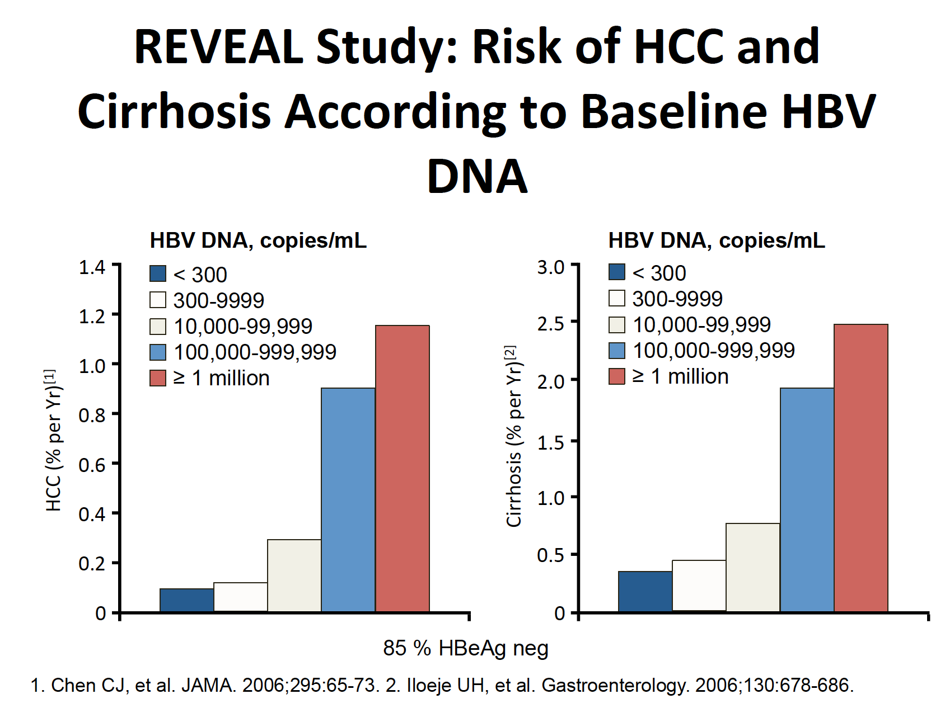
REVEAL Study
Risk of HCC and Cirrhosis According to Baseline HBV DNA
Disease progression
1. Chen CJ, et al. JAMA. 2006;295:65-73. 2. Iloeje UH, et al. Gastroenterology. 2006;130:678-686.

Slide 26
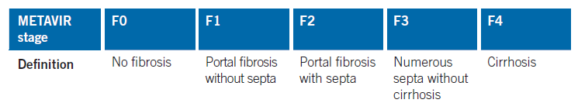
Assessment of Liver Disease Stage
Liver Biopsy
Liver biopsy has been considered the gold standard to grade and stage liver disease and assess the role of co-factors
Standardised biopsy scoring systems - METAVIR and Knodell and Ishak scores
Not widely available in resource-limited settings
Costly; invasive – risks
of bleeding and pneumothorax
Sampling error
Expert histological interpretation
Notes:
26
Liver biopsy has been used to assess the degree of necroinflammation and fibrosis, and to help guide the decision to treat. It is useful to assess the varying contributions of co-factors such as alcohol, NAFLD, Iron overload and drug-induced hepatoxicity.
There are several established methods of scoring histology and measuring activity (necroinflammation) separately from stage (fibrosis).
The pathological features of CHB on liver biopsy depend upon the stage of the disease, host immune response and degree of virus replication.

Slide 27
Assessment of Liver Disease Stage (continued)
Blood/Serum-based tests
APRI
Fib-4
FibroTest (patented commercial test)
Transient Elastography
Fibroscan
Use of accurate and validated NITs in
resource-limited settings
Will help with optimal selection of persons with CHB for antiviral Rx
Few validated studies
in sSA
Notes:
27
Non-invasive methods for assessing the stage of liver disease are supplanting liver biopsy and have been validated in adults with CHB, but there are few studies from sSA. Blood and serum markers for fibrosis, including APRI and FIB-4, as well as commercial markers such as FibroTest can be estimated, or transient elastography (FibroScan) performed to rule out advanced fibrosis.

Slide 28
Assessment of Liver Disease Stage (continued)
APRI and Fib-4
Indirect markers of fibrosis (ALT, AST, platelets)
Readily available in low-/middle-income countries
Less costly
No expertise required for interpretation
Outpatient setting
Fibrotest
Patented commercial test
Expensive
Accredited laboratory
NITs not validated to assess all stages of fibrosis/cirrhosis
Notes:
28
These markers of fibrosis have a high specificity but low sensitivity for significant fibrosis and cirrhosis at their specific cut-off ranges and, therefore, many persons with advanced fibrosis and cirrhosis are missed.

Slide 29
Assessment of Liver Disease Stage (continued)
APRI = (AST/ULN) x 100) / platelet count (10⁹/L)
Validated for the diagnosis of both significant fibrosis ≥ F2 and cirrhosis (F4)
WHO Guidelines recommend the use of a single high cut-off >2 for
identifying adults with cirrhosis (F4) and in need of antiviral therapy
FIB-4 = (age (yr) x AST (IU/L)) / (platelet count (10⁹/L x [ALT (IU/L)])
Validated for the diagnosis of significant fibrosis ≥F3, but not cirrhosis
Notes:
29
For APRI, ULN signifies the upper limit of normal for AST in the laboratory where these investigations were undertaken. For example, in a patient with an AST of 82 IU/L (where laboratory ULN for AST is 40 IU/L) and a platelet count of 90x109/L, the APRI would be: (82/40)x100/90 = 2.28. This value is >2 and is consistent with the presence of cirrhosis.
WHO Guidelines Development Group recommended the use of a single high cut-off >2 for identifying adults with cirrhosis (F4) and in need of antiviral therapy, and those ≤2 without cirrhosis for several reasons:
1. Although, in adults an APRI score of >2 would detect only one third of persons with cirrhosis, this high cut-off of >2 was used, because the low cut-off would result in an unacceptibly high number of false-positive test results (approximately one quarter of those tested).
2. It is also likely that adults with cirrhosis not detected using an APRI score >2 would be identified as being in need of antiviral therapy because of other eligibility criteria (such as persistently abnormal ALT levels as well as evidence of ongoing HBV replication (HBV DNA >20 000 IU/mL)
3. It is also simpler and more feasible to use a single cut-off in resource-limited settings.
Online calculators can be accessed for APRI at: http://www.hepatitisc.uw.edu/page/clinical-calculators/apri, and for FIB-4 at http://www.hepatitisc.uw.edu/page/ clinical-calculators/fib-4

Slide 30
Assessment of Liver Disease Stage (continued)
APRI and FIB-4
Optimal cut-off values that correlate with specific stages of liver fibrosis have been derived and validated
Use two cut-off points for diagnosing specific fibrosis stages
  Single cut-off would result
  in suboptimal sensitivity and specificity
High cut-off with high specificity (fewer false-positive results) used to diagnose fibrosis ≥ 2
Low cut-off with high sensitivity (fewer false-negative results) rules out the presence of particular stage of fibrosis
Indeterminate values – follow-up and repeat testing
Notes:
30

Slide 31
Assessment of Liver Disease Stage (continued)
Transient Elastography – Fibroscan (range is between 0 and 75 kPa)
Less than 10 minutes to perform
Outpatient / community setting
Costly and requires operator training
Regular maintenance and recalibration
Lack of extensively validated cut-off values for specific stages of fibrosis
Uses single cut-off value:
Significant fibrosis
(≥ F2 ) >7- 8.5 kPa
Cirrhosis (F4) >11-14 kPa
Mean cut-off 12.5 kPa to diagnose cirrhosis
Notes:
31
Other elastography techniques include 2-D acoustic radiation force impulse imaging (ARFI) and shear-wave elastography. ARFI and shear-wave elastography are similar in principle to transient elastography, and have been incorporated into new ultrasound imaging machines. However, they require more operator training and expertise than FibroScan

Slide 32
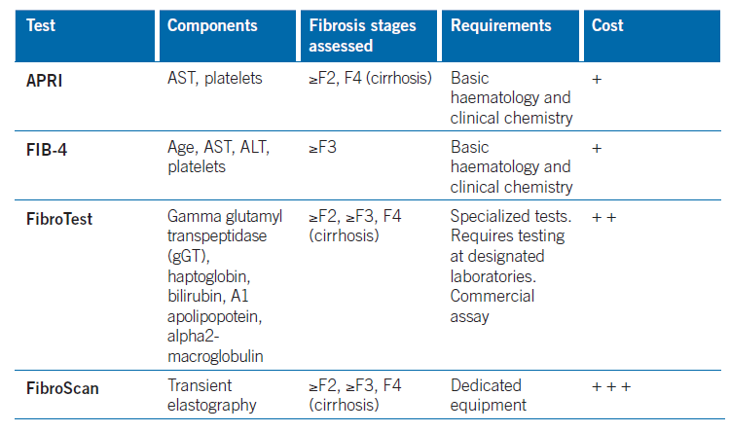
Assessment of Liver Disease Stage (continued)
2015 WHO Guidelines for the Prevention, Care and Treatment of Persons with Hepatitis B Virus Infection
Notes:
32

Slide 33
Assessment of Liver Disease Stage (continued)
Results of NITs may be impacted by intercurrent diseases that may falsely increase or decrease the scores:
Heavy alcohol intake (due to AST elevation from alcoholic hepatitis)
Use of drugs and traditional herbal medicines may increase ALT/AST
Malaria or HIV (may decrease platelet count)
Hepatitis flares or acute hepatitis, congestive heart failure or a recent meal may also increase high liver stiffness (fibroscan)
Notes:
33

Slide 34
2015 WHO Guidance on
Assessing Liver Disease Stage
Fibroscan and APRI
Most useful tests for assessing cirrhosis in LMICs (conditional recommendation)
PPV for detection of cirrhosis was low for all NITs, in particular for APRI (detecting only 1/3 of persons with cirrhosis)
Very limited evaluation in sSA
FIB-4
Not considered or recommended
Developed and validated for detection of fibrosis stages ≥F3 and not cirrhosis
2015 WHO Guidelines for the Prevention, Care and Treatment of Persons with Hepatitis B Virus Infection
Notes:
34

Slide 35
Assessment of Liver Disease Stage
& HBV Treatment Considerations
Current Treatment of Chronic Hepatitis B
Chronic HBV infection: defined as persistence of hepatitis B surface antigen (HBsAg) for six months or more after an acute infection with HBV
Major advancements in therapeutic options – 2 major strategies
  Interferon (IFN)-based therapy
  Nucleos(t)ide analogue therapy

Slide 36
Assessment of Liver Disease Stage
& HBV Treatment Considerations (continued)
Understanding the natural history and the phase of chronic infection
          Important in guiding treatment decisions
CURE is difficult as this is dependent on the eradication of hepatic intranuclear HBV cccDNA

Slide 37
Conclusions: Assessment of Liver Disease Stage
PPV of all NITs for the diagnosis of cirrhosis is low, especially for APRI
Many cases of cirrhosis will be missed using NITs alone
Important to combine NITs together with clinical criteria and other lab criteria (ALT and HBV DNA levels) to identify those in need of treatment
APRI is the WHO preferred NIT to assess fibrosis
blood tests needed to calculate APRI score are routinely available at most health-care facilities, even in LMICs
no evaluation of APRI in people from sub-Saharan Africa
WHO: APRI single high cut-off >2 for identifying adults with cirrhosis (F4) and in need of antiviral therapy

Slide 38
First-Line Treatment of Chronic HBV
MODULE 3

Slide 39
Learning Objectives
Explain goals of HBV treatment
Describe HBV treatment strategies
Identify approved therapies for HBV
Discuss efficacy of HBV therapies
Define WHO-recommended HBV therapy
Understand how to monitor HBV therapy

Slide 40
Goals of HBV Treatment
Prevention of long-term complications of chronic hepatitis B
Cirrhosis
Liver failure
Hepatocellular carcinoma
Notes:
The goal of therapy for chronic CHB is to reduce (or reverse) necro-inflammatory changes and hepatic fibrosis leading to progressive liver disease, cirrhosis, decompensated cirrhosis and liver failure, HCC and death. Surrogate measures of long-term treatment outcomes are used to assess efficacy : biochemical measures: normalisation of serum ALT as a surrogate measure for the resolution of necro-inflammation in the liver; and virological markers: a reduction in HBV DNA to undetectable levels by PCR, and HBeAg loss or seroconversion to anti-HBe status or rarely, HBsAg loss and seroconversion to anti-HBs status.
Prolonged viral suppression is associated with reduction in: necro-inflammation;, fibrosis and cirrhosis; decompensation; rates of HCC and mortality.
In the REVEAL study, HBV DNA levels were associated with increased risk of cirrhosis (>200 000 IU/ml) and HCC (>2 000 IU/ml) in both HBeAg positive and negative patients (Gastroenterology 2006;130:678; JAMA 2006;295(1):65). Ongoing viral replication is a risk factor for disease progression.
Therefore viral suppression is one of the key objectives of therapy.

Slide 41
Goals of HBV Treatment (continued)
Difficult to measure these clinical outcomes – surrogate measures
Biochemical: normalisation of serum ALT
Virological
Durable suppression to undetectable HBV DNA
Durable HBeAg loss or seroconversion to anti-Hbe
Durable HBsAg loss seroconversion to anti-HBs status
Histological
Decrease in necro-inflammatory score
Possibly regression of fibrosis on liver biopsy

Slide 42
Goals of HBV Treatment (continued)
HBsAg clearance is the ideal endpoint of therapy
Aim to reduce number of infected hepatocytes & reduce HBV viral replication level
HBsAg serum levels reflect the transcriptionally active cccDNA
HBsAg serum levels lowest in immune control phase
HBsAg clearance is associated with:
reduced incidence of cirrhosis
reduced incidence of HCC
improved survival
Gut 2002 50(1):100

Slide 43
Goals of HBV Treatment (continued)
CURE IS DEPENDENT ON
ERADICATION OF cccDNA
HBsAg clearance is the closest
to cure in chronic HBV

Slide 44
Treatment Strategies for Chronic HBV
Interferon (IFN)-based therapy
    Dual Antiviral and immunomodulatory activity
    Finite course of treatment
    Aim for sustained off-treatment immune control ( HBsAg +, HBeAg, and HBV DNA <2,000 IU/ml) through dual mode of action
    Successful in 30-50% patients
Nucleos(t)ide analogue therapy
    Antiviral activity
    Long-term (potentially indefinite) treatment
    Aim for on-treatment viral suppression (HBV DNA -)
  Maintained through continuous antiviral therapy
  Suppression of replication to undetectable levels to avoid resistance

Slide 45
Approved Therapeutic Options for HBV
Standard interferon
Pegylated interferon
Lamivudine
Telbivudine
Entecavir
Tenofovir ± emtricitabine
Sub-Saharan Africa
Lamivudine and tenofovir widely available as part of HIV antiretroviral therapy
Not always accessible for Rx of HBV monoinfection
Entecavir not widely available, no generics
Notes:
Currently, seven antiviral agents (six NAs – lamivudine, adefovir, entecavir, telbivudine, tenofovir, emtricitabine, as well as standard and two formulations of PEG-IFN) are approved and widely licensed for the treatment of CHB. Although all NAs act on HBV polymerase, their mechanisms of action differ, in addition to their pharmacokinetics, inhibitory capacity and resistance patterns. The widespread use of NAs with a low genetic barrier to resistance, such as lamivudine, adefovir and telbivudine has led to high rates of resistance in those who have received treatment for CHB.
In situations where entecavir is not available, Lamivudine can be used in clinically unstable patients with renal impairment - once clinically stable can be converted to Tenofovir.

Slide 46
Clinical efficacy : HBeAg pos | Lamivudine | Adefovir | Telbivudine | Entecavir | Tenofovir | PegIFN
Log₁₀ HBV DNA decline at 1yr | 5.54 | 3.5 | 6.45 | 6.9 | 6.4 | 4.5
HBV DNA undetectable (%) at 1 yr | 40-44 | 13-21 | 60 | 67 | 76 | 25
ALT normalization (%) at 1yr | 60-75 | 48-54 | 77 | 68 | 68 | 39
Histologic improvement (%) at 1yr | 56-62 | 53-68 | 64.7 | 72 | 74 | 38
HBeAg seroconversion (%)
1 year | 18-21.5 | 12-18 | 22.5 | 21 | 21 | 27
2 year | 27 | NA | 29.6 | 31 | NA | 42
3 year | 40 | NA | 46 | NA | 26 | NA
4 year | 47 | NA | NA | NA | 29 | 45
5 year | 65 | 48 | NA | NA | NA | NA
8 year |  |  |  |  | 31
HBsAg loss/seroconversion (%)
1 year | 1 | 0 | NA | 2 | 3.2 | 3-6
2 year | 2.8 | NA | NA | 5.1 | NA | NA
3 year | NA | NA | NA | NA | 8 | 11
4 year |  |  |  |  | 10.8 | 11
8 year |  |  |  |  | 10
Liver Int 2014;34 (S1):112; Abstract 229, AASLD 2014
Notes:
These are not head-to-head studies.
PegIFN has has the the advantage of ongoing virological improvement after completion of a finite course of treatment.
The longterm benefits of interferon based treatment include:
1. * HBeAg and HBsAg loss increase over time off Rx (Hepatology 2003 Apr;37(4):756; Hepatology 2004 Mar;39(3):804)
2. * Cirrhosis reduced by 35% (J Viral Hepat. 2009 ;16(4):265)
3. * HCC reduced 41% (49% in cirrhosis) (J Viral Hepat. 2009 ;16(4):265)
4. Liver death reduced 37% (80% in initial responder) (Aliment Pharmacol Ther 2010 ;32(9):1059)
* Meta-Analysis studies
However, 8 year studies with Tenofovir have shown no resistance and equivalent HBsAg loss (13%) and HBsAg seroconversion (10%) to PegIFN (Marcellin et al Abstract 229, AASLD 2014).
A total of 641 patients were randomized and treated; 585 (91%) entered the TDF extension phase at Year 1, and 412 (64%) remained on study at Year 8. Durable viral suppression was maintained between Years 5-8. No resistance to TDF was detected through Year 8. Through Year 8, a confirmed renal event (either ≥0.5 mg/dL increase in serum creatinine, or serum phosphorus <2 mg/dL, or creatinine clearance <50 mL/min) was observed in 2.2% of patients, and BMD (T scores) of hip and spine were stable between Years 4-8.

Slide 47
HBeAg Negative Chronic HBV
Therapeutic Endpoints | Placebo | Lamivudine | Adefovir | Telbivudineª | Entecavir | TDF^{b} | Peg-IFN
Undetectable HBV DNA | 10 - 20% | 60 - 73% | 51% | 88% | 90% | 93% | 63%
Loss of HBsAg | 0 - 1.5% | 0% | NR | <1% | <1% | 0% | 3%^{c}
ALT normalisation | 0 - 6% | 60 - 79%^{d} | 72% | 74% | 78% | 76% | 38%
Histologic improvement | 23 - 25% | 60 - 66%^{d} | 64% | 67% | 70% | 72% | 59%^{c}
All responses at 48 weeks, unless otherwise noted 52 week data Marcellin P, et al. N Engl J Med. 2008; 359: 2242 – 59 At 48 weeks at end of therapy and 72 weeks (24 weeks after end of therapy) At 48 weeks and 52 weeks into therapy
Adapted from: Lok AS, McMahon BJ. Chronic Hepatitis B: update 2009; 50: 661 – 2; Keeffe EB, Dieterich DT, Hans SH, Jacobson IM, Martin P, Schiff ER, Tobias H. A treatment algorithm for the management of chronic Hepatitis B virus infection in the United States: 2008 update.

Slide 48
Factors Favoring IFN as Initial Therapy
Favorable predictors of response
  Genotype A or B > C or D
  Low HBV DNA
  ∼ baseline <2x10⁶ - 2x10⁸ IU/mL
  ∼ 12 weeks <20 000 IU/mL
  High ALT (baseline) >2-5x ULN
  High activity scores on biopsy (≥A2)
Specific patient demographics
  Younger individuals
    Young woman wanting future pregnancy
Patient preference
No coinfection with HIV
Concomitant HCV or HDV infection
J Hepatol 2012; 57(1):167-85
Notes:
Interferon therapy should be considered when HBV DNA viral load and genotyping are available, IFN is available and affordable, or co-infection with HDV/HCV is present, as this offers the opportunity for a finite, short course of treatment. Disadvantages: Cost, subcutaneous injection, side effects and close monitoring required.
IFN side effects include: Initial influenza-like illness, fatigue, anorexia and weight loss, alopecia, myelosuppression with neutropenia and thrombocytopenia, hypo- and hyper-thyroidism, emotional lability and depression, retinal changes and impaired vision, flare in ALT occurs in 30-40% patients on treatment.
There are several absolute and relative contraindications to IFN, which include the presence of decompensated cirrhosis and hypersplenism, thyroid disease, autoimmune diseases, severe coronary artery disease, renal transplant disease, pregnancy, seizures and psychiatric illness, concomitant use of certain drugs, retinopathy, thrombocytopenia or leucopenia. IFN also cannot be used in infants less than 1 year of age.

Slide 49
Factors Associated with Choosing
Nucleos(t)ides as Initial Therapy
Favourable predictors of response
  High ALT
  Low HBV DNA
  (baseline < 1x10⁷ IU/mL
  and on treatment)
Specific patient demographics
  Older people
Patient preference
Concomitant HIV infection
No HCV coinfection
Cirrhosis
Notes:
The main advantages of NAs over IFN are the convenience of dosage (once-daily oral administration), tolerability and immediate affordability. The disadvantages of NAs are that lifelong therapy is usually required as NAs cannot eradicate cccDNA and thus is associated with high cumulative costs. Long term safety with lifelong therapy not yet known. Risk of resistance if NAs with low barrier to resistance are used.

Slide 50
HBV Treatment Strategies
What is the best HBV treatment in our setting?
Interferon (IFN)-based therapy has best chance of HBsAg eradication
with finite Rx
BUT interferon (IFN) has limitations in sub-Saharan Africa:
  Long immune tolerant phase
  High HBV DNA levels and often minimal necro-inflammation
  Liver biopsy assessment is advisable
  Expensive and close monitoring required
  Majority of HBV Rx candidates in sub-Saharan Africa not suitable for IFN-based Rx
  2015 WHO HBV Guidelines recommend entecavir and tenofovi) as first-line Rx

Slide 51
Efficacy: Tenofovir and Entecavir
Network meta-analysis
21 pair-wise comparison RCTs comprising 5073 HBeAg positive nucleoside-naïve persons
16 trials comprising 2604 HBeAgnegative nucleoside-naïve persons
Tenofovir monotherapy had highest probability of achieving undetectable HBV DNA at end of 1 year of Rx
HBeAg-positive 94.1% (95% CI: 74.7–98.9%)
HBeAg-negative 97.6% (95% CI: 56.7–99.9%)
2015 WHO Guidelines for the Prevention, Care and Treatment of Persons with Hepatitis B Virus Infection

Slide 52
Efficacy: Tenofovir and Entecavir (continued)
Entecavir monotherapy: Undetectable HBV DNA at end of 1 year of Rx
HBeAg-positive 64.5% (95% CI: 49.1–80.5%)
HBeAg-negative 91.9% (95% CI: 87.3–95.1%)
All other antiviral therapies had very low probability of achieving this outcome

Slide 53
Long-Term Effectiveness of Entecavir and Tenofovir after 3 and 5 Years
Low cumulative rates of:
Mortality
Entecavir : 3% and 3.8%
Tenofovir : 0.7% and 1.4%
HCC
Entecavir: 3.9% and 6.6%
Tenofovir: 1.4% and 2.4%
Genotypic resistance
Entecavir at 5 years of Rx (0.8-1.2%)
Tenofovir: no resistance at 8 years
2015 WHO Guidelines for the Prevention, Care and Treatment of Persons with Hepatitis B Virus Infection

Slide 54
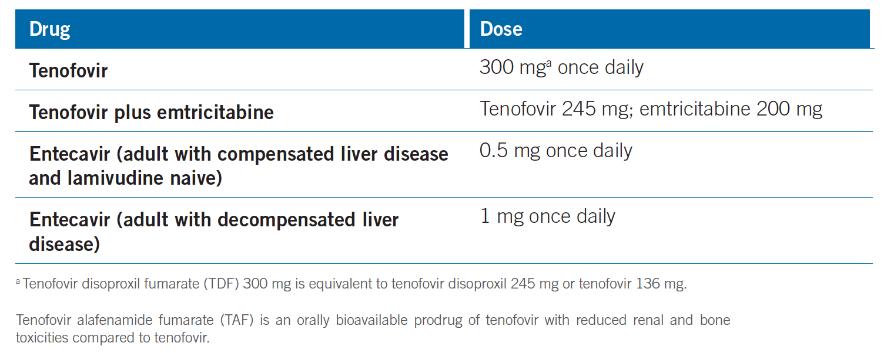
Recommended NAs and Dosages for Adults
2015 WHO Guidelines for the Prevention, Care and Treatment of Persons with Hepatitis B Virus Infection
Notes:
Entecavir 1mg with decompensated liver disease - monitor for lactic acidosis

Slide 55
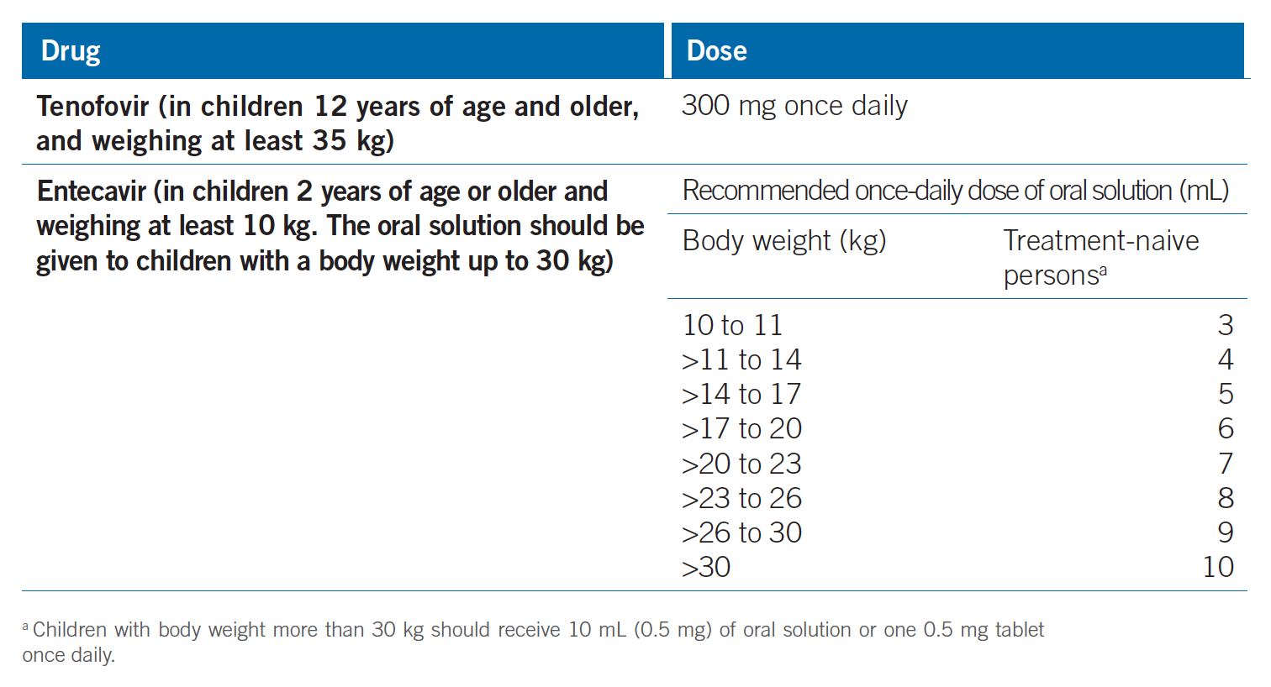
Recommended NAs and Dosages for Children
2015 WHO Guidelines for the Prevention, Care and Treatment of Persons with Hepatitis B Virus Infection
Notes:
A placebo-controlled RCT of tenofovir in adolescents showed a high virological response (89%) and normalization of serum ALT at 72 weeks of treatment, and no observed resistance (Hepatology 2012;56(6):2018.
An ongoing placebo-controlled trial of entecavir in children (AI463189 trial), but based on data submitted for a new drug application to the US FDA, showed that entecavir is superior to placebo at reducing HBV DNA levels to <50 IU/mL, inducing HBeAg seroconversion (24% vs 2%) and normalizing serum ALT levels (67% vs 27%) at week 48.

Slide 56
Assessment Prior to Treatment Initiation
Assess severity of chronic liver disease
Assessment of the level of viral replication
HBV DNA, HBeAg and HBeAb status (if available)
Assessment for the presence of co-morbidities
Lifestyle counseling
Preventive measures
HBsAg screening with HBV vaccination of non-immune family members and sexual contacts
Notes:
Assessment of the severity of liver disease should include a history, physical examination, including for the presence of hepatomegaly and splenomegaly, and measurement of ALT, AST, ALP and total bilirubin; full blood count, including platelet count and white cell count. ALT and platelet count measurements allow calculation of APRI for staging of liver disease. The synthetic function of the liver should be assessed with serum albumin and prothrombin time or international normalized ratio (INR). Patients should also be questioned about the presence of liver-related symptoms especially symptoms suggeestive of decompensation (jaundice, encephalopathy, ascites and variceal bleeds), although it is recognized that even advanced disease may be asymptomatic.
Assessment of the level of viral replication: HBV DNA levels and HBeAg NOT required to make the decision to treat. See 2015 WHO guidelines (Module 2)
Assessment for the presence of comorbidities: evaluation for the presence of other comorbidities, including co-infection with HIV, HCV or HDV, impaired glucose tolerance, dyslipidaemia, renal dysfunction, non-alcoholic fatty liver disease, alcoholic liver disease, iron overload and drug/toxin-induced injury. All persons with cirrhosis should be screened for the presence of HCC. A review of family history of HCC and medication history are also required
Counseling on lifestyle: assessment of alcohol consumption, and advice on lifestyle, including alcohol reduction, diet and physical activity. Consider also hepatitis A vaccination.

Slide 57
Preparation for HBV Treatment
Patient counseling
Indications for treatment
Benefits and side-effects of treatment
Need for and willingness to commit to long-term treatment
Need for follow-up monitoring both on and off therapy
Importance of full adherence for treatment
        efficacy of treatment
Risks of non-adherence
        risk of drug resistance
        progression of disease
        risk of acute liver failure with abrupt cessation of treatment
Cost implications of treatment and follow up

Slide 58
Toxicity of NAs
Nephrotoxicity: Assess renal function before NA initiation
Serum creatinine level
Estimated glomerular filtration rate
Urine dipsticks for proteinuria and glycosuria
Notes:
Tenofovir is principally eliminated via the kidney and has a side-effect profile characterized by proximal tubular cell dysfunction. The range of severity is from mild renal tubular dysfunction and hypophosphataemia with subclinical decline in renal function to classical Fanconi syndrome and impaired glomerular filtration.
Small decreases in bone mineral density with osteopenia or osteoporosis during the early phases of treatment have also been reported and, more rarely, lactic acidosis or severe hepatomegaly with steatosis, which may be fatal.

Slide 59
Toxicity of NAs (continued)
Risk factors for renal dysfunction
decompensated cirrhosis
CrCl <50 mL/min
poorly controlled hypertension and diabetes
proteinuria, active glomerulonephritis
solid organ transplantation
older age, BMI <18.5 kg/m2 or body weight <50 kg
boosted protease inhibitor for HIV
concomitant nephrotoxic drugs
Monitoring should be more frequent in those at higher risk of renal dysfunction

Slide 60
Toxicity of NAs (continued)
Nephrotoxicity: Assess renal function before NA initiation
solid organ transplantation
older age, BMI <18.5 kg/m2 or body weight <50 kg
boosted protease inhibitor for HIV
concomitant nephrotoxic drugs
Monitoring should be more frequent in those at higher risk of renal dysfunction
Notes:
Tenofovir is principally eliminated via the kidney and has a side-effect profile characterized by proximal tubular cell dysfunction. The range of severity is from mild renal tubular dysfunction and hypophosphataemia with subclinical decline in renal function to classical Fanconi syndrome and impaired glomerular filtration.
Small decreases in bone mineral density with osteopenia or osteoporosis during the early phases of treatment have also been reported and, more rarely, lactic acidosis or severe hepatomegaly with steatosis, which may be fatal.

Slide 61
Monitoring Long-Term NA Therapy
Long-term NA therapy
HBV DNA every 6 -12 months
HBsAg and HBeAg every 6-12 months
ALT and AST (for APRI) annually
Renal function (annually)
more frequently if risk factors for renal dysfunction
Adherence to therapy
Monitor for HCC
alpha-fetoprotein and Ultrasound liver every 6-12 months
Notes:
Monitoring during the first year of treatment with Nucleos(t)ide therapy if resources not limited: (South African Guideline for the Management of Chronic Hepatitis B: 2013
S Afr Med J. 2013 May;103(5 Pt 2):337)
1. A FBC, differential count, INR, Liver profile, amylase and creatinine should be performed at week 1, week 4 and then 3 monthly if stable.
2. HBV DNA levels are measured at week 12 to assess virological response and then every 12-24 weeks.
3. HBV DNA monitoring is critical to detect treatment failure. Undetectable HBV DNA levels by real-time PCR (level of detection <10-15 IU/ml) need to be achieved to prevent the development of resistance.
4. Partial responses (HBV DNA level detectable but <2 000 IU/ml) are assessed at 24 weeks for lamivudine and at 48 weeks for tenofovir and entecavir. If HBV DNA levels are still positive, but declining at 48 weeks on tenofovir or entecavir, monotherapy can be continued .
5. NUCs require dosage adjustments in the setting of renal impairment.
HBeAg positive disease
1. HBeAg and anti-HBe should be measured every 6 to 12 months. Can consider stopping NUCs 24 to 48 weeks after HBeAg seroconversion.
2. HBsAg should be checked 6 monthly after anti-HBe seroconversion.
HBeAg negative disease
1. A virological response (HBV DNA <2000 IU/ml) is associated with disease remission.
2. Monitor HBsAg 6 monthly, if HBV DNA levels are undetectable.

Slide 62
Stopping NA Therapy
CIRRHOSIS
Lifelong NA therapy
NO CIRRHOSIS
HBeAg positive chronic HBV
Consider stopping treatment if:
HBeAg loss and seroconversion to anti-HBe after completion of at least one additional year of treatment + persistently normal ALT + persistently undetectable HBV DNA
Need close monitoring after treatment cessation (20% may relapse)

Slide 63
Stopping NA Therapy (continued)
NO CIRRHOSIS
HBeAg negative chronic HBV
Lifelong NA therapy
Most patients with chronic HBV in sub-Saharan Africa
will need lifelong therapy

Slide 64
Conclusions: First-Line HBV Treatment
CURE is dependent on the eradication of intranuclear HBV cccDNA
HBsAg clearance is the closest to cure in chronic HBV
Tenofovir, entecavir, and peginterferon are preferred first-line drugs
  3rd generation NAs have high efficacy, very low rates of resistance & excellent safety record, but therapy is potentially lifelong
  PEG-IFN offers finite therapy & chance for cure through dual antiviral and immunomodulatory action
  Majority of treatment candidates in sub-Saharan Africa are not suitable for IFN-based treatment
Notes:
.

Slide 65
Conclusions: First-Line HBV Treatment (continued)
  2015 WHO HBV Guidelines recommend tenofovir and entecavir
  Tenofovir has excellent resistance profile and 10% HBsAg seroconversion at 8 years
Sustainable access to affordable generic NAs essential in sub-Saharan Africa, including for HBV monoinfection
Notes:
.

Slide 66
Identification and Management of HBV Treatment Failure
MODULE 4

Slide 67
Learning Objectives
Define primary and secondary HBV treatment failure
Understand the causes of and how to recognize HBV drug resistance
Explain how to monitor HBV treatment adherence
Describe the management of HBV treatment failure

Slide 68
Identifying HBV Treatment Failure
HBV Treatment failure may be primary or secondary
In settings with access to HBV DNA testing:
Primary antiviral therapy failure
  Failure of drug to reduce HBV DNA levels by ≥1 x log₁₀ IU/mL within 3 months following initiation of therapy
  Rare in persons initiating and adherent to entecavir or tenofovir Rx
  Can occur in persons treated with lamivudine, adefovir or telbivudine

Slide 69
Identifying HBV Treatment Failure (continued)
Secondary antiviral treatment failure
  Rebound of HBV DNA levels of ≥1 x log₁₀ IU/mL from the nadir in persons with an initial antiviral treatment effect (≥1 x log₁₀ IU/mL decrease in serum HBV DNA)

Slide 70
Identifying HBV Treatment Failure (continued)
In settings without access to HBV DNA testing:
Treatment failure and drug resistance suspected
  Use of antiviral drugs with a low barrier to resistance
    documented or suspected poor adherence
  Rising transaminases
  Evidence of progressive liver disease
Elevation in ALT level tends to occur late, relatively poor predictive marker of resistance
World J Gastroenterol 2010;16937):4691

Slide 71
Identifying HBV Treatment Failure (continued)
Confirmation of antiviral drug failure
  Sequencing the HBV DNA polymerase
  Identifying specific genetic markers of antiviral drug resistance
World J Gastroenterol 2010;16937):4691

Slide 72
Identifying HBV Treatment Failure (continued)
Drug resistance
  Concerns with long-term NA therapy
    selection of drug resistant mutations
  HBV has high rate of replication with 10¹⁰⁻¹² mutations generated daily
  Higher rates of NA resistance in individuals
    high baseline HBV DNA levels
    longer duration of treatment
    slower treatment decline in HBV DNA levels
  Several drug-resistance mutations in HBV polymerase
    cross-resistance to several
    NAs - limits future Rx options
Hepatology 2007; 46(1):254; Hepatol Int 2008;2:147
Notes:
Once drug-resistance mutations have developed, they are archived within the virus population and are rapidly selected if the same, or a cross-reacting antiviral agent, is reintroduced. The
emergence of antiviral resistance usually leads to an increase in HBV DNA levels or viral rebound after initial response during therapy, which is likely to be followed by biochemical breakthrough with a rise in the ALT levels and, in some cases, hepatitis flares and progression to hepatic decompensation. In general, the management of individuals previously treated with lamivudine, adefovir or telbivudine is based on the established in vitro and in vivo efficacy of the potent NAs tenofovir and entecavir, and knowledge of the patterns of cross-resistance across different NAs.

Slide 73
Identifying HBV Treatment Failure (continued)
Drug Resistance
  Increased risk of multidrug-resistant hepatitis B, if treated
  sequentially with NAs with a low barrier to resistance
  (lamivudine, adefovir and telbivudine) as monotherapy
  Widespread use of lamivudine for persons with CHB and high
  HBV DNA levels in some countries has led to a high burden of lamivudine-resistant hepatitis B
Virol J 2011;8(1):75; Pharmazie 2012;67(11):883; N Engl J Med 2008;359(23):2442;
World J Gastroenterol 2013;19(39):6665; J Clin Pharmacol 2014;52(2):189

Slide 74
Emergence of Drug Resistance
Emergence of Drug resistance
  Viral rebound with increasing HBV DNA levels
  Followed by biochemical breakthrough with rise in ALT
  Hepatitis flare and potential clinical decompensation
Gastroenterol 2003;125(6):1714

Slide 75
Approved NAs: HBV Treatment
lamivudine
emtricitabine
tenofovir
entecavir
adefovir
telbivudine
  Generic formulations of lamivudine/emtricitabine & tenofovir available in sub-Saharan Africa as part of ART at significantly reduced prices
    not always available for Rx of HBV monoinfection
  Generic entecavir preparations are not available in sub-Saharan Africa
  Globally both originator and generic entecavir prices are significantly higher than for lamivudine and tenofovir
J Virus Erad, 2015;1:103

Slide 76
Cumulative Rates of Resistance with Oral Agents in Nucleos(t)ide-Naïve Patients
Not head-to-head trials; different patient populations and trial designs
Lamivudine
Adefovir
Entecavir
Telbivudine
Tenofovir
100
80
70
67
60
49
Patients (%)
40
38
29
24
18
20
4
3
17
11
0.2
0.5
1.2
1.2
1.2
1.2
0
0
0
0
1
2
3
4
5
6
Year
EASL clinical practice guidelines. J Hepatol. 2009;50:227-242. Tenney DJ, et al. EASL; 2009; Copenhagen, Denmark. Abstract 20.
Notes:
Six approved NAs (lamivudine, adefovir, entecavir, telbivudine, tenofovir, emtricitabine). Lamivudine is associated with the highest rate of drug resistance and entecavir with very low rates of resistance (except in persons previously exposed to lamivudine and adefovir). Currently, in a Tenofovir 8 year cohort followup, NO RESISTANCE documented, renal dysfunction noted in <2.5% and no clinically relevant bone density loss was reported.

Slide 77
Preventing HBV Treatment Failure
Adherence
  Treatment adherence is essential for HBV viral suppression
  Adherence should be reinforced in all individuals with confirmed or suspected antiviral resistance
  Adherence is dependent on a number of factors:
    patient’s insight into need for treatment and risks of non-adherence
    guaranteed secure supply of medication
    Transport to healthcare centre supplying antivirals

Slide 78
Monitoring Adherence to
HBV Antiviral Therapy
Counseling
  Pre- and post-initiation of treatment essential to ensure adherence
Monitoring of adherence is essential
Self-reporting of missed doses by patient or caregiver is unreliable
Pharmacy refill records:
  Obtaining pharmacy refills at irregular intervals
  Overestimate adherence on sole basis of pharmacy refill records
      collecting medications does not equate with adherence
HBV DNA Viral load monitoring:
  Optimal way to diagnose and confirm treatment failure
Notes:
Objective monitoring of adherence to antiviral therapy is essential for effective long-term management of CHB. Each clinic visit is an opportunity for assessing and supporting treatment adherence. Often requires a combination of approaches.
1. Self-reporting: Regular counseling on the importance of remembering and/or documenting doses of antiviral medicines as well as creating a clinic environment that promotes honest reporting of non-adherence are critical for effective routine monitoring of adherence. A practical approach is to encourage the use of a pillbox.
2. Pharmacy refill records: Pharmacy refill records provide information on when individuals on antiviral therapy collect their drugs. Obtaining pharmacy refills at irregular intervals strongly suggests non-adherence.
3. HBV DNA Viral load monitoring is the optimal way to diagnose and confirm treatment failure. Treatment failure is MOST FREQUENTLY caused by lapses in adherence to antiviral therapy, but other factors (such as drug stock-outs or malabsorption) should also be considered.

Slide 79
Management of HBV Treatment Failure
Network meta-analysis : HBeAg positive patients
  Seven RCTs of pair-wise comparisons based on 919 lamivudine-resistant persons were included for outcome of undetectable HBV DNA (<300 copies/mL or 60 IU/mL)
  Six studies (771 persons) for the outcome of HBeAg seroconversion
Treatments evaluated in HBeAg positive pts
  Switch to an NA with a high barrier to resistance
  Continuation with or add-on therapy
  Included the following agents:
  Tenofovir, entecavir, adefovir, lamivudine
  Telbivudine and emtricitabine (in combination with tenofovir)
Hepatitis B (chronic): diagnosis and management of chronic hepatitis B in children, young people and adults [CG165]. London: National Institute for Health and Care Excellence; 2013.

Slide 80
Management of HBV Treatment Failure (continued)
Network meta-analysis: Treatments evaluated in HBeAg positive patients – tenofovir followed by entecavir + adefovir combination therapy had highest probability of achieving:
  Undetectable HBV DNA (66.2% and 33.8%, respectively)
  HBeAg seroconversion (39.8% and 31.2%, respectively) at the end of 1 year of treatment among all the evaluated treatments
After 1 year of tenofovir treatment:
  89% (95% CI: 51.8–98.2%) of lamivudine-resistant patients would be expected to achieve undetectable HBV DNA
  17.6% (95% CI: 1.4–74.9%) HBeAg seroconversion
  No NMA was conducted for lamivudine-resistant HBeAg-negative persons
Hepatitis B (chronic): diagnosis and management of chronic hepatitis B in children, young people and adults [CG165]. London: National Institute for Health and Care Excellence; 2013.
Notes:
Network meta-analysis: As tenofovir and entecavir have not been compared directly in an RCT, an NMA was undertaken to enable a direct comparison and estimation of the relative efficacy and ranking of different antiviral therapies, based on another systematic review of all the relevant RCT data (both indirect and direct treatment comparisons of single, combination and sequential therapy) used in the development of the UK NICE CHB guidelines

Slide 81
Management of Lamivudine Resistance
2015 WHO Guidelines recommend switch to tenofovir monotherapy (HBeAg+/- patients)
  Highest probability at 1 year of achieving low/undetectable HBV DNA levels
  Continuing ineffective antiviral therapy with ongoing HBV replication
      increased risk of disease progression to cirrhosis and HCC
  Use of tenofovir, which does not share cross-resistance with other NAs
      avoids selection of further compensatory mutations and development of drug resistance, with reservoirs of resistant HBV mutants
AIDS 2002;16(1):131
Notes:
For adefovir resistance, a switch to either tenofovir or entecavir can be considered. To date there is no reported resistance with tenofovir. If there is primary non-response to tenofovir or secondary treatment failure, then treatment adherence should be reinforced and monitored. At present, there is therefore no indication to switch to an alternative drug regimen.
Entecavir not be used as salvage therapy in individuals with known or suspected lamivudine resistance

Slide 82
Management of Lamivudine Resistance (continued)
  Lamivudine resistance (L180M + M204V/I) confers cross-resistance to telbivudine and entecavir, but not tenofovir
  Entecavir resistance is more LAM-resistant CHB with adefovir or telbivudine or entecavir
      leads to the selection of multidrug-resistant hepatitis B
AIDS 2002;16(1):131
Notes:
For adefovir resistance, a switch to either tenofovir or entecavir can be considered. To date there is no reported resistance with tenofovir. If there is primary non-response to tenofovir or secondary treatment failure, then treatment adherence should be reinforced and monitored. At present, there is therefore no indication to switch to an alternative drug regimen.
Entecavir not be used as salvage therapy in individuals with known or suspected lamivudine resistance

Slide 83
Conclusions: Identification and
Management of HBV Treatment Failure
Consider Treatment Failure
  Rising ALT
  Progression of liver disease
Assess Adherence
  Especially with clinical deterioration and virological failure on tenofovir
Exclude other causes of clinical deterioration
  DILI
  Other viral infections
  Development of HCC

Slide 84
Conclusions: Identification and
Management of HBV Treatment Failure (continued)
Management of Resistance
Tenofovir monotherapy
  Highest probability at 1yr of achieving low or undetectable HBV DNA levels in persons with lamivudine-resistant HBV
  Little evidence of advantage from the systematic review that adding NAs or combined use of NAs confers benefit in lamivudine resistance
  TDF shares no cross-resistance avoids selection of further compensatory mutations and development of drug resistance, with reservoirs of resistant HBV mutants
  Simplifies clinical management and drug procurement in persons who have developed resistance to lamivudine, adefovir, telbivudine or entecavir

Slide 85
HBV and Pregnancy
Management Considerations
MODULE 5

Slide 86
Learning Objectives
Explain the natural history of HBV in pregnancy
Describe HBV testing in pregnant women
Understand HBV treatment in pregnancy
Discuss prevention of mother-to-child transmission of HBV
Define how to recognize and address post-partum HBV flares

Slide 87
HBV and Pregnancy
Natural History and Pregnancy Outcomes
Conflicting data on natural history
  No worsening of liver disease in most women
  Case reports suggest HBV reactivation, hepatic exacerbations
  and fulminant liver failure may occur
Adverse pregnancy outcomes – some reports of higher rates of:
  Preterm births
  Gestational diabetes
  Antepartum hemorrhage
HBsAg positive mothers need close follow up during pregnancy
Semin Liver Dis. 2007 Aug;27 Suppl 1:18; World J Gastroenterol. 2004 Aug 1;10(15):2305;
Lancet. 1991 Feb 9;337(8737):364; J Hepatol. 2005 Nov;43(5):7717; J Hepatol. 2007 Jul;47(1):46
Notes:
Some reports suggest that HBV infection is associated with several adverse pregnancy outcomes [J Hepatol. 2005 Nov;43(5):7717;J Hepatol. 2007 Jul;47(1):46]. The outcomes of 253 hepatitis B surface antigen (HBsAg)–positive women were compared with those of 253 controls in 1 study and showed that the HBsAg carriers had higher incidences of preterm birth at < 34 weeks (4.7% vs 1.2%; P = .033), higher incidences of threatened preterm labor at < 37 weeks (11.9% vs 6.3%; P = .030), higher rates of gestational diabetes (19% vs 11%; P = .012), and higher rates of antepartum hemorrhage (11.5% vs 5.5%; P = .026) [J Hepatol. 2005 Nov;43(5):7717]. Another study showed that women with HBV infection (n = 1138) had a significantly increased risk of developing gestational diabetes vs women not infected with HBV (n = 12,545; odds ratio: 1.24 [drug: 95% CI: 1.01 1.51]).[J Hepatol. 2007 Jul;47(1):46]. Finally, children born to HBV-infected pregnant women were shown to have lower Apgar scores at 1 and 5 minutes post birth vs those born to HBV-uninfected women in one study (P = .001 and P = .007, respectively) [J Hepatol. 2005 Nov;43(5):771]

Slide 88
Hepatitis B Screening in Pregnancy
HBsAg screening of pregnant women essential: AASLD and EASL
  First trimester of each pregnancy
  Pregnant women not immune to HBV and with risk factors for infection should be vaccinated against HBV – SAFE IN PREGNANCY
  Ongoing high-risk behavior during pregnancy and HBsAg status unknown
  test for HBsAg at admission for delivery
  HBsAg positive women should be referred for additional testing, counseling and medical management
Hepatology 2009 50(3):661; J Hepatol 2012;57(1):167
Notes:
AASLD and EASL guidelines recommend that all pregnant women should be screened for HBV. This, however has not been implemented in most resource-poor countries including South Africa.

Slide 89
HBV Management Strategies in Pregnancy
Requiring HBV treatment and considering pregnancy
  Finite course IFN Rx (if favorable clinical profile) before pregnancy
  If clinically stable, can defer treatment until after pregnancy
  Consider antiviral treatment in 3rd trimester to prevent MTCT
Pregnant whilst on HBV treatment
  Consider need for treatment and risk of MTCT
  Review type of treatment
  Stop IFN and switch to antivirals
Pregnant and treatment not clinically indicated for HBV infection
  Defer treatment until after pregnancy and then reassess need
  Consider antiviral treatment in 3rd trimester to prevent MTCT
Clin Infect Dis. 2008;46(3):367; Hepatology 2009 50(3):661; J Hepatol 2012;57(1):167
Notes:
Most women of childbearing age (20s and 30s) are likely to be in the immune-tolerant (HBeAg positive, high HBV DNA and normal ALT) or immune control phase (HBeAg negative, low HBV DNA and normal ALT) of disease and are not candidates for HBV treatment (EASL and AASLD), but the risk of MTCT needs to be considered in pregnant women with high HBV viral loads.

Slide 90
HBV Treatment in Pregnant Women
Indications for Rx in HBV-infected pregnant mother same as usual indications:
  active viraemia (high HBV DNA levels)
  necro-inflammation (raised ALT or on histology)
  cirrhosis
Drug of choice is tenofovir
  similar rate of birth defects to general population
Interferon is contraindicated
Risk of HBV flare - close monitoring required
  mother is untreated
  if antivirals stopped during pregnancy or soon after delivery
Consolidated guidelines on the use of antiretroviral drugs for treating and preventing HIV infection: recommendations for
a public health approach. Geneva: World Health Organization 2013; Hepatology 2009 50(3):661; J Hepatol 2012;57(1):167
Notes:
It is important to make a distinction between a pregnant mother with acute HBV, compared to chronic HBV. In the former, unless there is evidence of liver failure, antivirals are generally not recommended. The patient should be monitored closely and treated conservatively. However, there is an increased risk of mother to child transmission, if the mother acquires acute Hepatitis B in 2nd or 3rd trimester and depending on the HBV DNA levels in 3rd trimester, may consider antivirals to prevent MTCT.
# Note: liver biopsy not necessary to diagnose necro-inflammation- increased risk of liver biopsy complications during pregnancy.
Indications for treatment in adults with CHB also apply to pregnant women, but need to consider risk of MTCT and potential risks of therapy to developing foetus.
When selecting an antiviral need to consider: antiviral efficacy, risk of resistance, human safety data, and pregnancy class of the drug.
If a woman becomes pregnant whilst on HBV therapy, the decision on whether to continue treatment or stop should be individualised based on the trimester that the pregnancy was discovered, the severity of her underlying liver disease, the risk adversity of the mother to medications during pregnancy (especially in early pregnancy), and the risk of flares when stopping the medications.
According to the Antiretroviral Pregnancy Registry International Interim Report for 1 January 1989 through 31 July 2013, the rate of birth defects in the general population from 1989-2003 was 2.72 per 100 live births (95% CI: 2.68-2.76), and the prevalence of birth defects per 100 live births diagnosed during the first 7 days of life (“early diagnosis”) was 2.09 (95% CI: 2.07-2.12). Although, these data cannot be precisely compared with the Antiretroviral Pregnancy Registry data on birth defects with HBV medications due to the self-reported nature and limitations of the registry, the reported rate of birth defects with any tenofovir containing regimen was reported to be 2.3% in 1st trimester and 2.1% in 2nd/3rd trimester.
Based on safety data from the Antiretroviral Pregnancy Registry in pregnant HIV-positive women who have received tenofovir and/or lamivudine or emtricitabine – tenofovir (category B) is the preferred antiviral, because it has a better resistance profile and more extensive safety data in pregnant HBV-positive women. Lamivudine (Category C) is also safe in pregnancy The safety of entecavir (category C) in pregnancy is not known, and IFN-based therapy is contraindicated.
It is advisable to continue HBV antiviral treatment throughout pregnancy.
If a pregnant woman remains untreated or anti-HBV therapy is discontinued during pregnancy or early after delivery for any reason, close monitoring is necessary, as there is a risk of hepatic flares, especially after delivery.

Slide 91
HBV Mother-to-Child Transmission
Over 60 million new HBV infections per annum
The majority of infections are acquired in the perinatal/neonatal period or in early childhood
Perinatal infections are the reservoir of infections in high endemic areas e.g. China, South-East Asia
Horizontal transmission in early childhood from infected family members (6 months to 5yrs) accounts for most infections in sub-Saharan Africa
Notes:
AASLD and EASL guidelines recommend that all pregnant women should be screened for HBV. This, however has not been implemented in most resource-poor countries including South Africa.

Slide 92
Perinatal HBV Transmission
Perinatal infection occurs:
In utero (uncommon)
During delivery
After birth
Breastfeeding (controversial)
J Med Virol 2002;67(1):20
Notes:
In-utero transmission is relatively rare and is not the major means of transmission of HBV from mothers to infants, although it may occur if intrauterine placental leakage arises as a result of threatened preterm labour

Slide 93
Risk Factors for Perinatal HBV Transmission
HBeAg positive mother
>90% risk of infecting child with no treatment
High maternal HBV DNA (>7.3 log₁₀ IU/mL)
Maternal acute HBV in 2nd or 3rd trimester or within 2 months of delivery
Risk reduced to <10 % with active-passive immunization
J Viral Hepat 2009;16(2):94; J Viral Hepat 2003;10(4):294
Notes:
Other risk factors are amniocentesis, preterm rupture of membrane, and possibly breastfeeding (controversial).

Slide 94
Age at HBV Acquisition and Chronicity
Chronicity of HBV determined by age of acquisition of infection
90% after neonatal infection (HBeAg positive mothers)
20-60% with childhood infection (<5 years of age)
<5% when acquired in adulthood
Prevention of neonatal & early childhood infection crucial
Prevents chronicity and subsequent complications of chronic liver disease and HCC

Slide 95
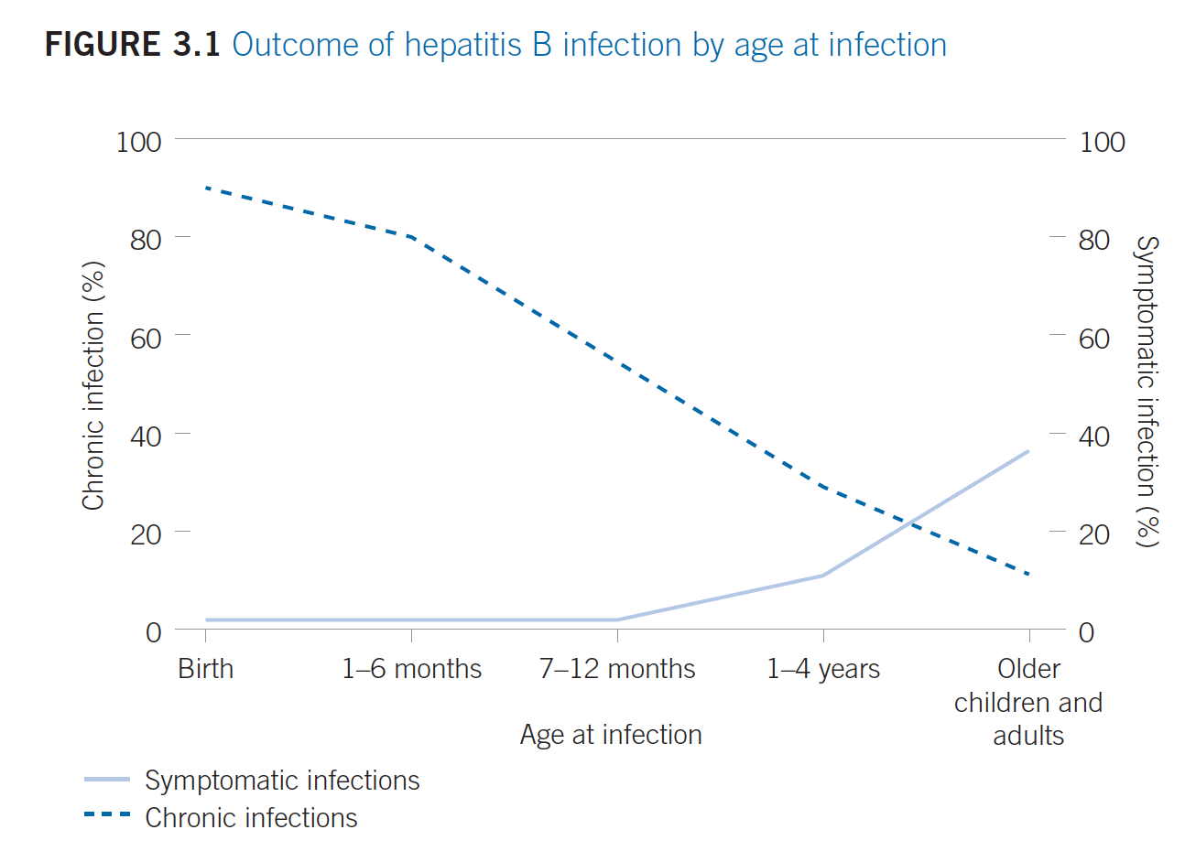
Age at HBV Acquisition and Chronicity (continued)
2015 WHO Guidelines for the prevention, care and treatment of persons with chronic hepatitis B infection

Slide 96
Prevention of Mother-to-Child Transmission of HBV
Significant relationship between maternal HBV DNA level and rate of persistent infection in infant (> 8 log₁₀ copies/mL or ~ 7.3 log₁₀ IU/mL)
HBeAg negative and positive mothers
  Treatment with lamivudine or tenofovir should be considered in 3rd trimester in mothers with high viraemia to prevent MTCT; tenofovir preferred antiviral
  If therapy is administered only for prevention of MTCT; may be discontinued within the first 3 months after delivery
  Role of elective Cesarean section in preventing HBV MTCT conflicting; not currently recommended
  Antiviral therapy for MTCT prevention must be combined with neonatal HBV vaccination
Clin Gastroenterol Hepatol 2013; 11(10):1349; BMC Pregnancy Childbirth. 2013 May 24;13:119J Hepatol 2012;57(1):167; J Hepatol 2012;57(1):167; J Viral Hepat. 2003;10(4):294
Notes:
Maternal viremia plays a significant role in perinatal transmission. In those mothers who do not require HBV treatment, selective treatment in the third trimester of pregnancy may lower risk of perinatal hepatitis B virus (HBV) transmission. Studies have shown an increased risk of HBV transmission to neonates born to mothers with high levels of viremia (> 8 log10 copies/mL or ~ 7.3 log10 IU/mL), suggesting that antiviral treatment should be considered to reduce the HBV DNA level prior to delivery.
Wen et al (J Hepatol. 2013;59(1):24) reported a stepwise increase in the risk of chronic infection in infants born to HBsAg-positive mothers according to maternal HBV DNA. Among 303 mother–infant pairs, predicted rates of infection at maternal HBV DNA levels of 7, 8, and 9 log10 copies/mL were 6.6% (95% CI: 0.5% to 12.6%; P = .033), 14.6% (95% CI: 5.6% to 23.6%; P = .001), and 27.7% (95% CI: 13.1% to 42.4%; P < .001), respectively, following adjustment for other factors likely to influence transmission.
Lamivudine MTCT: A recent study (Hepatology. 2013;58. Abstract 85) of treatment-naive HBeAg-positive mothers with HBV DNA > 6 log10 copies/mL, the use of 100 mg/day of Lamivudine in 2nd and 3rd trimester was compared for prevention of vertical HBV transmission. The study enrolled 155 consecutive mothers who were treated with lamivudine (second trimester, n = 61; third trimester, n = 94) and included 89 matched untreated mothers with comparable baseline values; all infants received appropriate immunoprophylaxis. None of the infants of the mothers who initiated treatment in the second or third trimester was positive for HBsAg or had detectable HBV DNA at 28 weeks. In addition, there was no significant difference in transmission rates whether lamivudine was initiated in the second or third trimester.
Tenofovir MTCT
No major safety issues associated with early Tenofovir treatment in pregnant women. Among 14 pregnant women in the French real-life cohort (VIREAL study), 12 women received Tenofovir from the first trimester throughout pregnancy. The median duration of Tenofovir exposure during pregnancy was 35 weeks (range: 5-39 weeks). In 10 of 12 patients assessed, HBV DNA was < 6 log IU/mL at delivery. None of the infants was positive for HBsAg, and there were no adverse events or birth defects associated with Tenofovir use during pregnancy or during breast-feeding (Hepatology. 2013;58. Abstract 952)
Similar results were observed among 21 pregnant patients who received Tenofovir 300 mg/day from Weeks 18-27 of gestation (World J Gastroenterol. 2013 Dec 28;19(48):9377). The infants also received hepatitis B immune globulin (HBIG) 200 IU within 24 hours postpartum and recombinant HBV vaccine 20 μg at 4, 8, and 24 weeks. At 28 weeks of age, none of the infants had immunoprophylaxis failure.
Finally, third trimester treatment with Tenofovir may also be beneficial. Recently, 60 women with a high HBV DNA (> 7 log IU/mL) received Tenofovir starting at 32 weeks of gestation (Hepatology. 2013;58.Abstract 880). Children born to these mothers had a median birth HBV DNA of 4.56 log IU/mL, and of the 34 babies available for testing, all were HBsAg negative at 9 months of age. Again, there were no treatment-related birth defects observed.
If Antivirals given in the 3rd trimester, the risk for having an impact on foetal development is reduced.

Slide 97
Prevention of HBV with Vaccination
Current WHO guidelines recommend universal HBV vaccination
WHO recommends birth dose of HBV vaccination in all endemic countries
HBV Vaccination ± HBIG prevents transmission in 80-95% cases
monovalent HBV vaccine given within 24 hours, ideally within 12 hours
followed by two or three doses to complete the primary series
subsequent vaccines can be monovalent or combination
doses 2 and three can be given at the same time as DTP
Most sub-Saharan African countries administer HBV vaccine
at 6, 10, and 14 weeks
2015 WHO Guidelines for the prevention, care and treatment of persons with chronic hepatitis B infection;
WHO Wkly Epidemiol Rec 2009;84(40):405; Vaccine 2013; 31(Supplement 2): B61
Notes:
In the WHO Africa Region, 45 countries (with the exception of Equatorial Guinea) have incorporated hepatitis B vaccine into an expanded programme of immunisation (EPI), however, only 23% of countries have implemented a birth dose. Full coverage with 3 doses of vaccine is estimated to be only 67%. The majority of countries in sSA administer the HBV vaccine at 6, 10 and 14 weeks in order to prevent childhood acquisition between 6 months and 5 years despite the WHO recommending a birth dose of HBV vaccination in all endemic countries. A WHO analysis in 73 countries revealed that an investment in HBV vaccination could prevent an estimated 4.8 million hepatitis B-related deaths over a 10 year period if supported by the GAVI Alliance. Unfortunately, an open call for GAVI support failed as the HBV vaccine costs only 0.17 US dollars and falls below their 0.20 US dollars funding threshold policy. Birth dose reduces risk of transmission by 90%
HBV vaccination schedules
In most cases, one of the following two options is considered appropriate: (i) a three-dose schedule of hepatitis B vaccine, with the first dose (monovalent) being given at birth, and the second and third (monovalent or combined vaccine) can be given at the same time as the first and third doses of diphtheria–tetanus–pertussis (DTP)
vaccine; or (ii) four doses, where a monovalent birth dose is followed by three monovalent or combined vaccine doses, usually given with other routine infant vaccines. Combination vaccine products that include HBV are widely used in Expanded Programme on Immunization/national immunization programmes, but only monovalent HBV vaccine can be used at birth.
A 4 dose vaccine regimen is easier to implement and does not immunologically compromise infants who may not access a birth dose. A four-dose approach is also recommended for improved immunogenicity if penta- or hexavalent vaccines are used in the EPI schedule.
Ideally these infants should be checked for response to vaccination at 9 to 15 months of age. Once again, this is not routinely done.

Slide 98
Passive Immunity with HBIG
HBIG provides temporary immunity: 3-6 months
HBIG prophylaxis plus HBV vaccination may be of additional benefit for the following newborns if:
  Mothers HBsAg positive, HBeAg positive
  Mothers HBsAg positive, HBeAg negative, high HBV DNA levels
Full-term neonates born to mothers HBsAg positive, HBeAg negative and low HBV DNA levels
  Protection against perinatally acquired infection achieved by immediate vaccination against HBV (given within 24 hours) may not be significantly improved by the addition of HBIG
2015 WHO Guidelines for the prevention, care and treatment of persons with chronic hepatitis B infection

Slide 99
Risk of HBV Transmission from Breastfeeding
HBsAg detected in breast milk
HBV vaccination plus HBIG gives protection
No difference in rates of HBV infection in breastfed versus bottle-fed babies
Breast feeding not contraindicated
stop if cracked or bleeding nipples
concern if high maternal HBV DNA
No data on effects on the infant of exposure to NAs during breastfeeding
Obstet Gynecol 2002;99(6):1049; Clin Pharmacokinet 1999;36(1):41; Obstet Gynecol. 2001;98(5 Pt 2):909;
MMWR Recomm Rep. 2005 Dec 23;54(RR-16):1-31.

Slide 100
Post-Partum HBV Follow-up
Risk of flares post-partum
  High HBV DNA levels (>4 log₁₀ IU/mL) and interferon-gamma inducible protein-10 levels (IP10>200 pg/mL) during the second trimester
  High pretreatment ALT or those treated <1 year before pregnancy have high risk of severe hepatitis flares after cessation of antiviral agents
Important to monitor post delivery for flares
  Mothers not on treatment
  Treatment stopped during pregnancy
  Treatment stopped after delivery
Hepatology. 2013;58. Abstract 915; Hepatol Int 2008;2(3):370; J Clin Virol. 2013 Apr;56(4):299

Slide 101
Conclusions: HBV and Pregnancy
  All pregnant women must be tested for HBsAg
  All neonates born to HBsAg positive mothers must receive birth dose of HBV vaccine ± HBIG and complete vaccine series
  High HBV DNA levels, typically observed in HBeAg positive women
  ≥10% risk of transmission despite HBIG and vaccine prophylaxis
  Consider tenofovir therapy in 3rd trimester to prevent MTCT of HBV
  Indications for HBV therapy in pregnancy are same as for non-pregnant women
  Close follow-up for 6 months post-partum; risk of flares if not on therapy or therapy stopped during pregnancy

Slide 102
Management Considerations for HIV/HBV Coinfection
MODULE 6

Slide 103
Learning Objectives
Understand the epidemiology of HIV and HBV
Discuss the impact of HIV/HBV coinfection
Explain the management of HIV/HBV coinfection
Describe guidelines for initiating HIV ART in HIV/HBV coinfection
Describe HBV treatment options in HIV/HBV coinfection

Slide 104
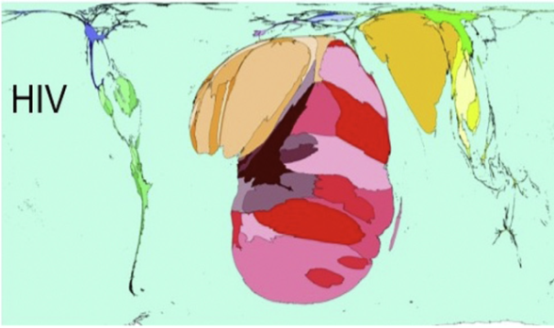
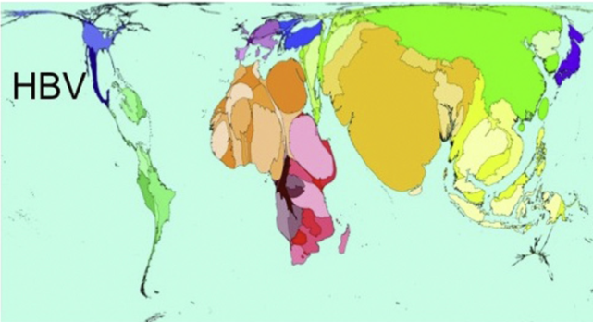
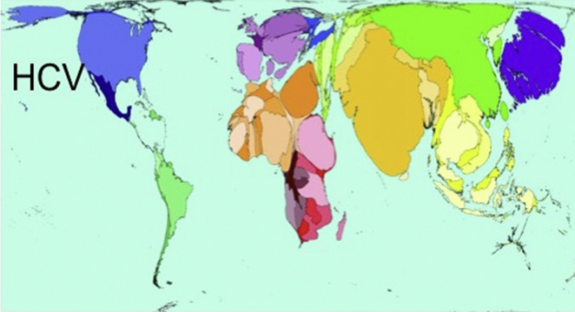
Epidemiology of HIV/HBV in Sub-Saharan Africa
70% of global 34 million PLHIV live in sub-Saharan Africa
  corresponding to regions of high HBV and HIV endemicity
HIV/HBV/HCV Mortality (annual death rate) (www.worldmapper.org in Nov 2012)
Clinical Infectious Diseases 2012; 55(4):507; J Clin Virol 2014;61:20
Notes:
Liver-related mortality is twice as high for chronic hepatitis B co-infected as for chronic hepatitis C co-infected individuals. A CD4 count of <200 cells/mm³ is associated with a 16.2 fold increase in risk of liver-related death compared to a CD4 count of >350 cells/mm³ .

Slide 105
HIV/HBV vs HIV/HCV Coinfection in Sub-Saharan Africa
HIV/HBV coinfections tend to outnumber HIV/HCV coinfections
  chronic HBV coinfection reported in 36% of all HIV-positive subjects
  highest rates in West and Southern African cohorts
  reflects low prevalence of injection drug use in sub-Saharan Africa
Liver-related mortality 2x higher in HBV/HIV than HCV/HIV coinfection
Clinical Infectious Diseases 2012; 55(4):507; J Clin Virol 2014;61:20
Notes:
Liver-related mortality is twice as high for chronic hepatitis B co-infected as for chronic hepatitis C co-infected individuals. A CD4 count of <200 cells/mm³ is associated with a 16.2 fold increase in risk of liver-related death compared to a CD4 count of >350 cells/mm³ .

Slide 106
HIV/HBV Coinfection in Sub-Saharan Africa
Independent transmission and acquisition of HBV and HIV
  HBV generally acquired in childhood under age of 5 years
  HIV infection occurs later in life, primarily via heterosexual sex
Series from West, East and South Africa
  Chronic HBV infection over-represented in HIV patients suggesting shared risk factors or co-transmission events
Bull Soc Pathol Exot 2009;102:226; J Clin Virol 2014;61:20
Notes:
Maternal HIV infection increases mother-to-child transmission up to 2.5 fold as HIV promotes Hepatitis B replication and HIV/HBV co-infected mothers are more likely to be HBeAg positive, have higher HBV DNA levels and are thus potentially more infectious leading to increased perinatal transmission risk.

Slide 107
Epidemiology of HIV/HBV in Sub-Saharan Africa
Shared transmission routes
  HIV and HBV may share transmission routes in infants and children
    mother-to-child transmission
    lack of resources for diagnosis & management of blood-borne viruses in pregnancy and peri-partum period
  Maternal HIV infection increases mother-to-child transmission of HBV (2.5-fold in one West African study) → HIV promoting HBV replication
Bull Soc Pathol Exot 2009;102:226; J Clin Virol 2014;61:20
Notes:
Maternal HIV infection increases mother-to-child transmission up to 2.5 fold as HIV promotes Hepatitis B replication and HIV/HBV co-infected mothers are more likely to be HBeAg positive, have higher HBV DNA levels and are thus potentially more infectious leading to increased perinatal transmission risk.

Slide 108
Impact of HIV/HBV Coinfection
HIV coinfection promotes:
  Increased HBV replication and rates of HBV reactivation
  ALF
  Increased rates of occult HBV
  Chronicity of newly acquired HBV infections
  Progression to fibrosis and cirrhosis
  Hepatocellular carcinoma
  Increased risk of HIV ART hepatotoxicity
  HIV ART-related immune reconstitution hepatitis
AIDS 2005;19(6):593; J Acquir Immune Defic Syndr 2000;24(3):211; J Inf Dis 2013;208(9):1454; South Afr Med J 2012; 102:157; World J Hepatol 2010; 2: 65 73; AIDS 2011; 25: 1727; Antivir Ther 2011;16:405; South Afr Gastroenterol Rev 2004; 2(3): 14; South Afr J Epidemiol Infect 2008: 23(1): 14; Lancet 2002; 360 (9349):1921
Notes:
HIV promotes chronicity of infection, liver fibrosis and increases the risk of hepatocellular carcinoma in both chronic hepatitis B and C, particularly in the clinical setting of low CD4 counts.
HIV co-infection augments the risk of reactivation or sero-reversion of hepatitis B. In adult-acquired hepatitis B infection, concurrently acquired or existing HIV infection increases the risk of fulminant hepatitis. Occult hepatitis B is also more prevalent in HIV infected people and HCC occurs at a younger age and is more aggressive.
HIV/HBV co-infected individuals have higher HBV DNA levels and liver-related mortality from chronic hepatitis B was increased in the pre-HAART era (RR of liver death 17.7 in co-infected compared to mono-infected individuals) .

Slide 109
Impact of HIV/HBV Coinfection (continued)
  CD4 count <200 cells/mm³ is associated with 16.2 fold increase in risk of liver-related death compared to CD4 count >350 cells/mm³
  Liver disease is leading cause of death in HIV/HBV or HCV coinfection in Western cohorts
  Mortality due to other HIV-related conditions has declined following introduction of HIV ART
  Earlier studies found no consistent evidence for a significant effect of HBV on HIV disease progression
  Recent longitudinal cohort studies – HBV coinfection also leads to increased progression to AIDS-related outcomes and all-cause mortality
DAD study Arch Intern Med 2006;166(5):1632, J Hepatol 2005;42(6):799; Lancet 2011;377(9772):1198; Lancet 2002;360(9349):1921; Ann Int Med 1992;117(10):837; Scand J Infect Dis1997;29(2):111; J Inf Dis 2012;205(2):185; Clin Infect Dis 2009;48(12):1763; AIDS 2011; 25: 1727; Antivir Ther 2011;16: 405; South Afr J Epidemiol Infect 2008: 23(1): 14; Hepatol 2010;52(3):1143; Clin Infect Dis 2009; 49:1268
Notes:
A potential association with adverse HIV outcomes in HBV co-infected individuals was demonstrated in the SMART study where HIV associated immune deficiency was enhanced by active HBV replication. Also, an HBeAg positive status has demonstrated an association with a slower virological response to HAART, compared to an HBeAg negative status.

Slide 110
Management of HIV/HBV Coinfection
HBV Screening and Vaccination
  All newly diagnosed HIV infected individuals screened for HBV
    HBsAg and anti-HBs
  Non-immune (HBsAg and anti-HBs negative) - vaccinate
  Lower response to vaccination especially with low CD4 counts
  Meta-analysis - 4 double dose (40ug) vaccine schedule gives higher protective anti-HBs
Hepatitis A Vaccination
  Should be considered in all HIV-positive patients, especially men who have sex with men
Screen for Hepatitis C
  Triple HIV/HBV/HCV – Treat the dominant virus
Consolidated guidelines on the use of antiretroviral drugs for treating and preventing HIV infection: recommendations
for a public health approach. Geneva: World Health Organization; 2013; Int J STD AIDS 2013;24(2);117
Notes:
In sSA, where Individuals acquiring and clearing Hepatitis B in childhood often lose anti-HBs positivity. HB IgG core Ab positivity is best marker of previous exposure. Individuals who are HB IgG core Ab positive may have occult HBV (detectable HBV DNA in liver and HBV DNA <200IUin serum. Individuals with occult HBV are at risk of reactivation and are still at risk of developing HCC
Meta-analysis of 5 HBV vaccination studies, 883 HIV-positive vaccine recipients showed that a schedule of four double (40 μg) doses of HBV vaccine provides a higher protective anti-HBs titre than regular three 20μg dose schedule. Pooled OR 1.96 (95% confidence interval [CI]: 1.47; 2.61) Int J STD AIDS. 2013 Feb;24(2):117-22

Slide 111
Management of HIV/HBV Coinfection (continued)
Aetiology of abnormal liver profile: often multifactorial
  Drug-induced liver injuries
    HIV ART, TB drugs, cotrimoxazole, fluconazole, traditional, herbal/alternative supplements
  HIV related opportunistic infections
  HBV clearance
  Emergence of drug resistance
  IRIS
  Reactivation after withdrawal of therapy
  Super-infection with HCV, HAV, HDV, and HEV
  Comorbidities - Non-alcoholic fatty liver disease, alcoholic liver disease

Slide 112
Management of HIV/HBV Coinfection (continued)
  Deranged liver enzymes often multifactorial
  More aggressive natural history of HBV and possibility of comorbidities
  Lower threshold for performing liver biopsy to assess the differential diagnosis and the stage and grade of histologic injury
  Noninvasive methods - serum biomarkers and transient elastography to assess fibrosis
J Infect Dis. 2002;186:23-31; Lancet 2002;360:1921-1926; J Hepatol 2009;50:1074-1083

Slide 113
Initiation of HIV ART in HBV Coinfection
2013 WHO ARV guidelines recommend initiation of HIV ART in
All HIV-infected adults with a CD4 cell count <500 cells/mm³
regardless of stage of liver disease
Individuals with severe chronic liver disease regardless of CD4 count
at greatest risk of progression and mortality from liver disease
HIV ART initiation may improve overall survival in cirrhotics
All pregnant or breastfeeding women regardless of CD4 count
All children less than 5 years of age regardless of CD4 count
Consolidated guidelines on the use of antiretroviral drugs for treating and preventing HIV infection: recommendations for a public health approach. Geneva: World Health Organization; 2013.

Slide 114
Initiation of HIV ART in HBV Coinfection (continued)
Goal of therapy
  Virological suppression of both HBV and HIV replication
  Amelioration of transaminitis and histological injury and prevention of liver-related complications
Choice of ARV regimen in HBV/HIV co-infected patients
  HIV ART regimen containing 2 agents that are also active against HBV
    reduces the risk of resistance
  tenofovir + lamivudine/emtricitabine) + efavirenz as FDC
    first line therapy for adults, adolescents and children >5 yrs
Hepatology 2000;31:1030-1031; Lancet 2001;358:718-723; J Hepatol 2012;31:167-185 (EASL) ;
Hepatol 2009;50:661 (AASLD); AIDS 2013;27(14):2219
Notes:
It is essential that HAART regimen is active against both HBV and HIV to reduce the risk of resistance. A Tenofovir-based regimen is recommended therapy.
The fixed drug combination (Tenofovir, Lamivudine/Emtricitabine and EFV) prevents the selection of HIV and HBV resistant mutants. This also simplifies management of HIV/HBV co-infection regardless of immunological, virological or histological considerations. There are no significant differences in response in those with or without HIV co-infection.

Slide 115
Treatment of HIV/HBV Coinfection
Fixed-dosed combination (tenofovir, lamivudine/emtricitabine and efavirenz)
HBeAg-positive patients after 5 years of treatment: high rates of
  HBV DNA suppression (90%)
  HBeAg loss (46%)
  HBsAg loss (12%)
  No evidence of resistance
  Reduced progression to cirrhosis
  Risk of HCC persists, but is low
  No significant difference in response rates compared with HBV monoinfection
Gastro 2010;139(6):1934; AIDS 2013;27(14):2219

Slide 116
HIV/HBV Coinfection Treatment Options
Monitoring on FDC
  Recommended annual renal function assessment
  Consider annual assessment of bone function
Renal impairment
  Adjust tenofovir dose according
  to GFR
Tenofovir contraindicated
(HIV nephropathy)
  Little data on the best alternative treatment
  Consider entecavir as part of HIV ART regimen
    not alone; has weak HIV antiviral activity
    no previous exposure to lamivudine
    previous lamivudine, but no evidence of lamivudine associated HBV polymerase resistance

Slide 117
HIV/HBV Coinfection Treatment Options (continued)
Treatment of HIV without the use of tenofovir in the regimen
  may lead to flares of hepatitis B due to ART-associated IRIS
Treatment discontinuation, especially lamivudine, associated with
  HBV reactivation, ALT flares, and hepatic decompensation
If ARVs need to be changed because of HIV drug resistance/toxicity
  Tenofovir and lamivudine or tenofovir/emtricitabine should be continued together with the new ARV drugs
Consolidated guidelines on the use of antiretroviral drugs for treating and preventing HIV infection: recommendations for a public health approach. Geneva: World Health Organization; 2013

Slide 118
Considerations for HIV/HBV
Coinfection Treatment in Children
Additional management challenges:
Choice of HIV ART regimen in children not requiring Rx for HBV
Tenofovir cannot be used in children aged <12 years
Logistically challenging to use a lamivudine-free regimen
Use a standard HIV ART regimen (that may include the use of lamivudine)
  with subsequent modification to tenofovir-based regimen
  at age of 12 years

Slide 119
Conclusions: HIV/HBV Coinfection
Sub-Saharan Africa is the epicenter of HIV and HBV is endemic
  Increased risk of HIV/HBV coinfection
HIV promotes chronicity of HBV infection, liver fibrosis and increases the risk of hepatocellular carcinoma
Fixed-dose combination of tenofovir + lamivudine/emtricitabine + efavirenz simplifies management of HIV/HBV coinfection regardless of immunologic, virologic, or histologic considerations
Second-line ART for HIV resistance – important to continue tenofovir, lamivudine/emtricitabine to prevent HBV reactivation, ALT flares and potential hepatic decompensation
HIV ART improves overall survival even in cirrhotics

