Slide 1

90-90-90 Trends and Modeling Implications for Getting to Zero in City and Municipal HIV Responses
Sindhu Ravishankar, MPhil
Senior Director, Technical Programs
Fast-Track Cities, IAPAC

Slide 2
WHERE WE WERE
World AIDS Day 2014

Slide 3

Fast-Track Cities was launched World AIDS Day 2014 in the City of Paris where 26 original cities signed Paris Declaration on Fast-Track Cities
Engagement of Mayors for the creation of political will around 90-90-90 and zero stigma and discrimination
Most cities and many countries were not reporting baseline 90-90-90 data, many cities did not report baseline care continua

Slide 4
WHERE WE ARE
Fast-Track Cities 2019 Conference

Slide 5
300+ municipalities have joined the network in every region
Countries including Brazil, France, South Africa, Ireland, Portugal, Spain, UK, USA, have a critical mass of Fast-Track Cities
Many cities have Fast-Track City steering committees and strategic municipal implementation plans
Several ~40 cities are reporting 90-90-90, care continuum, and other locally relevant data on Fast-Track City dashboards

Slide 6
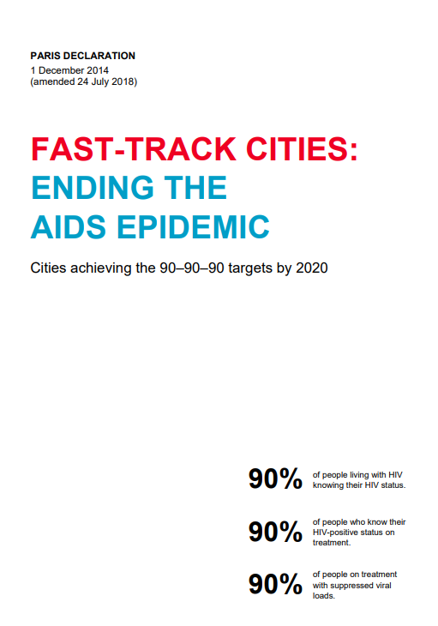
PARIS DECLARATION 2.0
90-90-90 as an entry point for:
Getting to zero
U=U, MIPA, GIPA
HIV prevention
  Primary HIV prevention
  Biomedical (PrEP)
Syndemic conditions
  Mental health
  Substance use
Comorbidities associated with aging
Viral hepatitis
  HBV & HCV elimination

Slide 7
61 cities have reported partial/full 90-90-90 data*
41 cities have reported full 90-90-90 data*
Cities reaching first 90 | 14 | Amsterdam; Austin; Bangkok; Brighton and Hove; eThekwini; Glasgow; Kigali Kingston/St. Andrew; London; Lusaka; Manchester; New York City; Providence; San Francisco
Cities reaching second 90 | 16 | Amsterdam; Berlin; Brighton and Hove; Casablanca; Kampala; Lagos; London; Lubumbashi; Manchester; Melbourne/Victoria; Milan; Montreal; Nairobi; Paris; Seville; Taipei
Cities reaching third 90 | 23 | Amsterdam; Berlin; Brighton and Hove; Brussels; Denver; eThekwini; Kyiv; London; Manchester; Melbourne/Victoria; Milan; Montreal; Nairobi; New York City; Odesa; Paris; Phoenix; Providence; Quezon City; Salvador de Bahia; San Francisco; São Paulo; Seville; Taipei
Cities surpassing 90-90-90 | 4 | Amsterdam; Brighton and Hove; London; Manchester
Cities surpassing 95-95-95 | 1 | London
*Reported publicly, on FTC dashboard, or shared by city with IAPAC; additional cities may also be reporting 90-90-90

Slide 8
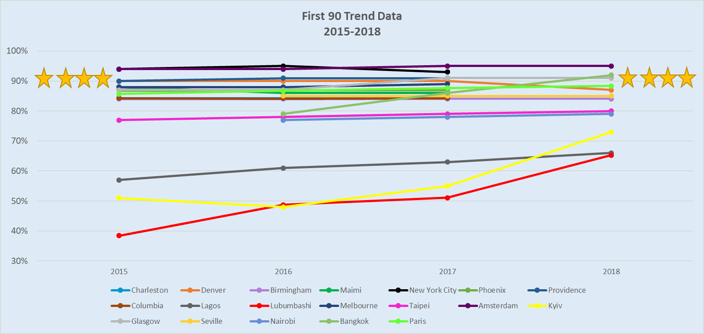
11 of 19 cities have shown improvements in their first 90
4 of 11 cities have had ≥5 percentage point increases
3 of 4 cities have had ≥10 percentage point increase
*Includes cities reporting 3-4 years of trend data from a 2015 baseline (start of FTC initiative)

Slide 9
12 of 15 cities have shown improvements in their second 90
9 of 12 cities have had ≥5 percentage point increase
5 of 9 cities have had ≥10 percentage point increase
*Includes cities reporting 3-4 years of trend data from a 2015 baseline (start of FTC initiative)

Slide 10
10 of 14 cities have shown improvements in their third 90
3 of 10 cities have had ≥5 percentage point increase
3 of 3 cities have had ≥10 percentage point increase
*Includes cities reporting 3-4 years of trend data from a 2015 baseline (start of FTC initiative)

Slide 11
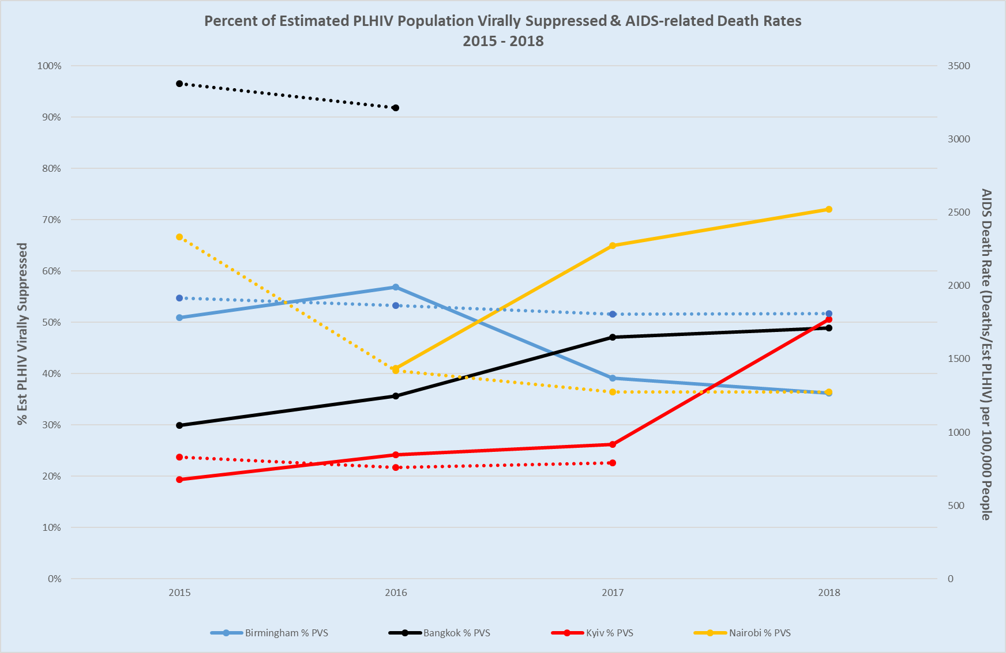
It is necessary to look at 90-90-90, and particularly the 3rd 90, in the context of AIDS mortality (and HIV incidence)
Mortality and incidence can help validate whether upward 90-90-90 trends are accurate and assess if we are moving towards ending urban epidemics
More data points are needed to accurately denote association/trends over time; as Fast-Track Cities continue to provide these data, this graph can provide better insight into these metrics
*Inclusion criteria: >3 years of continuum of care data, >2 years mortality data. >75 AIDS-related deaths.
Notes:
These cut-off points were chosen to allow for the greatest time frame and numbers in hopes of spotting patterns and trends.
Additionally, to calculate population virally suppressed, the estimated number of PLHIV was used as the denominator.

Slide 12
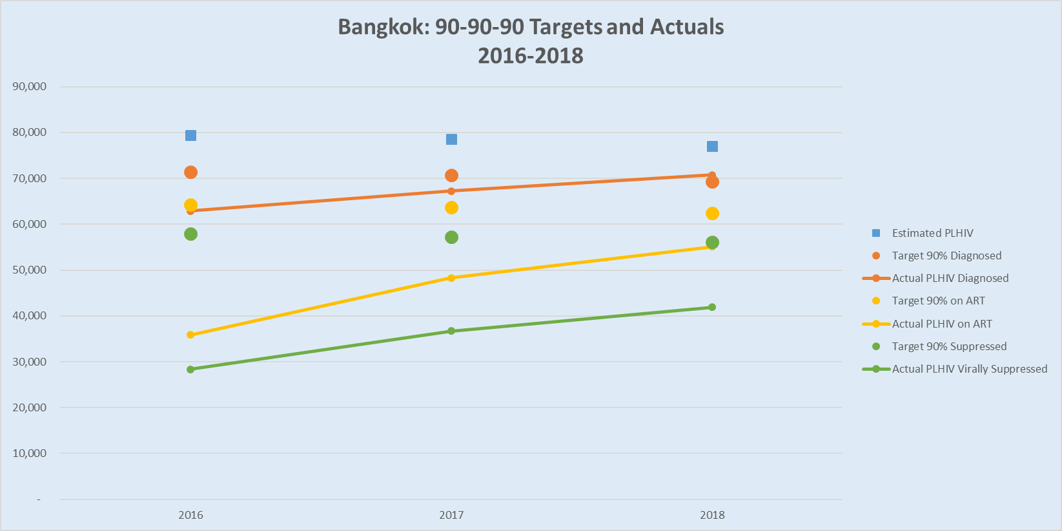
Baseline 2014: 66-57-76
Current 2018: 92-78-76
Development of FTC committee and a FTC Road Map
Improvement in HIV and KP estimation methodologies
Key population led services
Innovations to reach KPs and youth
Increased domestic funding for KP and CBOs
*Targets calculated based on converted care continuum proportions 90%-81%-72.9%

Slide 13
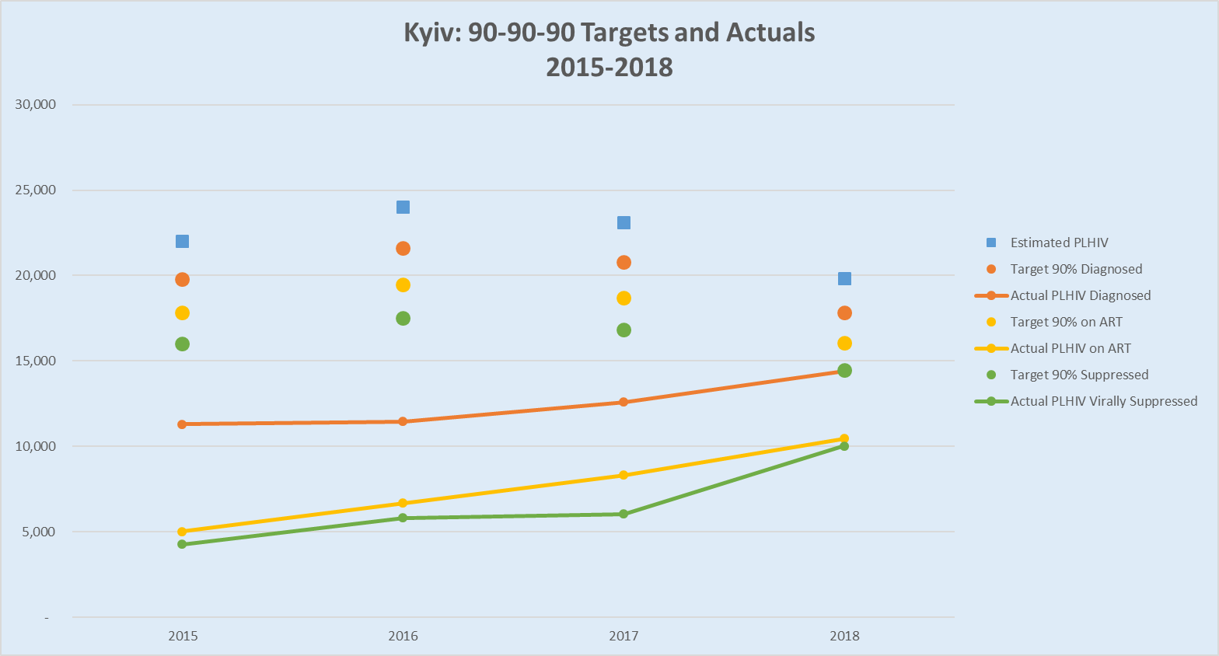
Baseline 2015: 51-44-85
Current 2018: 73-73-96
Strong political advocacy
Decentralized ART and testing
Increased public/private partnerships
Increased intersectoral partnerships
PrEP roll out and increased OST and other prevention programs

Slide 14
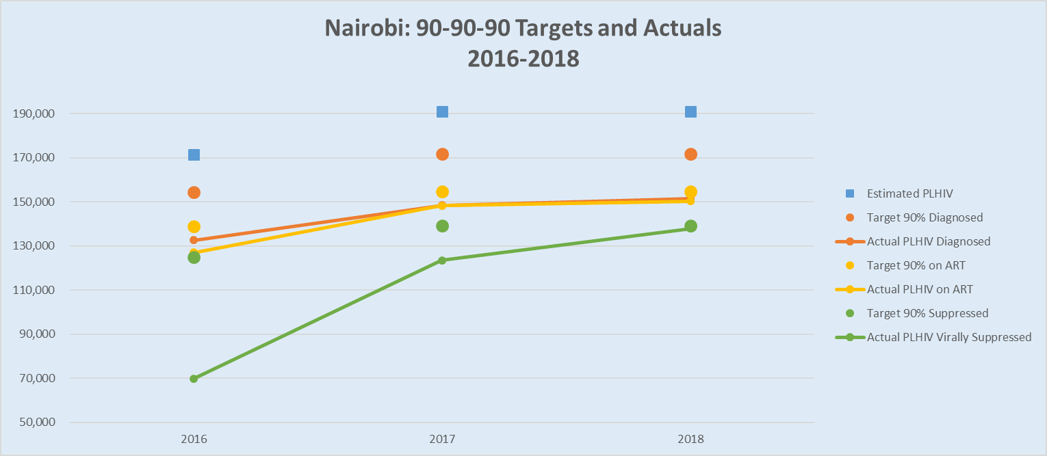
Baseline (2017): 77-96-55
Current (2019): 79-99-92
Focused efforts for adolescents, Key Populations, populations in informal settings, girls and young women
PrEP and HIV self testing rollout
Granulated HIV and TB data by facility
Improved EMR systems for data management

Slide 15
WHERE WE’RE GOING
Ending Urban HIV Epidemics by 2030

Slide 16
Ending HIV Epidemics in Fast-Track Cities
We reviewed epidemiological trends in select cities with respect to the HIV and incidence, AIDS-related mortality, and antiretroviral therapy (ART) coverage
Our aim was to better understand progress in ending urban HIV epidemics and what needs to be done in terms of ART scale-up to achieve this objective
“Ending HIV Epidemics” defined: Less than one new HIV infection and one AIDS death per thousand adults

Slide 17
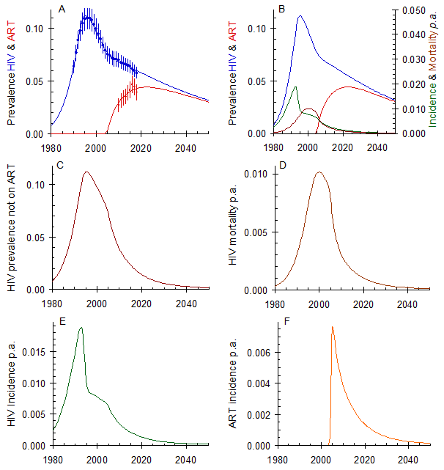
Nairobi County
Current ART Coverage Levels Maintained
Considerable progress has been made
HIV incidence (E) and AIDS-related mortality (D), as well as the number of people starting ART each year, will continue to decrease slowly
Nairobi’s HIV epidemic could end by ~2050 (C to F)
Source: Spectrum 2018

Slide 18
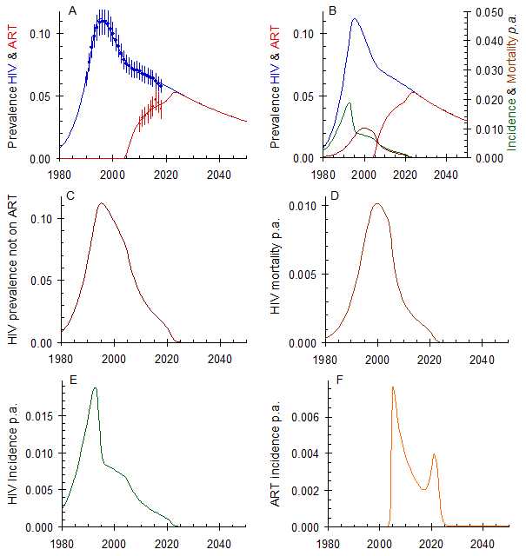
Nairobi County
Aggressive ART Scale-Up*
Scaling up ART now (F) will decrease HIV incidence (E) and AIDS-related mortality (D) as well as the number of people starting ART each (F) year
Nairobi’s HIV epidemic could end by ~2024 (compared to 2050)
*aggressive ART scale up defined as annual testing for anyone at risk followed by immediate ART
Source: Spectrum 2018

Slide 19
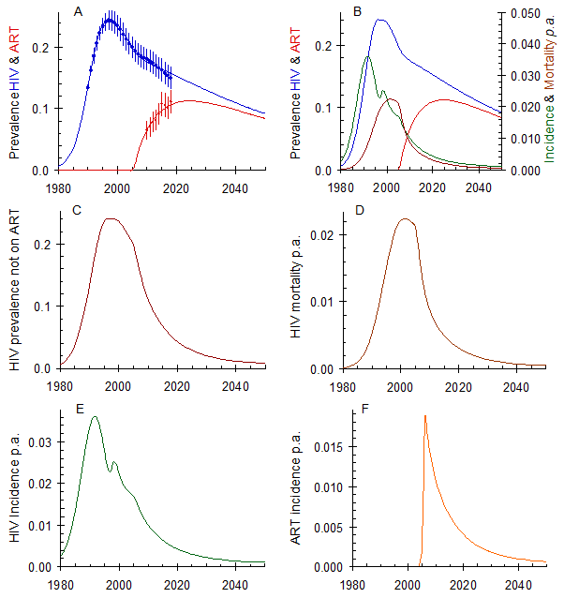
Lusaka
Current Levels of ART Coverage Maintained
Considerable progress has been made
HIV incidence (E) and AIDS-related mortality (D), as well as the number of people starting ART each year, will continue to decrease slowly
Lusaka’s HIV epidemic could end by ~2050 (C to F)
Source: Spectrum 2018

Slide 20
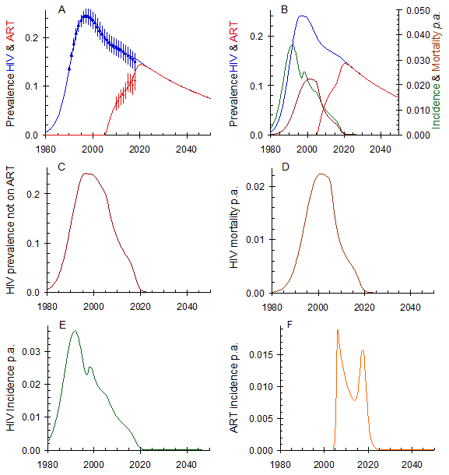
Lusaka
Aggressive ART Scale-Up
Scaling up ART now (F) will decrease HIV incidence (E) and AIDS-related mortality (D), as well as the number of people starting ART each (F) year
Lusaka’s HIV epidemic could end by ~2020
Source: Spectrum 2018

Slide 21
Limitations to the Model
PrEP uptake and other HIV prevention data are not taken into consideration since several years of temporal data were not available
The early data, at the start of the epidemic, are important because they determine the underlying dynamics which in turn determines the impact of control. Improved trend data increases the accuracy of the model
Where possible data on particular risk groups are important because the dynamics and impact of control are very different

Slide 22
Conclusions
Fast-Track Cities have made considerable progress towards 90-90-90 targets with many cities having surpassed one or more of the 90s
Ending the Epidemic and Getting to Zero requires that we cannot consider 90-90-90 in a silo and must jointly focus on HIV mortality and incidence trends
Sustained efforts of treatment scale up have seen improvements in lowering incidence and mortality in Lusaka and Nairobi, but an aggressive scale up could be necessary in many cities to meet the 2030 deadline
Now is not the time to be complacent

Slide 23
Acknowledgements
Brian Williams, SACEMA
Eleanor Gouws, UNAIDS
Sonal Pathak, DataRev
José M. Zuniga, IAPAC
Molly Pezzulo, IAPAC
Chris Duncombe, IAPAC
Imane Sidibé, IAPAC
All the Fast-Track Cities that contributed data

Slide 24
Thank You
For more information on the presentation, data reported by Fast-Track Cities, or the FTC initiative, contact me at: sravishankar@iapac.org
For more information on the modelling contact Brian Williams at: williamsbg@me.com

