Slide 1
Improving Physician-Patient Adherence Communication
Ira Wilson, MD, MSc
Notes:
Show of hands for physicians and non-physicians.

Slide 2
Conflicts of Interest
Dr. Wilson has no conflicts of interest

Slide 3
Goals: 4 Questions
Is provider-patient communication really that important in adherence?
What is the quality of adherence related communication?
Who should be doing adherence counseling?
What are the elements of successful adherence counseling?

Slide 4
Clinical Framework
Diagnosis and Treatment
Diagnosing the presence of non-adherence
  Clinical data
  History; a conversation
How good are physicians as adherence diagnosticians?

Slide 5
MDs as Adherence Diagnosticians
Charney E, Bynum R, Eldredge D et al. How well do patients take oral penicillin? A collaborative study in private practice. Pediatrics. 1967;40:188-195.
Caron HS, Roth HP. Patients' cooperation with a medical regimen. Difficulties in identifying the noncooperator. JAMA. 1968;203:922-926.
Roth HP, Caron HS. Accuracy of doctors' estimates and patients' statements on adherence to a drug regimen. Clin Pharmacol Ther. 1978;23:361-370.
Mushlin AI, Appel FA. Diagnosing potential noncompliance. Physicians' ability in a behavioral dimension of medical care. Arch Intern Med. 1977;137:318-321.
Gilbert JR, Evans CE, Haynes RB, Tugwell P. Predicting compliance with a regimen of digoxin therapy in family practice. Can Med Assoc J. 1980;19;123:119-122.
Blowey DL, Hebert D, Arbus GS, Pool R, Korus M, Koren G. Compliance with cyclosporine in adolescent renal transplant recipients. Pediatr Nephrol. 1997;11:547-551.
Hall JA, Stein TS, Roter DL, Rieser N. Inaccuracies in physicians' perceptions of their patients. Med Care. 1999;37:1164-1168.
Bosley CM, Fosbury JA, Cochrane GM. The psychological factors associated with poor compliance with treatment in asthma. Eur Respir J. 1995;8:899-904.

Slide 6
MDs as ARV Adherence Diagnosticians
Steiner JF. Provider assessments of compliance with zidovudine. Arch Intern Med. 1995;155:335-336.
Haubrich RH, Little SJ, Currier JS et al. The value of patient-reported adherence to antiretroviral therapy in predicting virologic and immunologic response. AIDS. 1999;13:1099-1107.
Paterson DL, Swindells S, Mohr J et al. Adherence to protease inhibitor therapy and outcomes in patients with HIV infection. Ann Intern Med. 2000;133:21-30.
Bangsberg DR, Hecht FM, Clague H et al. Provider assessment of adherence to HIV antiretroviral therapy. J Acquir Immune Defic Syndr. 2001;26:435-442.
Gross R, Bilker WB, Friedman HM, Coyne JC, Strom BL. Provider inaccuracy in assessing adherence and outcomes with newly initiated antiretroviral therapy. AIDS. 2002;16:1835-1837.

Slide 7
Adherence Diagnosis
Diagnosis and Treatment
Diagnosing the presence of non-adherence
  Clinical data
  History; a conversation
Understanding the reason for non-adherence
  Can only come from a conversation
  Trust required
  Patient won’t tell you if he/she believes the result will be disapproval, scolding or censure
Notes:
Caveat…even if you think you can get the data from laboratory testing

Slide 8
Adherence Treatment
Treatment
  Difficult and complex
  Treatment is driven by the diagnosis
  Highly individualized
  Requires or at least benefits from skills in behavior change counseling

Slide 9
Question 1
  Is provider-patient communication really that important in adherence?

Slide 10
Meta-analysis

Slide 11
Haskard and DiMatteo Meta-analysis
Searched literature from 1949 to 2008
106 studies correlating physician communication with patient adherence
45,093 subjects
87/106 were studies of medication adherence
Non-adherence is 1.47 times greater among those whose MD is a poor communicator (standardized relative risk)
Notes:
This looks across time at multiple conditions, what do we know about communication in HIV and adherence in HIV disease?

Slide 12
Schneider et al., 2004

Slide 13
Schneider et al., 2004
Cross-sectional study
22 practices in the Boston metropolitan area
554 patients taking ART
Adherence measured with 4-item scale
Physician-patient relationship quality measured with 6 scales

Slide 14
Schneider et al., 2004

Slide 15
Beach et al., 2006

Slide 16
Beach et al., 2006
Cross-sectional survey
4694 interviews in 1743 patients with HIV
Independent variable: HIV provider “knows me as a person”
Dependent variables
  Receipt of ART
  Adherence with ART
  Undetectable VLs

Slide 17
Beach et al., 2006
Notes:
So, I’ve tried to argue so far that provider-patient interactions matter in HIV care. The next question is: is there any problem here? There isn’t much need to talk about this if providers in general, and HIV providers specifically are doing a great job.

Slide 18
Question 1
  Is provider-patient communication really that important in adherence ?
  Answer: Yes, it is important, both in general and specifically for ART in HIV disease.

Slide 19
Question 2
  What is the quality of adherence related communication?
  Is there a problem?

Slide 20
National Medicare Study (2006)

Slide 21
MD-PT Communication
50 state sample
Random sampling from 3 strata
  Full Medicaid benefits
  No Medicaid but residence in high poverty neighborhood (13% of elderly below 100% poverty)
  No Medicaid, non-high poverty
July – Oct 2003
Response rate 51% (N=17,569)
Did you skip Did you talk with a doctor about it

Slide 22
Adherence Dialogue

Slide 23
Adherence Communication in HIV Care

Slide 24
Methods: Design
Randomized, cross-over, intervention trial
5 varied sites in Massachusetts
Eligibility: detectable viral loads
Intervention was a detailed adherence report given at the time of a routine office visit
  Electronic drug monitoring
  Self-reported adherence
  Drug and alcohol use
  Depression
  Attitudes and beliefs

Slide 25
Study Design
Audiorecorded

Slide 26
Theory and Hypothesis
Theory: Physicians are good adherence counselors, but they lack accurate adherence data regarding who should be counseled
Better Dialogue
Improved Adherence
Intervention
Notes:
So our hypothesis was, simply, that the intervention would produce better dialogue, which would in turn lead to improved adherence. Because measuring dialogue quality is complex, I’ll describe it in more detail in a minute.

Slide 27
Intervention Impact
MD-PT dialogue: General Medical Interaction Analysis System (GMIAS)
Adherence: electronic drug monitoring (EDM)
Self-reported adherence
Viral loads
Notes:
To understand the impact of the intervention we examined these 4 types of outcomes. Because of time I’ll only discuss the first 2 today: physician-patient dialogue and adherence as assessed by MEMS, the electronic monitoring system.

Slide 28
GMIAS

Slide 29
Adherence Dialogue (n=58)

Slide 30
Electronic Drug Monitoring Outcomes
100
80
60
Mean MEMS Adherence
40
20
0
Baseline
Dr. Visit1
Dr. Visit2
Time
Dr. Visit3
Dr. Visit4
Mean MEMS Adh for Interv-then-Control Group
Mean MEMS Adh for Control-then-Interv Group
Notes:
This slide shows mean MEMS adherence levels for those who had intervention visits first, in blue, and control visits first, in red. The crossover happens between visits 2 and 3. As you can see there is not much separation between the lines, and the p-values for the difference were greater than p=0.05.
So what happened here?

Slide 31
Adherence Dialogue (n=58)

Slide 32
Problem Solving

Slide 33
Implications
Increased adherence dialogue, but…a lot of scolding and threats
Our hypothesis about providers’ training/skills in adherence counseling was wrong
Better data related to adherence: necessary but not sufficient
But maybe these findings aren’t generalizable to other HIV care settings…?
Notes:
What my coders report is that there is a lot of scolding in these interactions, things like “you really need to do better”, but not much concrete problem solving. The obvious implication of this is that physicians probably need more than just an awareness that there are adherence problems – they need training or skills development in adherence counseling. In other words, the kind of data we provide in this report are necessary to solve these problems, but not sufficient.

Slide 34
ECHO Study
4 cities Baltimore, NY, Detroit, Portland OR
47 providers
420 visits audio recorded and coded with GMIAS

Slide 35
ECHO: Adherence Level

Slide 36
ECHO: VL suppression

Slide 37
Conclusions from ECHO Study Data
Some adherence talk
But not much trouble shooting or problem solving related to ARV adherence
Do other kinds of data support this conclusion?

Slide 39
Tugenberg et al. (2006)
“Study participants experienced their physicians as insisting on perfect adherence. Fearing disapproval if they disclosed missing doses, interviewees chose instead to conceal adherence information. Apprehensions about failing at perfect adherence led some to cease taking antiretrovirals over the course of the study. Well-intentioned efforts by clinicians to emphasize the importance of adherence can paradoxically undermine the very behavior they are intended to promote.”

Slide 40
Physician perspective

Slide 41
Barfod et al. (2006)
“An important barrier to in-depth adherence communication was that some physicians felt it was awkward to explore the possibility of non-adherence if there were no objective signs of treatment failure, because patients could feel “accused” … a recurring theme was that physicians often suspected non-adherence even when patients did not admit to have missed any doses, and physicians had difficulties handling low believability of patient statements.”

Slide 42
Question 2
  What is the quality of adherence related communication?
  Is there a problem?
  Answer: Yes

Slide 43
Question 3
  Who should be doing adherence counseling?
    Physicians?
    Nurses?
    Pharmacists?
    Adherence counselors?
    Peer counselors?
    Accompagnateurs?

Slide 44
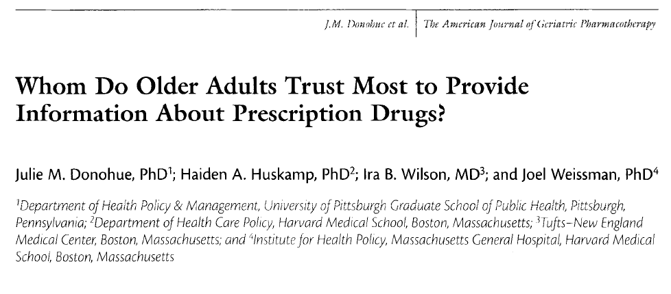
Who Should do Adherence Counseling?
Donohue JM et al. Am J Geriatr Pharmacother. 2009 Apr;7(2):105-16.

Slide 45
Donohue et al. (2009)
National telephone survey
Cross-sectional
Age ≥ 50 years, taking 1 or more chronic medication
Quota sampling:
  50:50 gender
  50:50 < 65 and ≥ 65
In field Oct – Nov 2006
N=1001

Slide 46
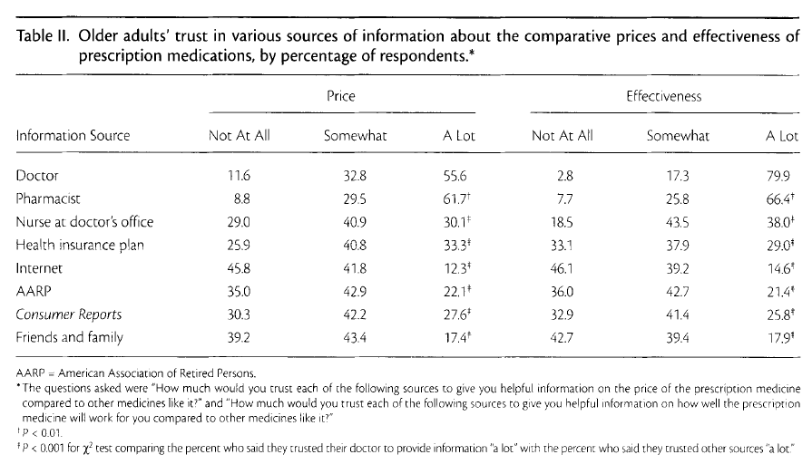
National Survey (Donohue et al.)
Notes:
What do we conclude from this? At least in this population, doctors and or pharmacists need to be involved with medication discussions, because they are the ones that are trusted on those topics.

Slide 47
Who Should Do Adherence Counseling?

Slide 48
NP and PA Care Quality

Slide 49
Question 3
  Who should be doing adherence counseling?
    Physicians?
    Nurses?
    Pharmacists?
    Adherence counselors?
    Peer counselors?
    Accompagnateurs?
Answer: all of the above
BUT: physicians are a necessary part of this team

Slide 50
Summary
Provider-patient communication is important in medication adherence
It isn’t very good
Because physicians are trusted sources to give medication related advice, physicians are probably important to target for interventions

Slide 51
Question 4
What are the elements of successful physician adherence counseling?
Not much data, but we have some hypotheses based on focus groups and pilot studies

Slide 52
Pilot Study: Beach et al.
Intervention with physicians and patients at 3 sites
Patients coached
Physicians trained: 1 hour lunchtime talk
Physicians randomized within sites to intervention or control
Results: providers in intervention sites engaged in more
  Positive talk
  Emotional talk
  Asking patient’s opinions
  More brainstorming of solutions to adherence problems (41% vs 22% of encounters)

Slide 53
Laws Focus Groups
Patients want direct and clear messages from physicians
Establishing a relationship of trust and collaboration is essential for these messages to be received
Clear messaging cannot include threats, over-directiveness
Patients want to feel that physicians will stick with them and continue to be supportive even when they are non-adherent

Slide 54
Principles
Patient-centered care
Adult learning theory
Motivational Interviewing

Slide 55

Patient Centered
Patient centered care is “care that is respectful of and responsive to individual patient preferences, needs, and values and, and ensuring that patient values guide all clinical decisions.”
IOM Crossing the Quality Chasm, 2001

Slide 56
Andragogy (Malcolm Knowles)
Learners learn when they “need to know”’ when the information is important in their life
Self-concept of the learner
  Autonomous
  Self-directing
  Resent and resist others telling them what to learn
Prior experience of the learner
  Resources and experience
  Mental models
  To ignore is to devalue the learner and their experience

Slide 57
Motivational Interviewing
Motivational interviewing is a client-centered, directive method for enhancing intrinsic motivation to change by exploring and resolving ambivalence
Non-judgmental, non-confrontational and non-adversarial

Slide 58
Practice
Listen well
Understand ambivalence
Avoid direct persuasion
Inform skillfully
Be clear and direct

Slide 59
Listen Well
Medical model: patients come to you for answers and expertise
Behavior change model: answers lie within the patient, and finding those answers requires listening
    “A practitioner who is listening, even if it is just for a minute, has no other immediate agenda than to understand the other persons’ perspective and experience.”
    Rollnick S, Miller WR, Butler, CC. Motivational Interviewing in Health Care, 2008

Slide 60
Understand Ambivalence
People are often ambivalent about taking medications
There are PROs and CON’s to taking any medicine, particularly ARVs
Goal of motivational interviewing is to produce change talk, so that the PROs of taking ART outweigh the CONs

Slide 61
Avoid Direct Persuasion
Doctor-centered information delivery
Direct persuasion
Finger shaking, threatening, lecturing, convincing, cheerleading

Slide 62
Be Clear and Direct
Confusion about physicians’ expectations is common
  What the regimen is
  How important it is to follow it rigorously
Ask permission, but then make advice about adherence clear and direct
Guide patients with information, clear advice, and support

Slide 63
Conclusions and Context
Communication about adherence is important.
In the physicians we have studied – and probably for other providers as well – adherence counseling skills could be improved.
Research is needed about how to efficiently provide that training.

Slide 65
Does MD training work?
Haskard meta-analysis, 2009
21 studies of training physicians in communications skills that had adherence as an outcome
1,280 physicians, 10,190 patients
Risk of non-adherence 1.27 time greater among patient of trained patients (standardized relative risk)

Slide 66
WHO Model
WHO adherence model
  Social/economic
  Condition
  Therapy
  Patient
  Health system/Health Care Team
Adherence to Long-Term Therapies: Evidence for Action. WHO, 2003.
Notes:
Is provider-patient really important?

Slide 67
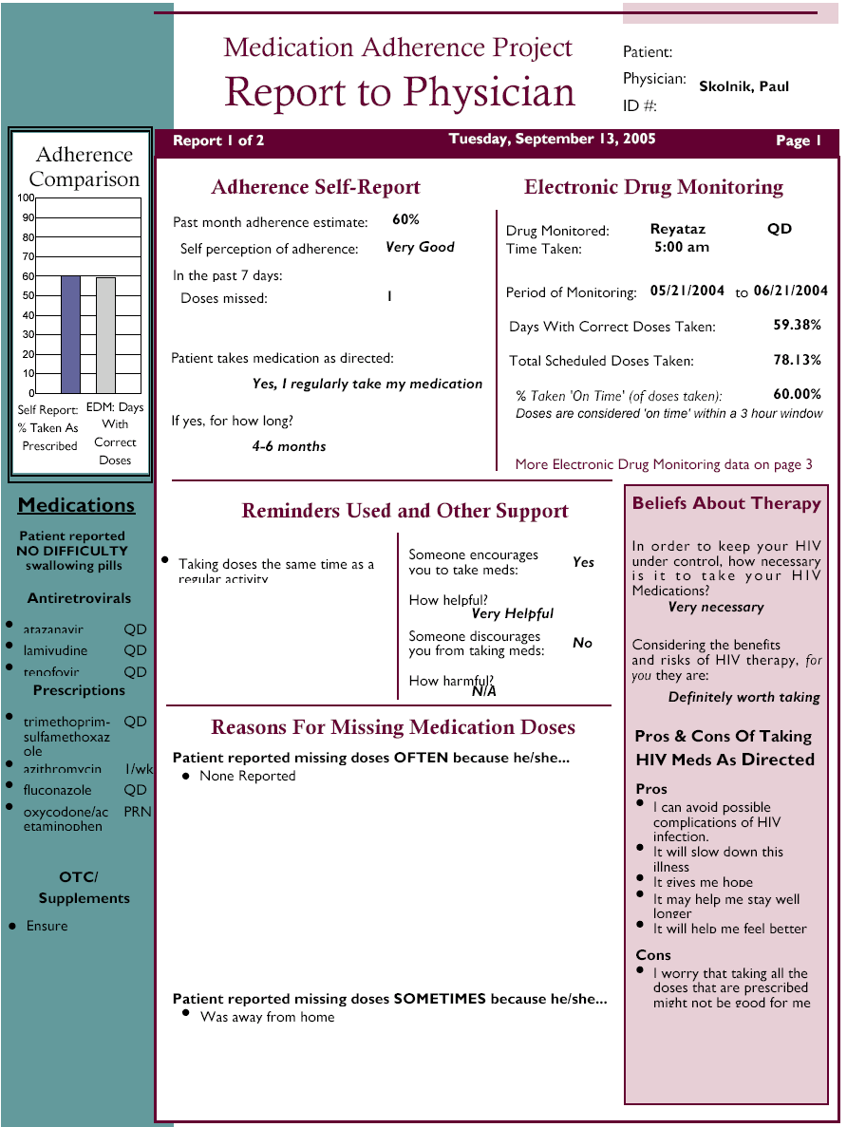
Notes:
The Intervention was a 3 page report. This is an example of the first page. Although the print may be too small to read, on the left hand side, there is a bar graph comparing self-report and MEMS adherence, and below it a list of medications, including ARVs, other prescription medications, and over the counter medications.
The section on reminders and other support shows that this patient takes ARV doses at the same time as other regular activities but does not use, for example, a pill box.
In the box on the right it shows that the patient reports that he believes that ARVs are very necessary, and under reported pros and cons, it shows that the patient worries that taking so many medications may not be good for him.

Slide 68
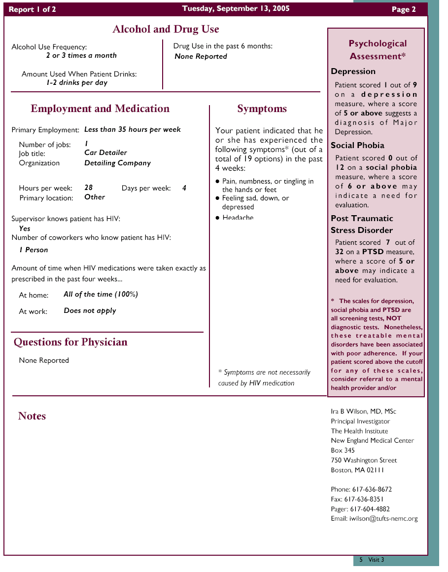
Notes:
On the second page, we see that the patient drinks 2-3 times a month, and has 1-2 drinks at those times, and does not report drug use. He works 28 hours a week as a car detailer. In the right hand panel, the patient reports 1 of 9 symptoms of major depression, but screens in or positive for post-traumatic stress disorder or PTSD.

Slide 69
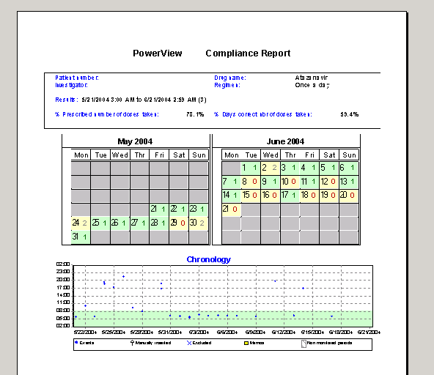
Notes:
The last page of the report allows the report user to examine patterns of adherence. If you could read it you could see that the monitored ARV is atazanavir, and the patient takes it once a day. If you look at the third row or week of June (on the right), you can see that the patient took a dose on Monday, missed on Tuesday and Wednesday, took a dose on Thursday, and then didn’t take any doses for the rest of the week. The graphic below shows that the patient sometimes takes the dose in the morning, but sometimes in the evening.

